Slide 1


Aqua Scientia Potentia Est
Water Knowledge is Power
2026
Trudi Schifter
Founder & CEO AquaSPE
trudi@aquaspe.com
Zurich Switzerland

Slide 2
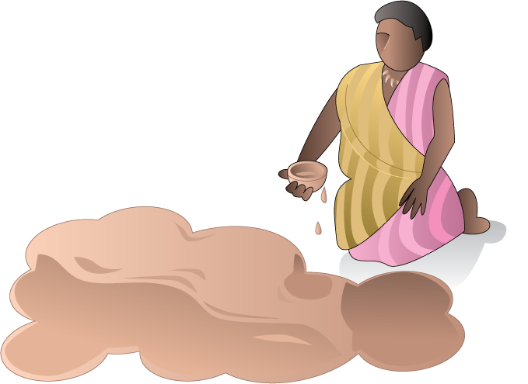

The world has a major water crisis
The Problem
Our Solution
TheWaterNetwork.com
$ 900 billion sector facing up to 56% gap in supply by 2030, only 3% of Industrial water is reused
2.2 billion people without access to safe drinking water
46 % of the world’s population has no basic sanitation
The water sector lags significantly in digitalization
AI tool-based knowledge network
Monetization of »new water» from reuse

Slide 3
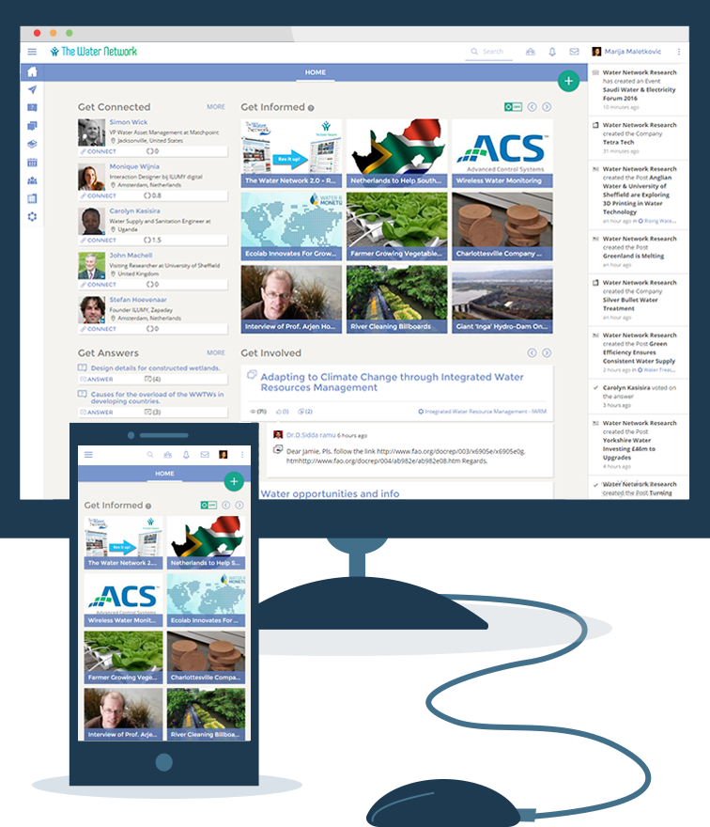

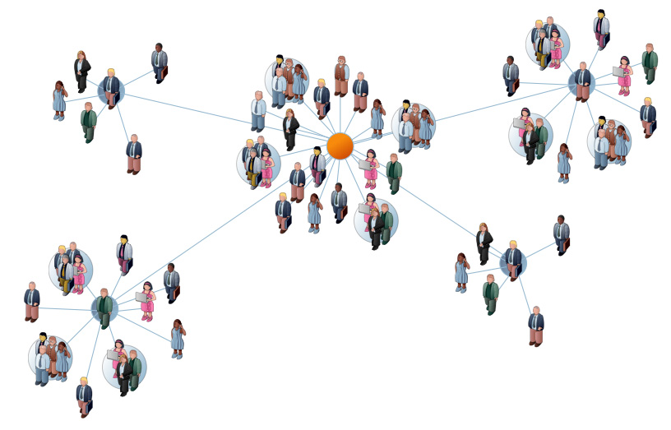


The largest digital platform for the global water sector
Digitalizing the water sector,
for professionals & organizations
> 128,000 members from all countries
  75% with advanced degrees
  50% in managerial roles
> 200 groups & communities
500 technology volunteers
12,859 organizations
330,000 newsletter subscribers
100,000 page views/month
Workspace
Workspace
Individuals
Community
Group
Team/Project
Group
Group

Slide 4
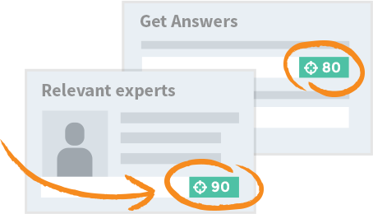
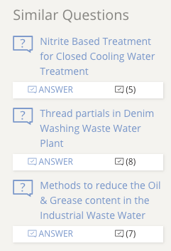
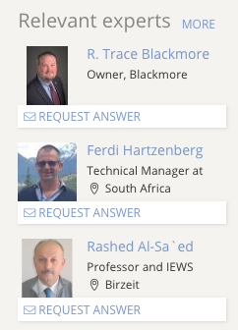
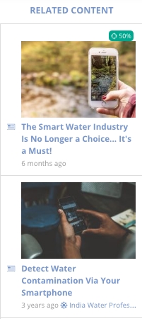

SmartMatchProTM algorithms tuned to each members information needs
AI tools for market intelligence & to match needs with assets
Recommended for you, related content, company and thematic tracking
Notes:
Replace this image with the original

Slide 5


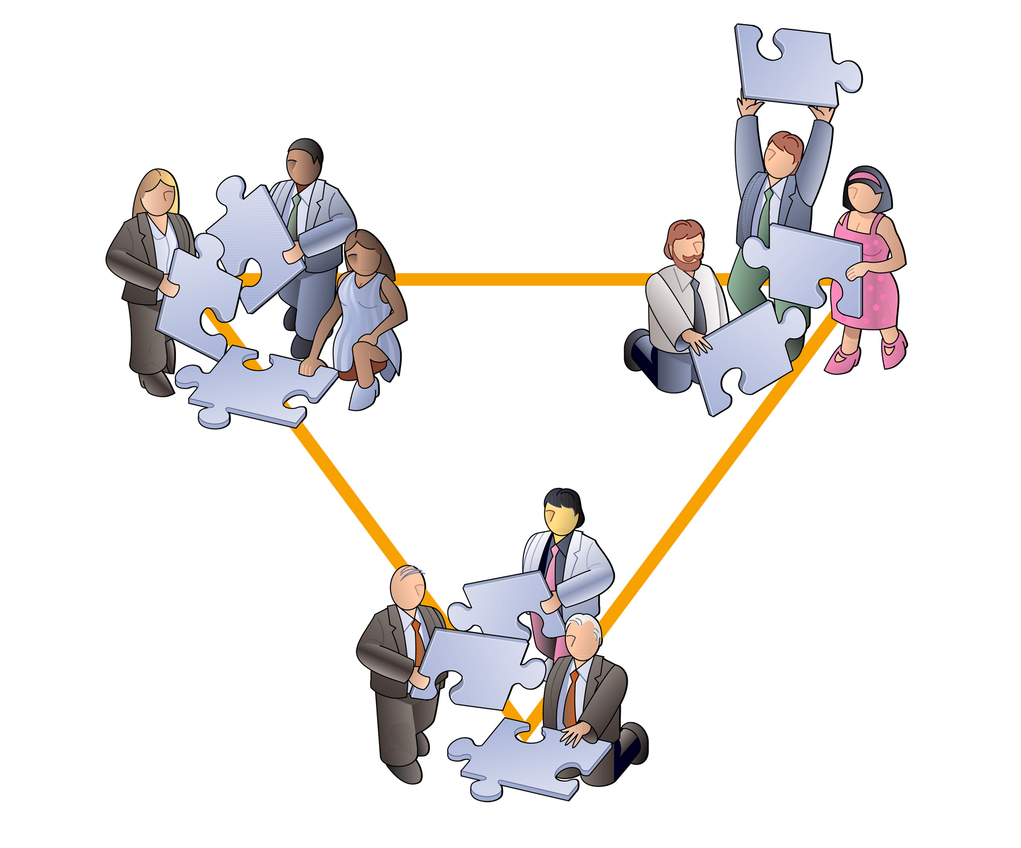


World’s only integrated ecosystem for water professionals .
Business Exchange
Experts Exchange
>12,964 organizations.
Products, services, case studies,
bids database, job board
Secure messaging & communications,
thematic groups,
professional communities & events
Help Desk
Library
3,000 answered questions,
1 million views
> 30,000 articles, data collections,
documents & training courses

Slide 6

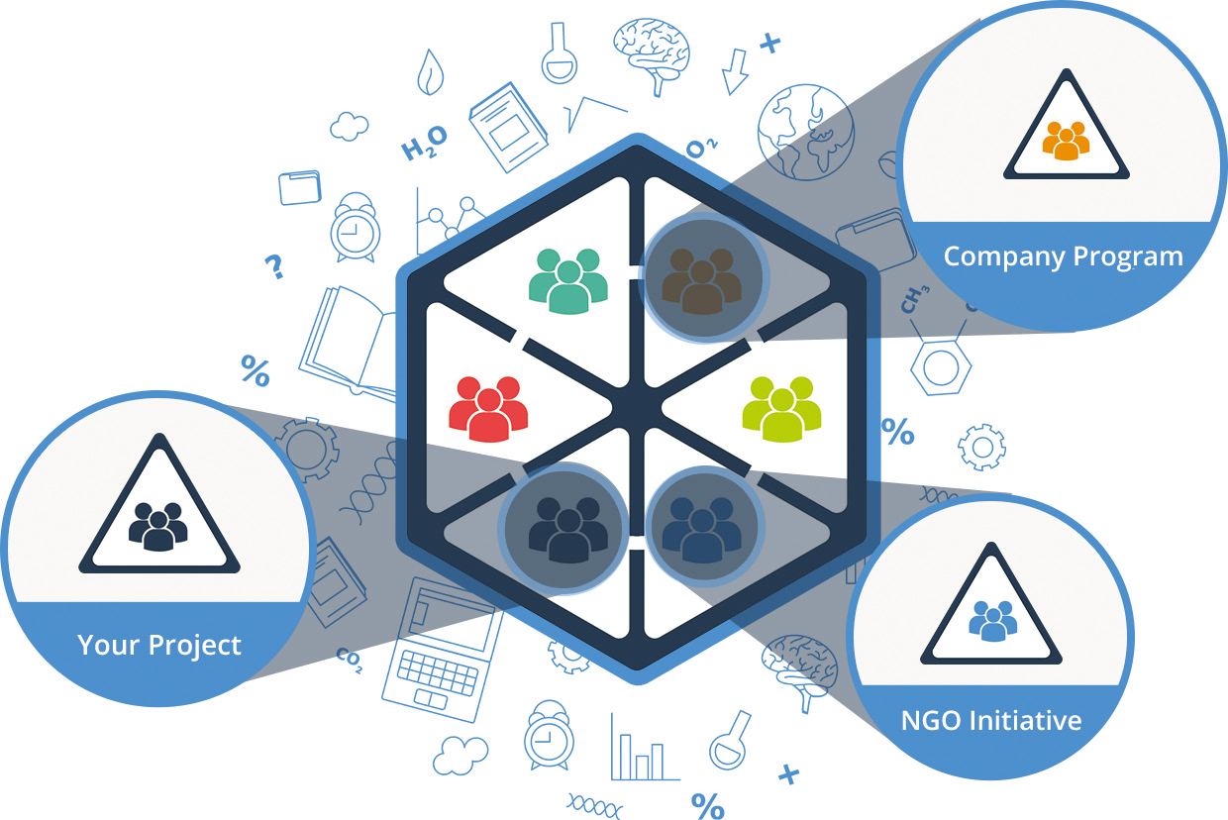






Digital water workspaces for organizations, programs, facilities, regions...
Benefits:
Best of class remote workspace for teams, organizations and regions; custom configured for the water sector; native mobile app; 5 minute set up; configurable; secure; cost effective.
Digital Water Workspace
Share
knowledge
Help Desk
Secure Mobile app & Communications
Secure data
storage & backup
Member
management
Advanced content management
Custom
configuration
Teams are 40-60% more efficient when supported by a virtual workspace

Slide 7



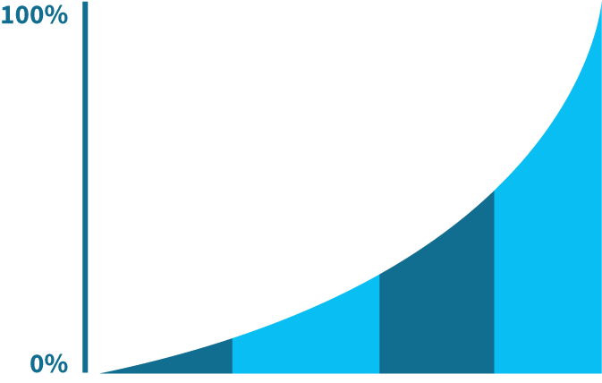


Business model – open access with premium paid services
Membership
- free for all
Digital Services
Digital Marketing
  Sponsored $1,600 /yr
    products, services, jobs, content
  E-mail campaigns $2,500-$6,000
  Digest & Newsletter banner Ads $350 - $2,000
  Custom marketing campaigns $12,000/yr
Digital workspace $5,800/yr
Bids revenue sharing with H2Bid
Scalable business
model
Freemium Services
Native mobile app free
Premium member utilities $49/month
H2OT new water reuse token *
* Coming soon

Slide 8

Monetize Reuse with H2OT New Water Token
Sources of used water: Utilities, Manufacturers, Oil extraction – produced water, AquaCulture Producers
Token buyers: green funds, ESG Credit buyers, Industry, Governments
New water users: agriculture, manufacturers, industry, data centers, water basin managers

Slide 9
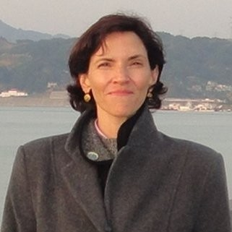
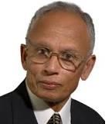
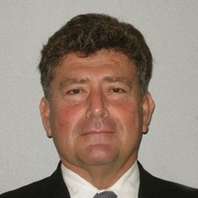
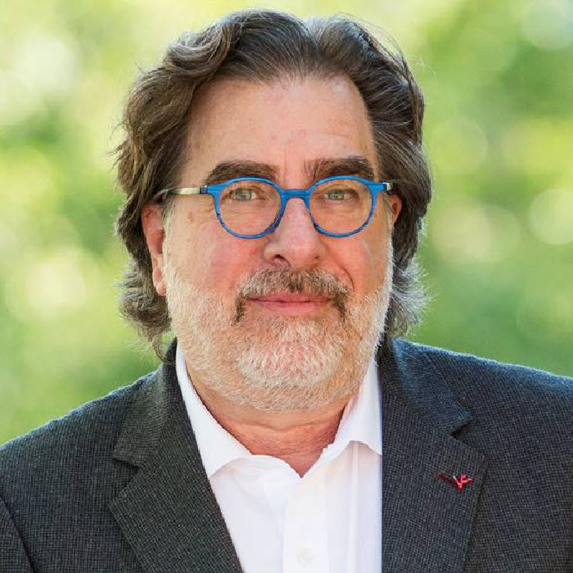
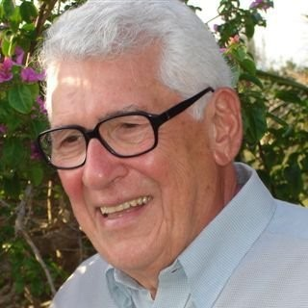
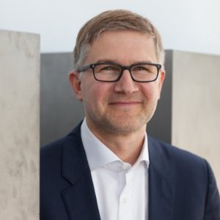

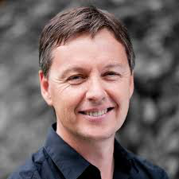
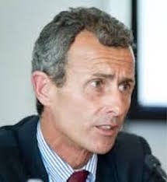
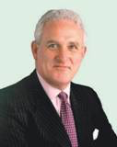
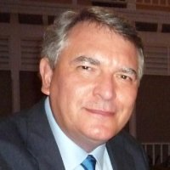
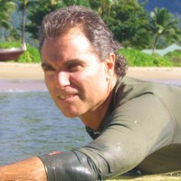
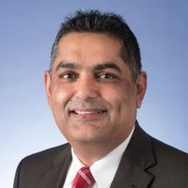
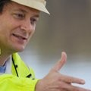
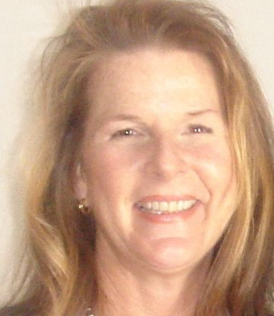
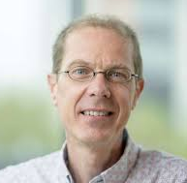
Powered by an army of volunteer editors
Trudi Schifter, CEO 30 yrs business development & Venture Capital experience
Mirko Krstic, Software Development Manager
16 World Class Advisors
100s of expert volunteers, in 18 functional disciplines
CONFIDENTIAL

Slide 10


Solving the world‘s water crisis one answer at a time
Trudi Schifter
Founder & CEO
AquaSPE AG
trudi@aquaspe.com
+ 41 52 566 9595
Trittligasse 12
8001 Zurich Switzerland

