Slide 1

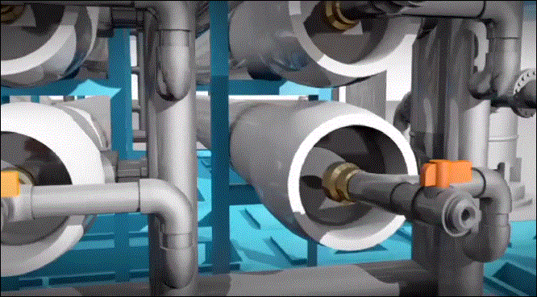

Water Business Opportunities for 2012 and Beyond
Desalination Market &
Technology Trends
& Opportunities
March 6, 2012
Nikolay Voutchkov, PE, BCEE
Water Globe Consulting

Slide 2
Desalination – Where Are We Today?
16,000 Desalination Plants Worldwide –
17,500 MGD
Source: IDA Desalination Yearbook 2011-2012

Slide 3
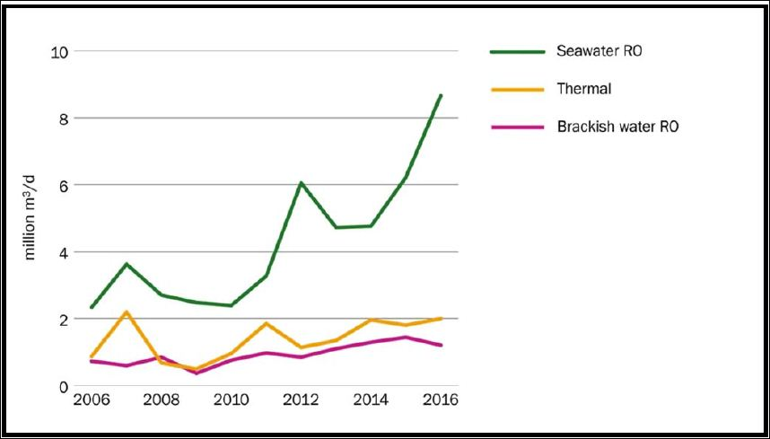
Seawater Membrane Desalination Dominates the Market
RO Seawater Desalination Has
Over 80 % the Market Share
Source: Global Water Intelligence

Slide 4
Desalination Plants in the US

Slide 5
Membrane Desalination –
Key Trends
SWRO Desalination Technologies Dominate;
Large - (over 15 MGD) and Mega - (over 50 MGD) Desalination Plants Are the Wave of the Future;
Most Large Urban Coastal Centers Worldwide Have Established a Target to Produce 25 % of their Drinking Water from Desalination;
Research &Development Activities are in 10-Year High – Likely to Yield Breakthroughs in Membrane and Desalination Technologies by 2015;
Large SWRO Projects Are Aiming at Sustainability – Green is In!

Slide 6
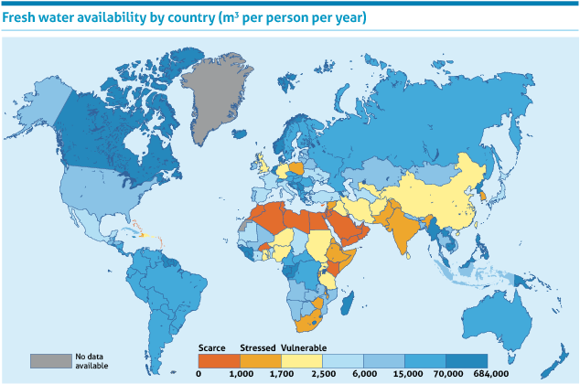
Desalination Market Drivers
Water Scarcity
Economic Growth
Population Growth

Slide 7
Main Desalination Market Challenges & Industry Response
Challenge | Industry Response
Relatively High Fresh Water Production Costs | Accelerated Development of Higher Productivity RO Membranes and Lower Cost Pretreatment Systems and Plant Components Investment in Non-RO Technologies
High Energy Use | Advances in Low Energy Desalination Technologies & RO Energy Recovery Systems
Environmental Impacts | Coupling of Desalination Plants with Green Power Sources (Wind Power)

Slide 8
Typical Cost and Energy Ranges
(Medium & Large SWRO Plants)
Classification | Cost of Water Production (US$/kgal) | SWRO System Energy Use (kWh/kgal)
Low-End Bracket | 2.0 - 3.0 | 9.5 – 10.5
Medium Range | 3.5 - 5.5 | 11.0 - 12.0
High-End Bracket | 6.5 - 11.0 | 12.5 – 14.0
Average | 4.0 | 11.5

Slide 9
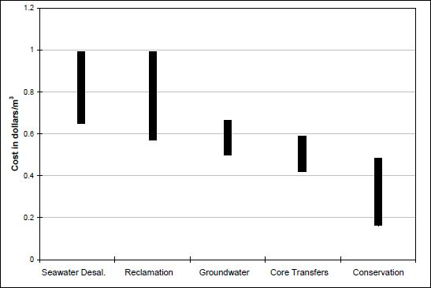
Comparative Costs of Other Water Supply Options

Slide 10
Cost of Water for Recent SWRO Projects

Slide 11
Costs of Recent US SWRO Projects
Project | Status | Capital Cost (US$) | Annual O&M Cost (US$/kgal) | Cost of Water (US$/kgal)
0.6 MGD Sand City, CA | In Operation since 2010 | US$11.9 MM | US$1.15/kgal | US$2.91/kgal
25 MGD Tampa Bay, FL | In Operation since 2008 | US$138 MM | US$1.54/kgal | US$3.48/kgal
50 MGD Carlsbad, CA | In Financing | US$350 MM | US$1.75/kgal | US$4.00/kgal
2.5 MGD Santa Cruz, CA | In Planning | US$59-64 MM | US$3.94/kgal | US$7.6-8.0/kgal
2.5 MGD Brownsville Demo Project, TX | In Planning | US$22.5 MM | US$2.80/kgal | US$4.38/kgal
25 MGD-80 MGD Coquina Coast, FL | In Planning | US$180 MM -US$560 MM | US$1.99/kgal | US$4.47/kgal (US$5.35-US$6.10 w/ conveyance)

Slide 12
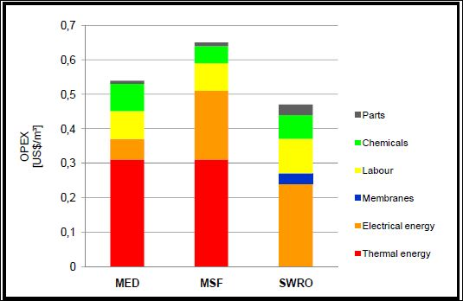
Energy Dominates Desalination O&M Costs
Source: Global Water Intelligence

Slide 13
Key Desalination Market Segments
Equipment & Manufacturing – 47 %
  Membranes & Pumps – US$0.5 to 0.7 billion/yr., each
  Energy Recovery Devices – US$0.08 – 0.1 billion/yr.
Engineering & Construction Services – 25 %
Operation and Maintenance Services – 28 %
Top Market – Saudi Arabia
@ US$4.5 to 5.5 billion/year

Slide 14
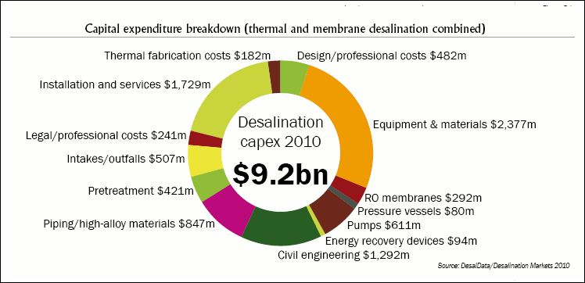
Desalination Market Segment Size
Equipment, Materials and Installation Constitute
Over 50 % of the Market

Slide 15
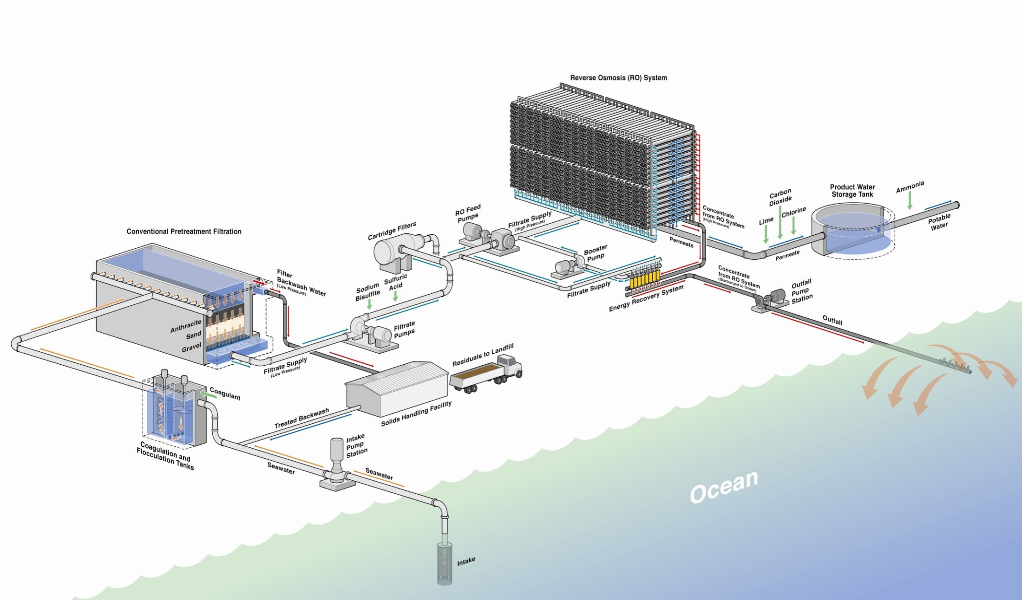
Equipment Market Segmentation Follows Key
Cost Components
RO System –
40 % to 60 % of
Construction Costs
Pretreatment –
15% to 20 %
of Construction costs
Discharge – 5 to 15 %
of Construction Costs
Intake – 5 to 20 %
of Construction Costs
Notes:
15

Slide 16

Desalination Market Trends
The Desalination Market Has Higher Growth Rate
than Any Other Water Market Segment
The 2011 Market Size of US$ 6.9 Billion
Is Projected to Double by 2016

Slide 17
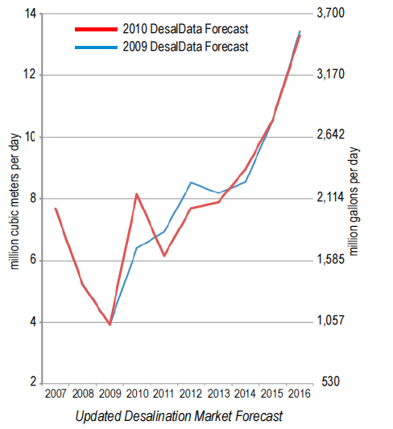
Projected New Desalination Capacity in 2012
7.9 MM m³/day = 2,100 MGD
16 % Growth/year
Actual New Capacity in 2011 6.8 MM m³/day = 1,800 MGD
Source: WDR, July 2010

Slide 18
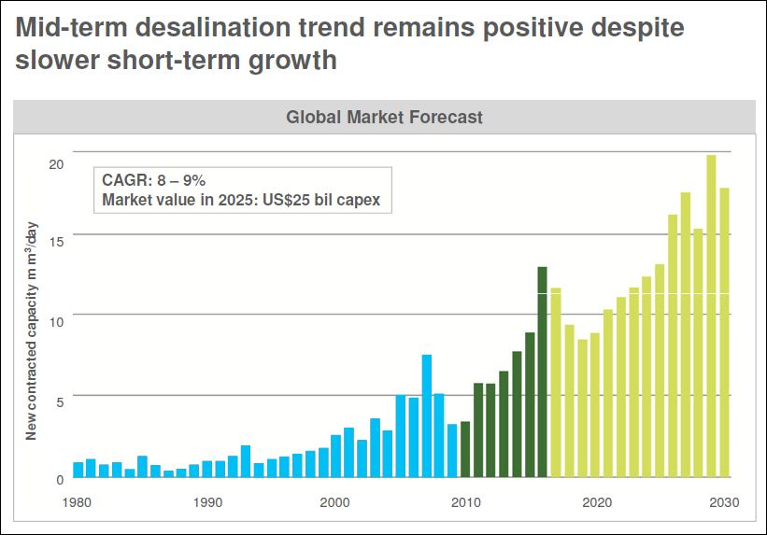
After “Arrested Development in 2010” the Market is Recovering and Accelerating
Market Deceleration in 2009 & 2010 Were Mainly Due to Traditionally High-growth Markets in Algeria, Spain and Australia Reaching Planned Maximum Capacity & Water Demand Setbacks in the Western US, Florida, Southern Spain and UAE

Slide 19
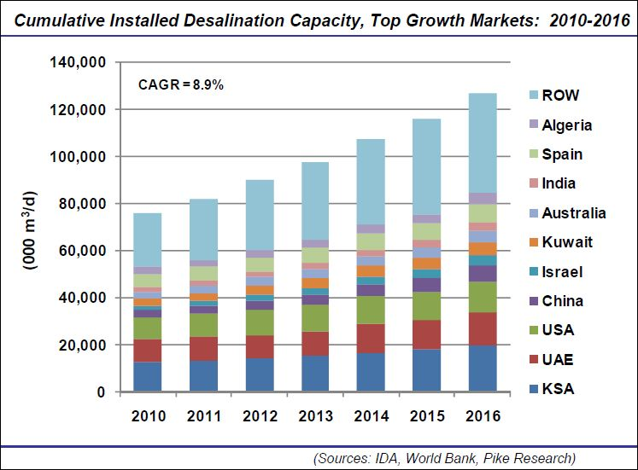
Desalination Market Growth Forecast
Note: ROW – Rest of the World

Slide 20
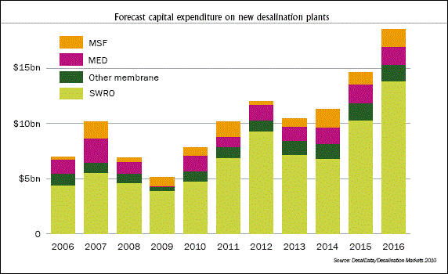
Thermal vs. RO Desalination

Slide 21
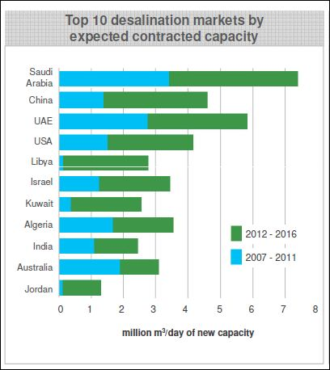
The 10 Highest Growth Markets in the Next 5 Years
Slow Economic Recovery
Will Likely Keep Market Growth Just Below 10 % in the
Next 3 Years
Double-digit Growth Projected
Past 2015
Materials & Membranes Markets Are Expected to Experience the Highest Growth
Chemicals Market is Expected to be Curtailed Dramatically
Turnkey BOO Method of Delivery will Dominate Until the Market Matures

Slide 22

Where Future Cost & Energy Reduction Breakthroughs Would Come From?
- Materials Science
New Membrane & Pipe Materials
& Separation Technologies
Notes:
22

Slide 23
Main Areas Expected to Yield Cost Savings in the Next 5 Years
(20 % Cost & Power Reduction )
Improvements in Membrane Element Productivity:
  Polymetric Membranes (Incorporation of Nano-particles Into Membrane Polymer Matrix);
  Bio-membranes & Enzymatic Transport of Water
  Carbon Nanotube Membranes
Increased Membrane Useful Life and Reduced Fouling:
  Smoother Membrane Surface
  Increased Membrane Material Longevity;
  Use of Systems for Continuous RO Membrane Cleaning;
  UF/MF Membrane Pretreatment.
Commercial Forward Osmosis Systems;
Larger RO Elements, Trains and Equipment.
Notes:
23

Slide 24
Concluding Remarks
Desalination Market Is Continuing to Grow at Accelerating Rate of 8 to 9 % per Year and is Expected to Exceed US$10 billion Mark in 2012;
Persian Golf Countries, China and India are Likely to Fuel Sustained Market Growth in the Next 3 to 5 Years;
Economic Recovery in Traditional Desalination Markets is Forecasted to Double the Market Growth by 2016;
Long-term Investment In Research and Development Has the Potential to Reduce the Cost of Desalinated Water and Propel Market Size to US$25 billion by 2025.
Notes:
24

Slide 25


Questions ?
Nikolay Voutchkov, PE, BCEE
Water Globe Consulting
nvoutchkov@water-g.com
Nikolay Voutchkov

