Slide 1
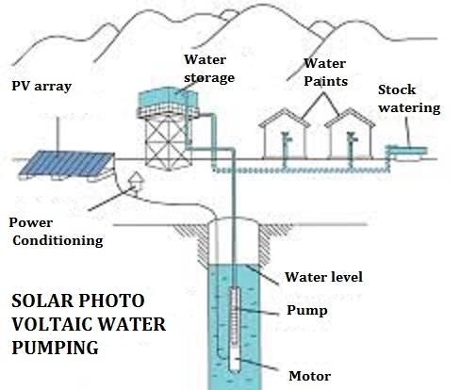
A solar-powered pump is a pump running on electricity generated by photovoltaic panels or the radiated thermal energy available from collected sunlight as opposed to grid electricity or diesel run water pumps.[ The operation of solar powered pumps is more economical mainly due to the lower operation and maintenance costs and has less environmental impact than pumps powered by an internal combustion engine (ICE). Solar pumps are useful where grid electricity is unavailable and alternative sources (in particular wind) do not provide sufficient energy.

Slide 2
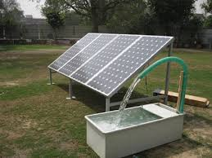

Slide 3
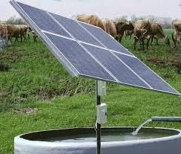

Slide 4
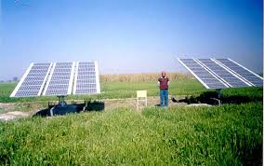

Slide 5
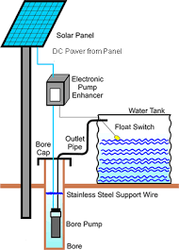

Slide 6
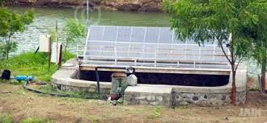

Slide 7


Slide 8


Slide 9
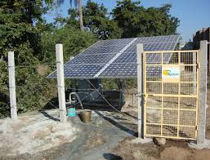

Slide 10
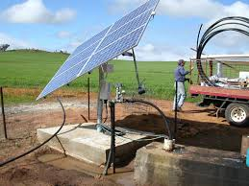

Slide 11


Slide 12


