Slide 1
The Food-Water-Energy Nexus: what is it, and what does it mean for the Mekong?
Larry Harrington
Research Director, CPWF

Slide 2
Mekong Forum on Water, Food and Energy
Convener
Co-hosts
Convened by CGIAR Challenge Program on Water and Food (CPWF)
CPWF initiative, funded by Australia through AusAID
Institute of Water Resources Planning, Government of Vietnam
Mekong Program on Water, Food and Resilience (M-POWER)
IWMI

Slide 3
Second Forum
First Forum: Phnom Penh, Cambodia, December 2011
Second Forum: Hanoi, Vietnam, November 2012

Slide 4
An important aim of the Forum
Open and constructive dialogue on the water- energy – food nexus among representatives from:
  Government
  Industry
  Financers
  Civil society
  Research institutions

Slide 5
What is a “nexus”?
From the dictionary:
  A connection, tie or link
  A connected series or group
  The core of a matter or a situation

Slide 6
What is a “water – food – energy” nexus?
Connections, ties and links among
  water
  food and
  energy

Slide 7
Water food and energy “Nexus” in the news
Bonn Conference (2011)
World Economic Forum (Davos, 2012)
Sixth World Water Forum (Marseille, 2012)
South African Water, Energy and Food Forum (2012)
The Fortune Global Forum Sustainable Development Roundtable on “Energy, Food & Water (Beijing, 2012)
This is recognized as a topic of global importance

Slide 8
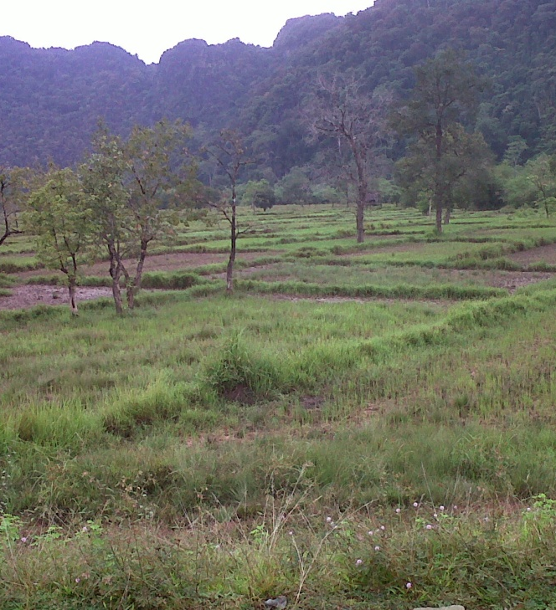
About a river . . .
“The [river] provides freshwater . . . for domestic and industrial use . . . and for irrigated agriculture, hydropower dams and the vast fisheries resource”

Slide 9
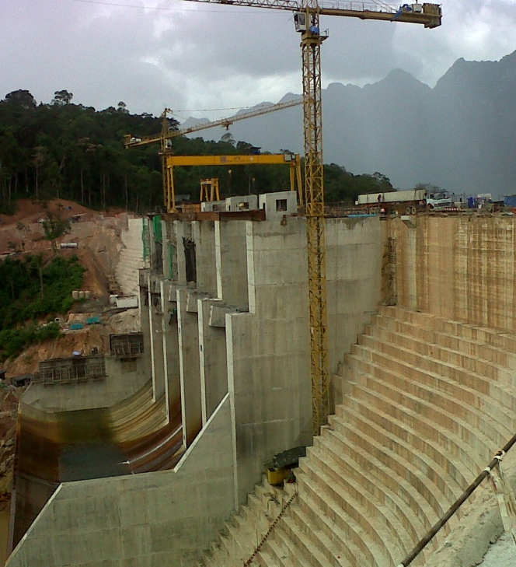
About a river . . .
“With significant new dams and development works being planned . . . the need for science-based evidence to inform policy decisions has never been greater”

Slide 10
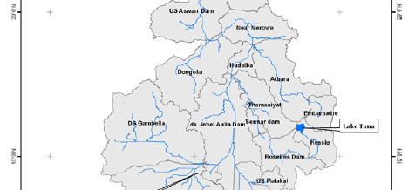
But they are talking about the Nile!
Kirby et al 2010

Slide 11
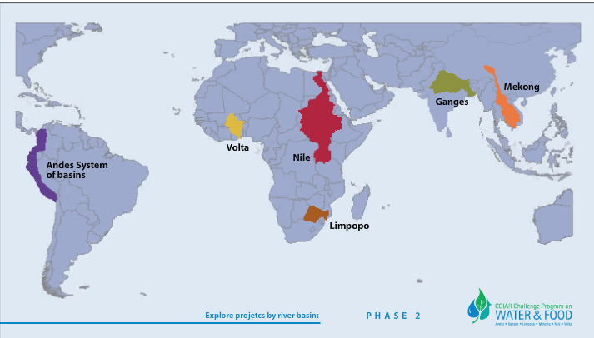
Nexus issues are everywhere
Issues of the water – food – energy nexus are found in all basins where the CPWF works

Slide 12
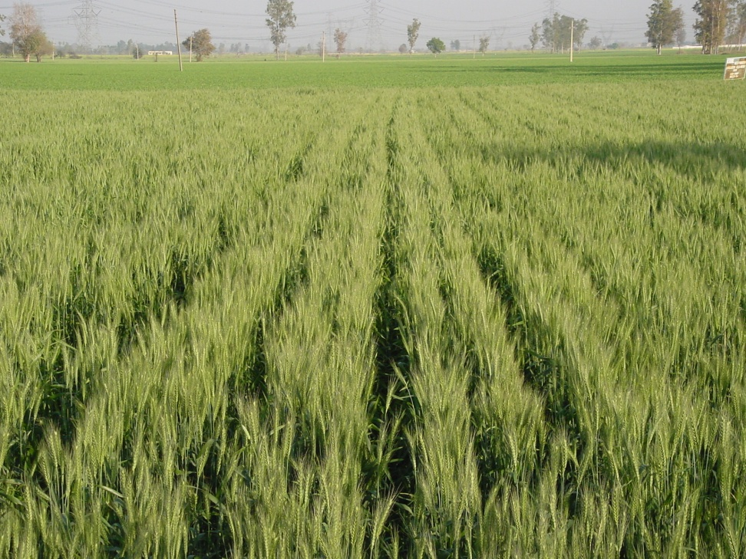
Exploring the nexus
Water is needed to grow food (crops, fish)
  Rainfed
  Irrigated
  Catch fisheries
  Aquaculture
Water is needed to produce energy (hydro, coal, nuclear, fracking, biofuel)

Slide 13
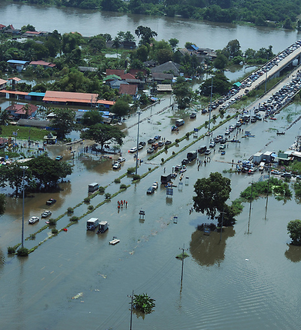
Exploring the nexus
Too much water damages industry, homes and crops
Too little water endangers food production
Water management is central to ecosystem services (wetlands, diversity, flood control, others)

Slide 14
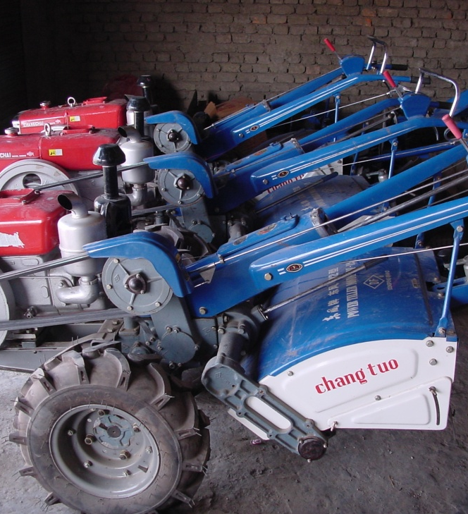
Exploring the nexus
Energy is needed to grow food (tillage, inputs)
Energy is needed to market and transport food
Energy is needed to build strong economies
Strong economies with high incomes can buy food
Hydropower is NOT the only source of energy

Slide 15
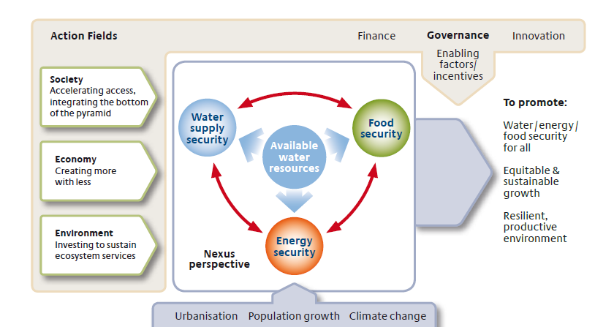
H. Hoff 2011

Slide 16
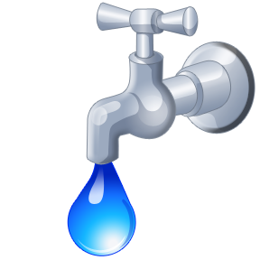
A side-trip to the Andes
Maybe managing the nexus is easier in the Andes
Downstream communities want clean water
Midstream hydropower generators want reliable water
Public policy supports highland ecosystem conservation

Slide 17
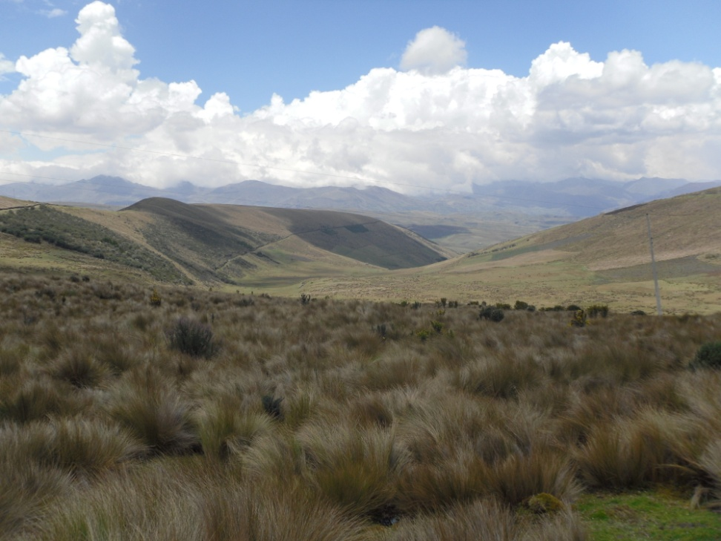
A side-trip to the Andes
Therefore
Downstream water users donate to a trust fund
The trust fund invests in improved upstream land and water management
Example of a “benefit sharing mechanism”
Everyone wins

Slide 18
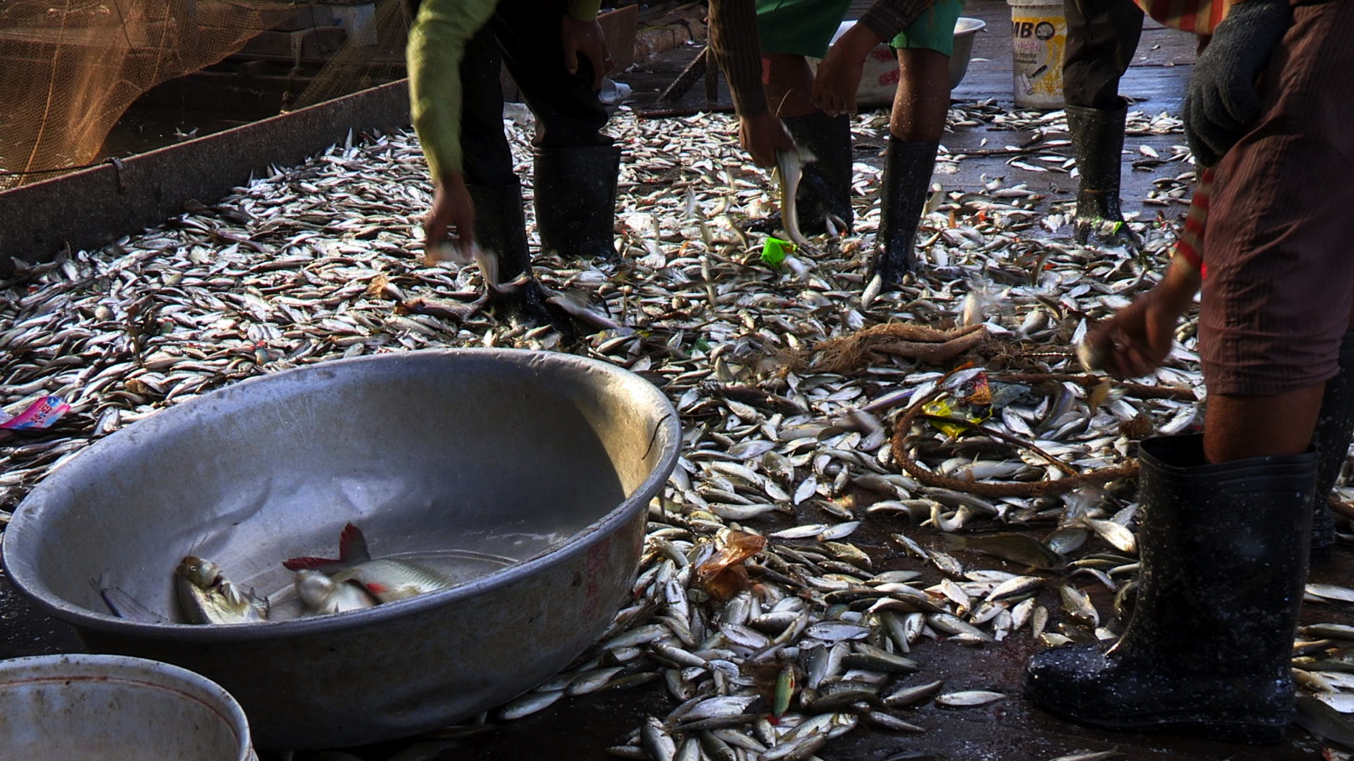
Water, food and energy nexus issues in the Mekong

Slide 19
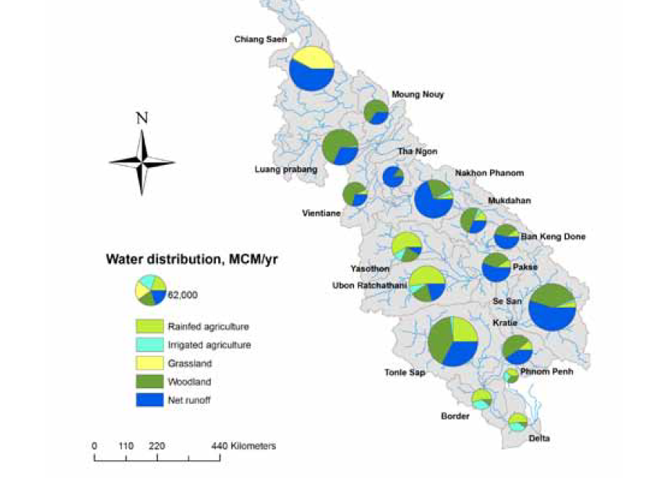
The Mekong is “water rich”
Kirby et al 2010

Slide 20
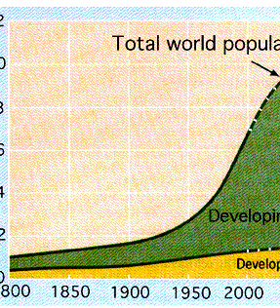
Energy demand is growing
Vietnam – about 15% per year
Thailand – about 4% per year (but from a very large base)
Economic growth plus population growth

Slide 21
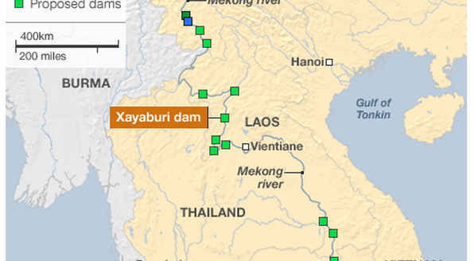
Riparian countries seek to tap these resources by constructing dams for hydropower
CPWF map reproduced by BBC News 6/11/12

Slide 22
The need for informed dialog
Dams will have impacts
The debate over what impacts, their size and incidence
Who wins? Who loses? By how much?
How do we know? Where’s the evidence?

Slide 23
Seeking win-win outcomes
Dams displace people: design resettlement to benefit these people
Dams create environmental problems: design and manage dams to mitigate problems
Multiple dams have cumulative impacts: understand cumulative impacts and coordinate construction and management
Seek to meet energy production, environmental, and social goals all at once

Slide 24
Final point
People often see dams as points of controversy.
In this Forum the intention is that they become points for dialog and cooperation

