Slide 1
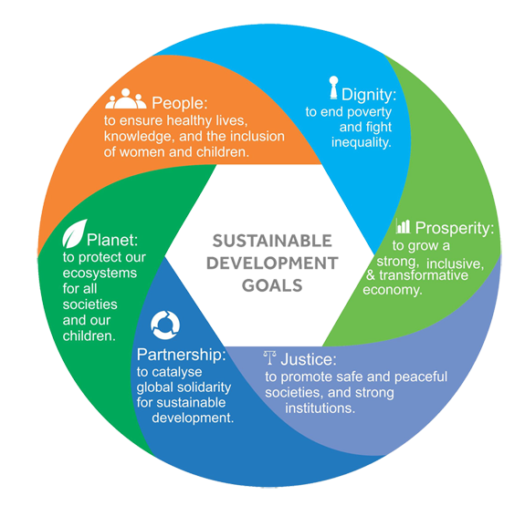
UTILIZATION OF RAIN WATER
& SUSTANABLE DEVELOPMENTS
Presented By
Prem Baboo
Sr. manager(Prod)
National fertilizers Ltd.
India

Slide 2
Agricultural production provides income, employment and food at affordable prices as well as raw material for the processing industry and foreign exchange from exports. Creating a sustainable agricultural development path means improving the quality of life in rural areas, ensuring enough food for present and future generations and generating sufficient income for farmers.
Supporting sustainable agricultural development also involves ensuring and maintaining productive capacity for the future and increasing productivity without damaging the environment or jeopardising natural resources. In addition, it requires respect for and recognition of local knowledge and local management of natural resources, and efforts to promote the capabilities of current generations without compromising the prospects of future ones.
Consequently, economic and environmental sustainability, adequate farmer incomes, productive capacity for the future, improved food security and social sustainability are important elements of developing countries’ agricultural development.

Slide 3
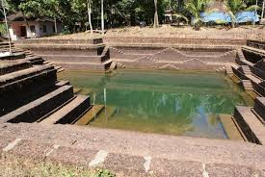

Slide 4
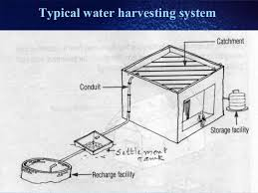

Slide 5
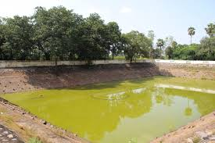

Slide 6
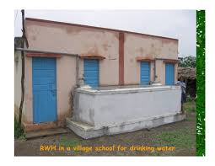

Slide 7
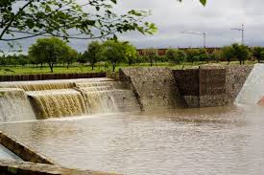

Slide 8
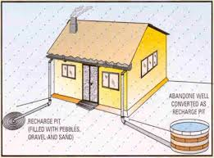

Slide 9
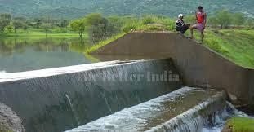

Slide 10
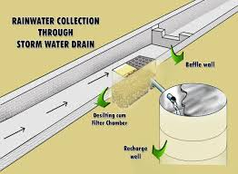

Slide 11
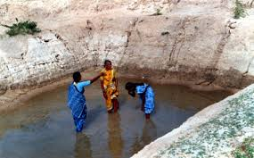

Slide 12
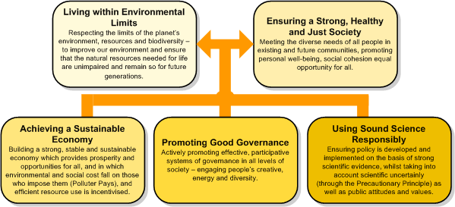

Slide 13
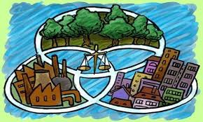

Slide 14
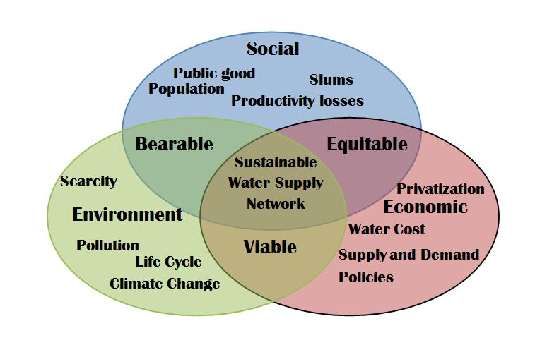

Slide 15
“Achieve gender equality and empower all women and girls.”
“Ensure availability and sustainable management of water and sanitation for alL”
“Ensure access to affordable, reliable, sustainable and modern energy for all.”
“Promote sustained, inclusive and sustainable economic growth, full and productive employment, and decent work for all.”
“Strengthen the means of implementation and revitalise the global partnership for sustainable development.”
“Promote peaceful and inclusive societies for sustainable development, provide access to justice for all and build effective, accountable and inclusive institutions at all levels
Make cities and human settlements inclusive, safe, resilient and sustainable.”

