Slide 1
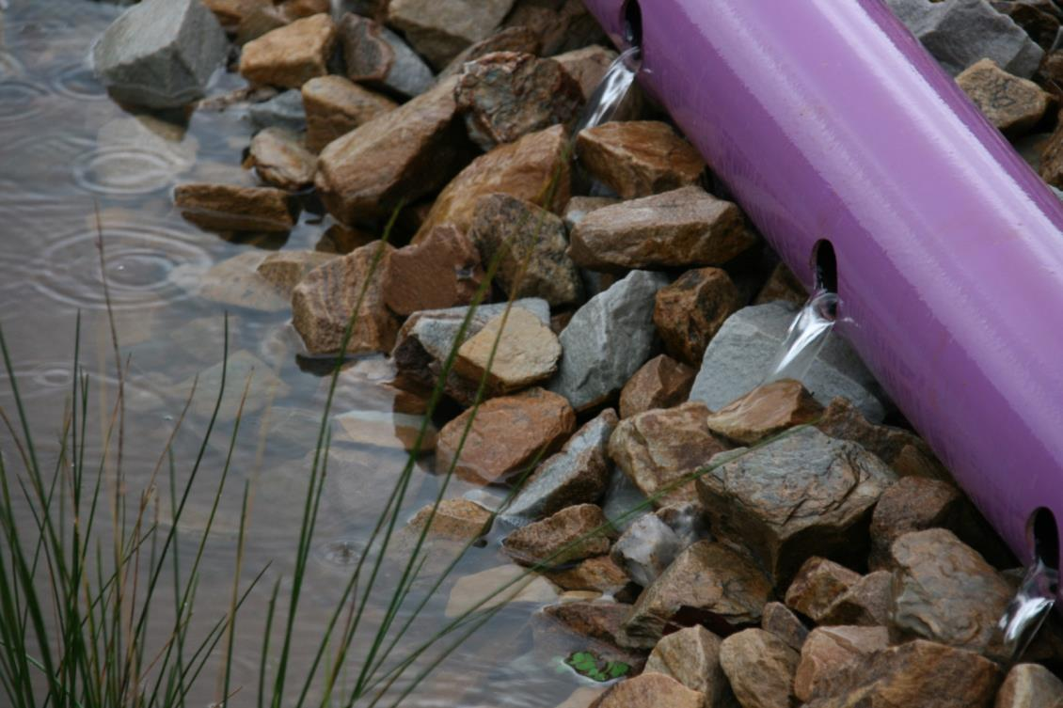


Integrated Water Management
IPWEA VIC Leadership Breakfast

Slide 2
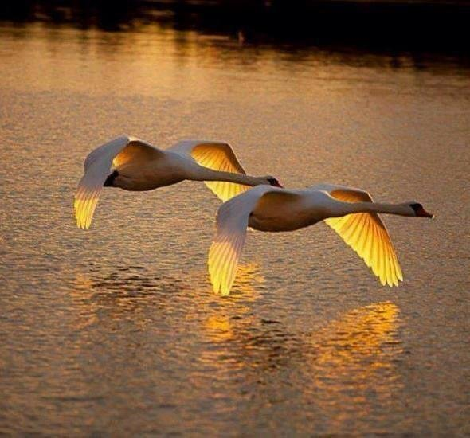
Water is life, water is food, water is health, water is energy, yet water is wealth.

Slide 3
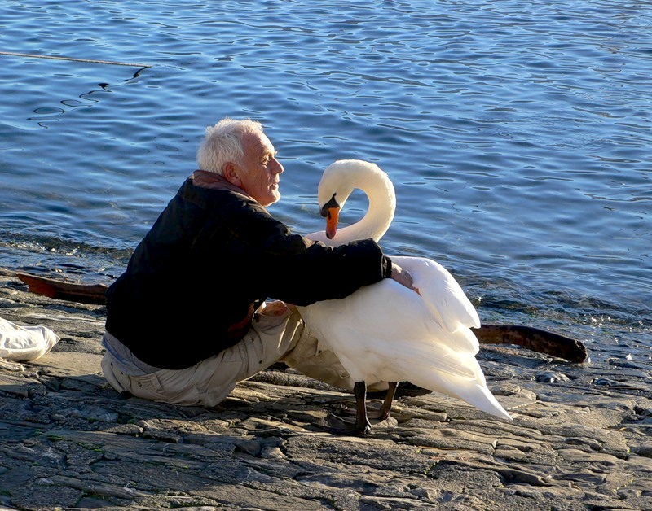
Water is a fragile resource which can not be replaced

Slide 4
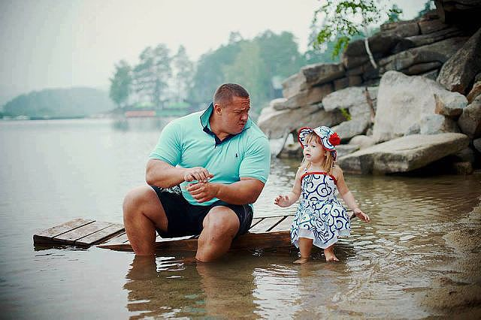
And we must protect and preserve it for future generations

Slide 5
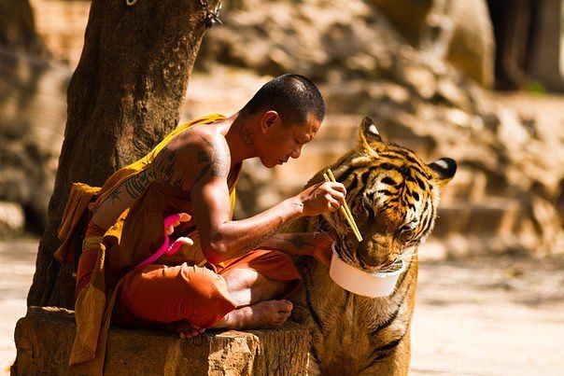
It starts with the mindset

Slide 6
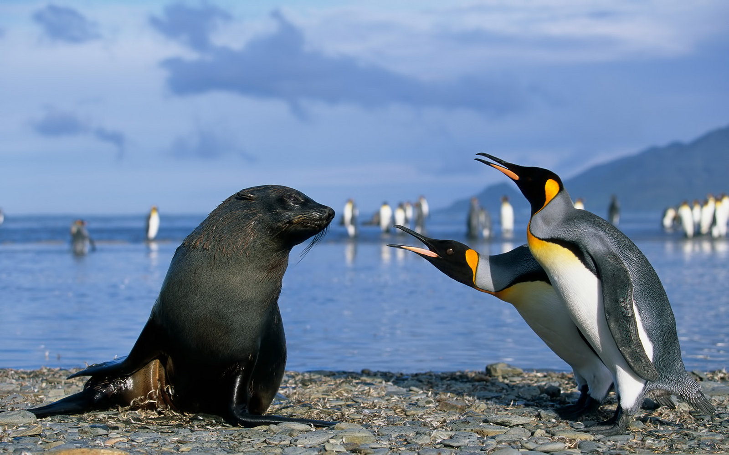
Requires patience and tolerance

Slide 7
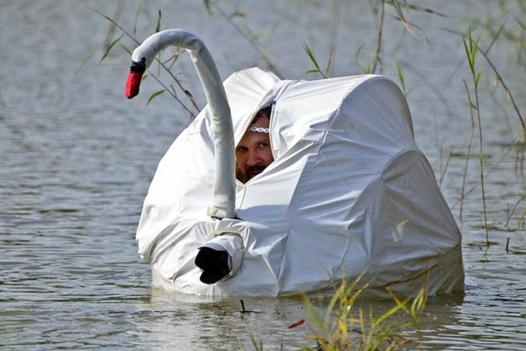
Learning and knowledge sharing

Slide 8

Various faces of collaboration
Desired outcomes:
Behavioural and technical acceptance of IWM
Value for community investment
Collaboration and leadership

Slide 9
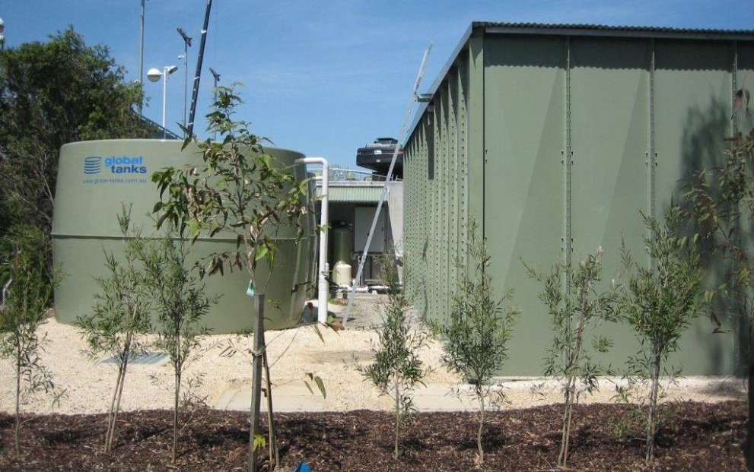
Engineering aspects of IWM

Slide 10
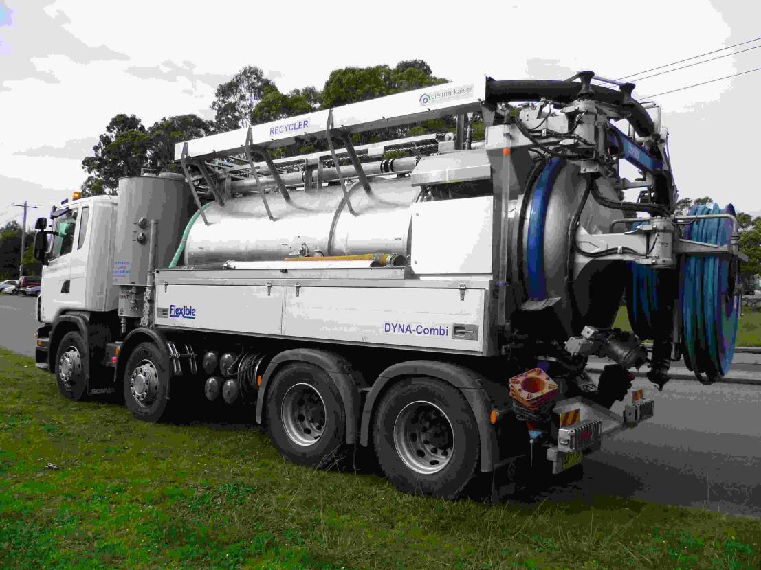
Operation & Maintenance

Slide 11
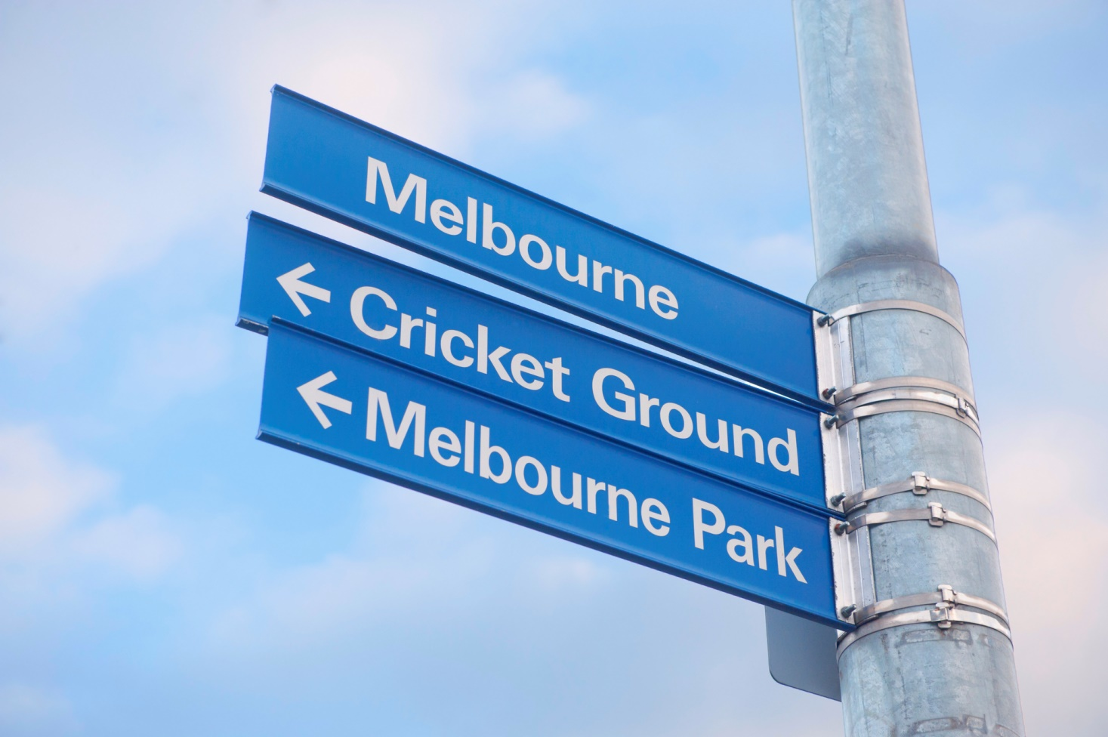
Operational projects and case studies
Stormwater Harvesting

Slide 12
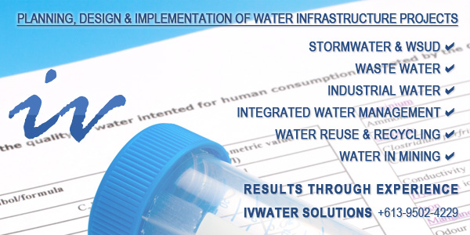
Various faces of collaboration
https://www.youtube.com/watch?time_continue=1&v=Beoea1l5yLw

