Slide 1
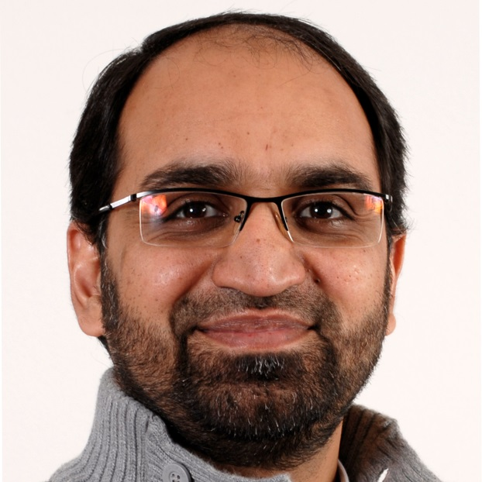
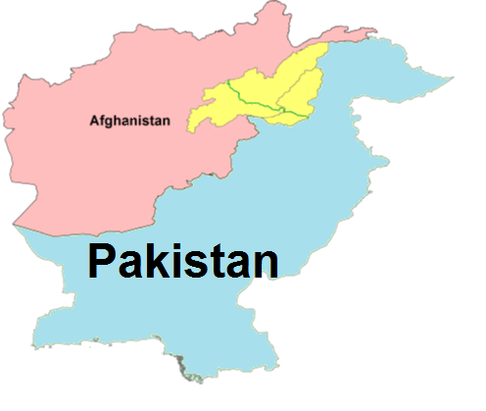
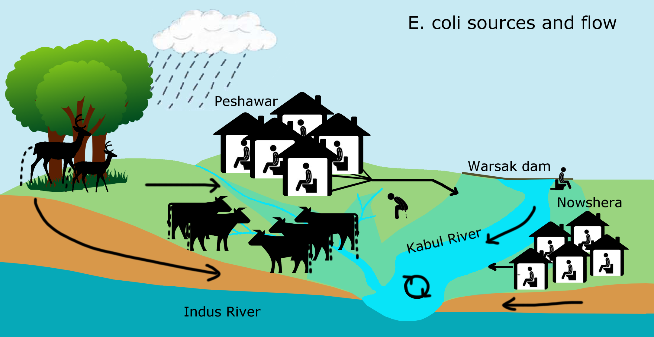
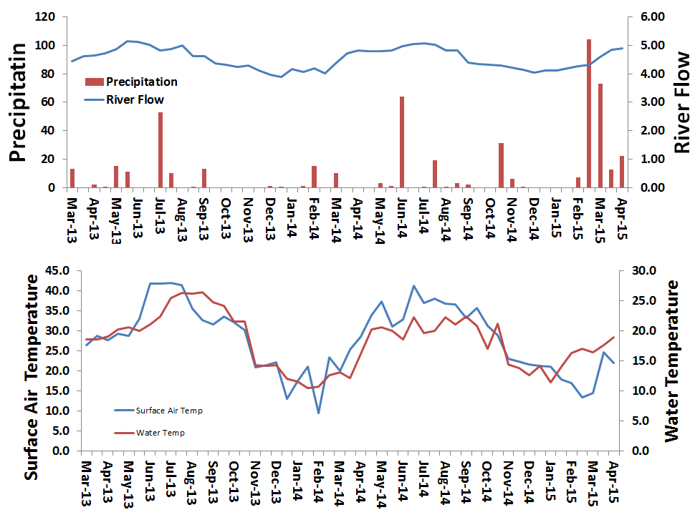
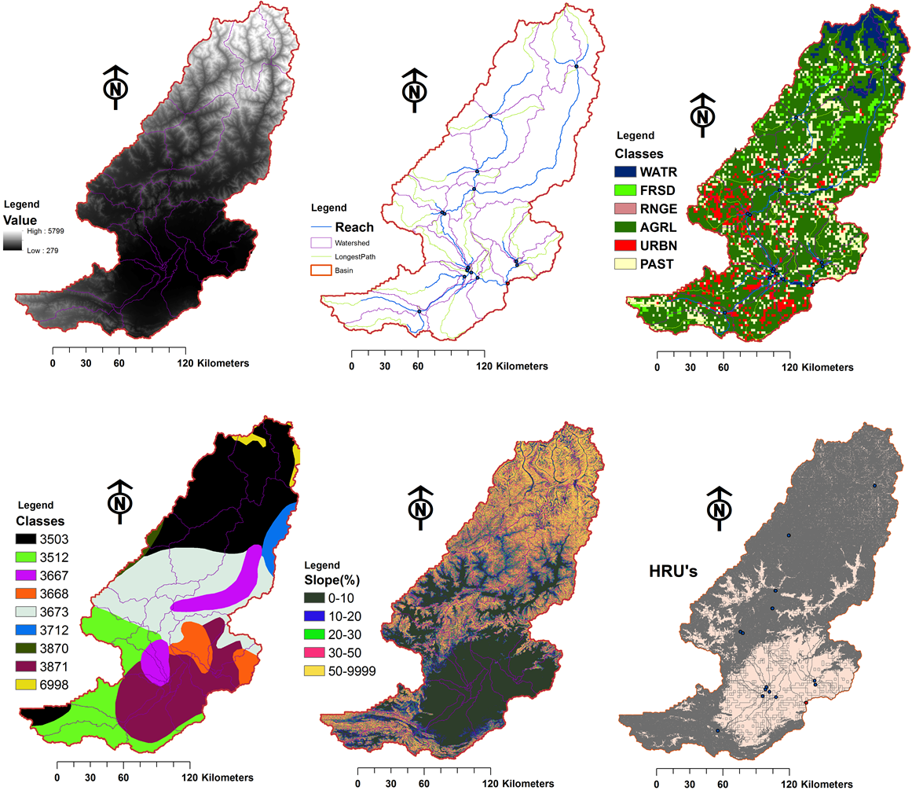

Evaluating floods in the Kabul River basin of Pakistan with the Soil and Water Assessment Tool (SWAT) model
Muhammad Shahid Iqbal and Nynke Hofstra
Environmental Systems Analysis group, Wageningen University, The Netherlands.
Objective
Outlook
Our aim is to better understand the impact of flooding on public health in the Kabul River basin. We plan to use SWAT to model the concentration of E. coli in the surface water to enable fate and transport studies and scenario analysis.
This modelling study will provide quantitative proof of increased E.coli concentrations in surface water with flooding and enable assessment of major sources of water pollution.
Background
Study area, E. coli sources and flow
3.4 million people died out of 1.5 billion people worldwide who suffer from waterborne diseases (UNICEF/WHO 2009). Also in the Kabul River basin in Pakistan a large percentage of deaths is due to waterborne diseases.
E. coli is relatively easy and cheap to measure indicator bacterium for waterborne pathogens.
Kabul river floods every year and this makes the basin an ideal test case to study flooding impacts on E.coli concentration in surface water.
Methodology
Input Data
Validation E. coli concentrations in Kabul River
Weather & hydrological data
Basin details
DEM
Streamflow
network
Land use
SWAT MODEL
Present and future E. coli concentration
Soil types
Slope
HRUs
Scenario data
IPCC (SSPs / RCPs)
Environmental System Analysis group.
P.O. Box 47, 6700 AA Wageningen
Contact: muhammad.shahidiqbal@wur.nl
M +31 (0)6 84579082
www.wageningenur.nl/esa
Acknowledgements
Special thanks to the Netherland Fellow Ship Program to fund this project. We thank the Pakistan Meteorological Department Peshawar Region, Pakistan Agricultural Research Council, for sharing their data with us.

