Slide 1

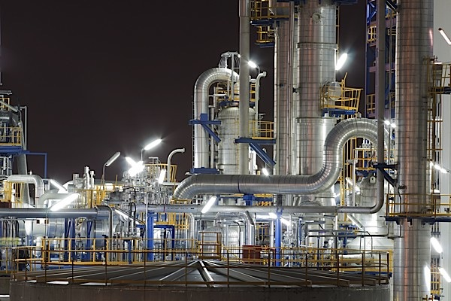
2022
2022
Chemical Professional Services
COMPANY PROFILE
CHEMICALS & EQUIPMENT

Slide 2

ABOUT US
Genger Projects and Consulting (Pty) Limited is a sole proprietor company registered in 2017 based in Johannesburg South Africa.
GenGer Chemical Professional Services lead by one of the companies cofounder Noel Bryan Gerald Naylor has over 30 years experience within the Chemical and Associated Industry sector, boasting a Technical Chemical Engineering Qualification, as well as a Business International MBA.
GenGer Chemical Services specializes :
Supplying chemical raw materials and process equipment
Consulting on engineering processes, business strategies and project initiatives
Project participation from initiative to management
Our Passion is Our Drive For Success
To ensure that we offer our clients professional resources and quality products on time that will assist them to achieve their procurement needs so that they achieve their contractual obligations and/or their performance goals.
VALUE PROPOSITION

Slide 3

OUR STRENGTHS
Our lead specialist having 30 years of experience within the chemical an associate equipment supply and business strategy and project sphere.
Extensive network of manufactures, suppliers and technology providers
Network of logistic services providers
KEYS TO SUCCESS
Establishing a high quality, high value relationship with its suppliers, customers and logistic partners.
Ensuring a reliable and timely delivery of products and services
Reliable administration and organization
Genger prides itself on the development of long-term sustainable business partnership, providing clients with commercial and technical support

Slide 4
STRATEGIC SOURCING SERVICES
In addition to manage its own product categories, GenGer is also involved in strategic sourcing of key commodities for its customers.
Key attributes that differentiates GenGer as a strategic sourcing partner are:
Market Intelligence and knowledge of the different markets
Establishing long-term relationships with commodity suppliers, service providers and customer base
Committed to establishing supply economics of scale
Utilizing strategies to minimize the effect of fluctuations in rate of exchange, supply and logistic challenges.

Slide 5
OUR SERVICES
Chemicals
Equipment
Projects

Slide 6
CHEMICALS
Strengths:
In-house professional chemical engineer with 30 years of experience within the chemical sector both manufacture and supply
South African network of chemical suppliers & technology
Global network of chemical suppliers & technology
15 years of experience in exporting chemicals into Africa
Experience with exporting hazardous chemicals class 2 ,class 5.1 and class 8
Experience in exporting both commodity and specialty chemicals

Slide 7


MINING CHEMICALS
Chemicals | Application
Caustic Soda Lye 50% | Leaching agent pH modifier
Hydrochloric Acid 32% | Ore dissolution pH modifier
Soda Ash | pH modifier
Caustic Soda Flake/Pearl | pH modifier
Quicklime | flotation or recovery of non-ferrous metals, including copper, zinc, nickel and lead-bearing ores. recovery of gold and silver
Polyacrylamides (PAM) | Underground settlers flocculant Surface clarifier Flocculant
Water treatment Chemicals | Coagulants/Flocculants Biocides
Calcium Chloride | Dust Suppressant
Ferrous Chloride | Chrome oxidation state reduction
Sodium Metabisulphite (SMBS) | Removing Cyanide from mine effluent
Chemicals | Application
Hydrogen Peroxide 50%
Granular Sulphur
Magnesium Oxide

Slide 8
WATER TREATMENT CHEMICALS
Chemical Name | Some Important Application/Industry uses
CHLORINE GAS | Disinfection Oxidation
Calcium Hypochlorite | Disinfection
Sodium Hypochlorite 15% | Disinfection
Coagulants/Flocculants | Turbidity & Color Removal
Activated Carbon | Color & odor control
Lime | Ph control
Zeolite | Filter medium ( Replace sand or multimedia filters)
Aluminum Sulphate | Turbidity & Color removal
Industrial | Boiler & Cooling tower chemicals

Slide 9
SWIMMING POOL CHEMICALS
Type | Description
Green Go | Once off shock chemical treatment to turn swimming pools from green to blue.
Monthly treatment | Monthly treatment program for different pool sizes All in one total solution package treatment floater type option
Smart Pool | Special treatment package for larger than 75,000 liters

Slide 10

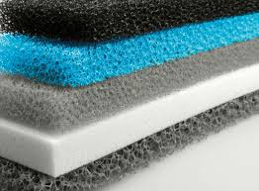
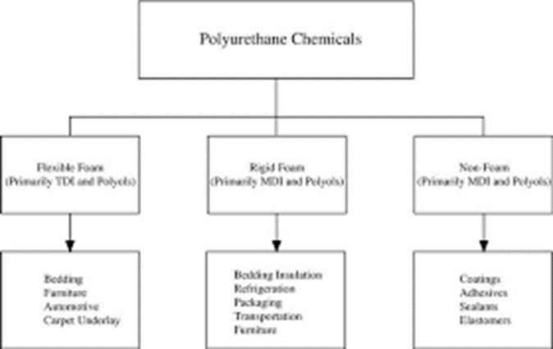
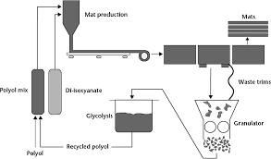
POLYURETHANE (PU)FOAM CHEMICALS:
Chemical Name | Some Applications | Some Industry Types
Toluene Diisocyanate (TDI) | PU Flexible Foam manufacture | Mattresses Foam Automotive Chair Foam Heat insulation Foam
Polyol | PU Flexible Foam manufacture | Mattresses Automotive Chair Foam Heat insulation Foam

Slide 11
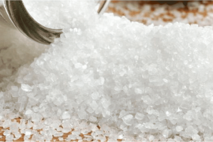
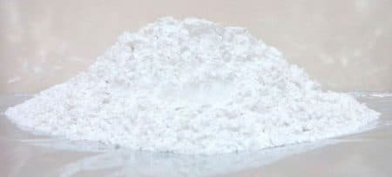
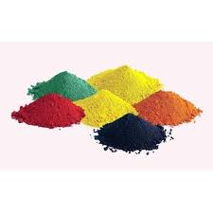
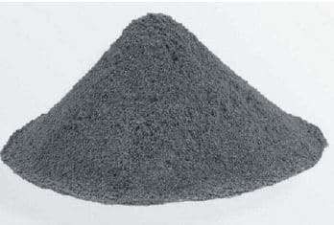
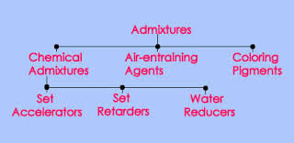
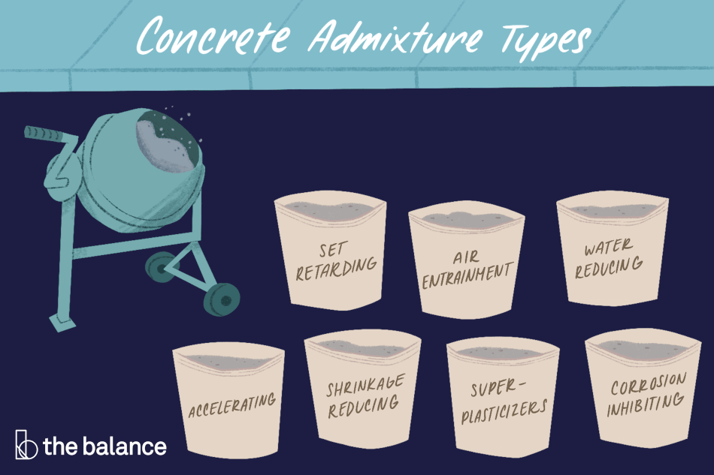
CONCRETE CHEMICALS
Chemical Name | Application/function | Types of Industry
Concrete admixture | Increase concrete curing time (drying) | Roof tile manufacturers Cement Manufacturing
Concrete Oxide Pigments | Concrete color | Roof tile manufacturers
Sodium Carboxyl Methyl Cellulose(CMC) | Stabilizer and hydrophilic agent | cement and building materials
Sodium Silicate | Compacting agent | Cement Manufacturers
Calcium Chloride | Accelerator in hydration process of cement | Cement Manufacturers
Calcium Chloride
Retarding Admixture
Coloring Pigments
Accelerator Admixture

Slide 12
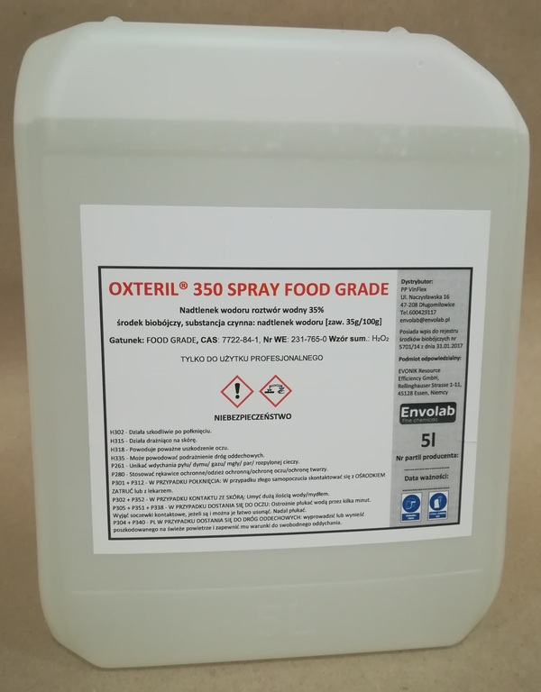
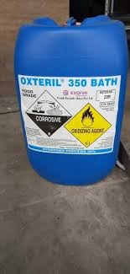
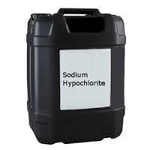
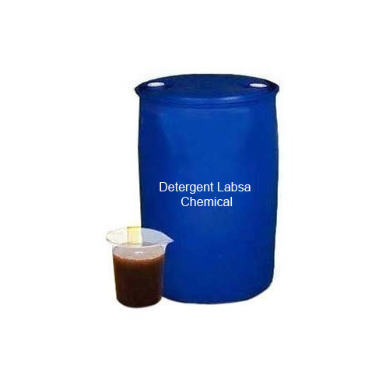
CLEANING & HYGIENE CHEMICALS
Chemical Name | Some Applications | Some Industry Types
Hydrogen Peroxide 35% FG | Sterilization Chemical detoxification Disinfectant | Beverage Processing(Juice) Food Processing Detergent Hand sanitizers
Linear Alkyl Benzene Sulphonic Acid(LABSA)/ linear Alkyl Sulfonate(LAS) | Surfactant for laundry powder and liquids, hand dishwashing liquid Emulsifier for agricultural herbicide | Detergent Agricultural herbicide
Sodium Hypochlorite 15% | Diluted to 3% and sold as household disinfectant Disinfectant | Detergent Hand Sanitizers Water treatment
Sodium Perborate Monohydrate | laundry detergents, fabric softener, hand dishwashing | Detergent
Sodium Carboxyl Methyl Cellulose(CMC) | Inhibitor in soap and detergent products | Soap manufacture
Phenol Crystal
Hydrogen Peroxide FG 35%
Sodium Hypochlorite 15%

Slide 13
COSMETIC/PERSONAL CARE CHEMICALS
Chemical Name | Some Applications
Hyaluronic Acid | Used in skin care products
Sodium Perborate Monohydrate | Eye drops, wound cleaners, whitening of toothpaste
Sodium Benzoate | Hair shampoos, baby care product, sunscreen
Untreated Fluff Pulp | Baby Diaper Manufacture

Slide 14
FOOD & BEVERAGE CHEMICALS
Chemical Name | Some Applications
Hydrogen Peroxide 35% FG | Sterilization Chemical detoxification
Sodium Benzoate | As a preservative and anti-fungal properties it is used in cleaning products Preservative in juice, carbonated beverages, salad dressing, condiments
Xanathan Gum | Food additive
Potassium Sorbate | Preservative in food, beverages
Citric Acid (Monohydrate/Anhydrous) | Food additive Ingredient in cleaning compounds
Ascorbic acid | Antioxidant food additive

Slide 15
AGRICULTURE CHEMICALS
Fertilizers
Crop Protection chemicals(Insecticides etc.)
Bio-fungicides & Stimulants
Nutrition Chemicals

Slide 16
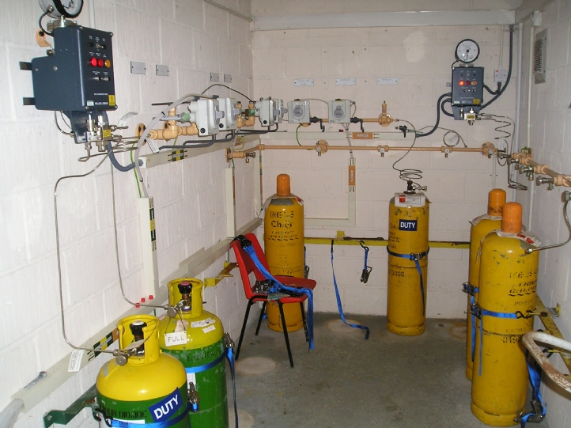
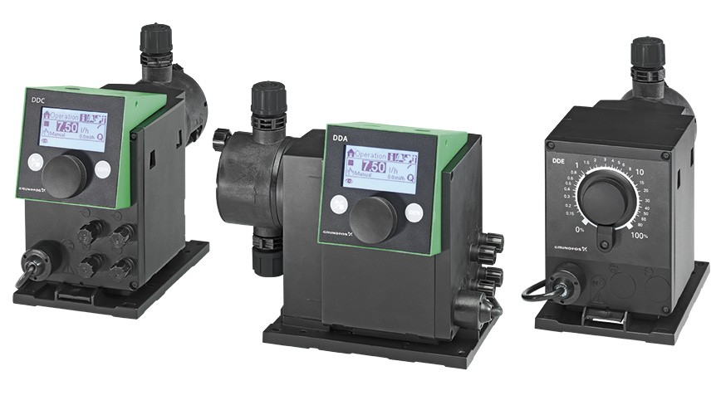
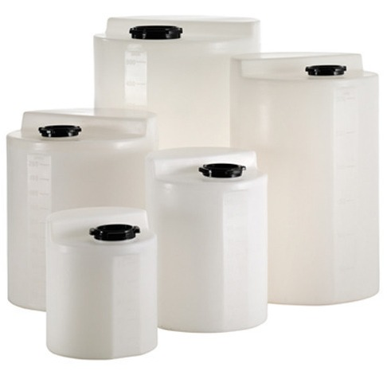
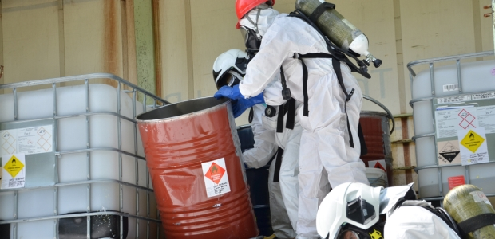
EQUIPMENT
Chlorinators (Chlorine gas dosing)
Chlorine Flexible connectors
dosing pumps (Chemical, liquids, solids)
Borehole/Well submersible pumps
Surface Water booster and distribution pumps
Plastic Tanks (Chemicals ,Water)
Laboratory equipment
Process & Analytical Instrumentation
RO systems
Ion Exchange Columns
Resins (IX and PVC)
Safety PPE
Containerized filter systems
Chemical dosing systems
Others

Slide 17
PROJECTS,CONSULTING & TRAINING
Chemical & Industrial Process Engineering Projects Since 2017:
Modular Chlor Alkali Facility Tanzania
‘Project Lead Technical & Commercial Advisor’
2017 to date
Project CAPEX $115Mil
Chlorine Gas Dosing Station
Rehabilitate chlorinator and associated dosing system units at a wastewater treatment plant
March to April 2022,successfully completed
Project CAPEX R600K

Slide 18
Contact Us
Home Office (South Africa)
905 Netball street
Weltevreden Park
Johannesburg
1709
Tel : 0795113904
Email : noel@genger.co.za

