Slide 1
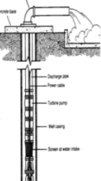

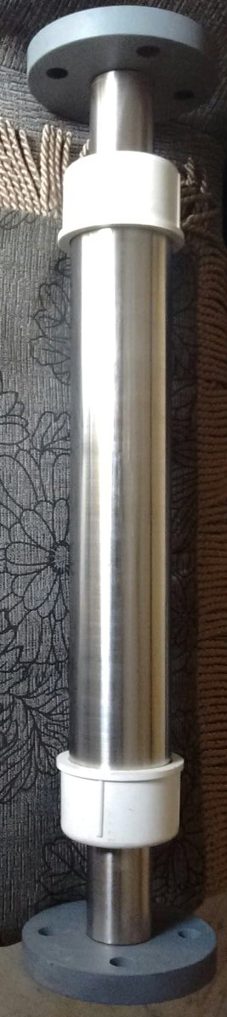


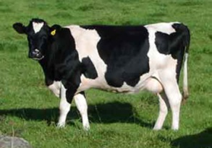
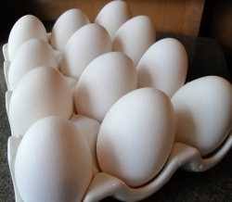
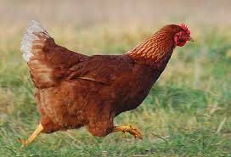
Energizer
B
O
R
E
W
E
L
L
Decreases Salinity
30% Less Water Consumption
Arrests Drip Blockage
30% More Yield
10 Years Life
Zero Maintenance
No Additives
Free Energy
Restructures and Revitalizes water
Agrow Energizer
Beneficiates essential minerals
Neutralizes toxins
Contact: M Seetha Ramulu | Mobile: +91 92931 99567 | email: mseetharamulu@gmail.com

Slide 2

Main Advantages in Agriculture
Increases flow of all irrigation & Drip irrigation lines sprinkles stay Clean without any scaling and corrosion.
Increases water absorption and penetration in soil structure & reduces water consumption
Increases bioavailability of water and nutrients to plants
Increases seed germination and improve crop uniformity
Increases oxygen concentration
Improves soil conditions, improves plant vigor and quality
Reduce the consumption of fertilizer & pesticide
Encourages plant &crop growth increases yield
Reduces friction in pumps and energy use
Reduces salinity in soil
Birds (Poultry) growth f aster more weight & strong Egg shell
Helps in increasing milk in diary(cows)
Contact: M Seetha Ramulu | Mobile: +91 92931 99567 | email: mseetharamulu@gmail.com

Slide 3
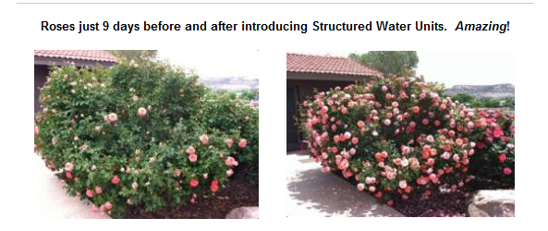
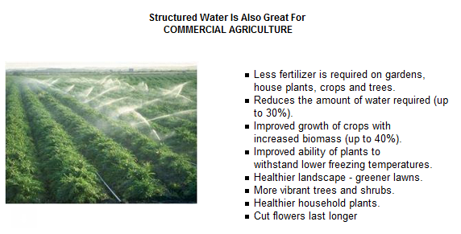
Contact: M Seetha Ramulu | Mobile: +91 92931 99567 | email: mseetharamulu@gmail.com

Slide 4
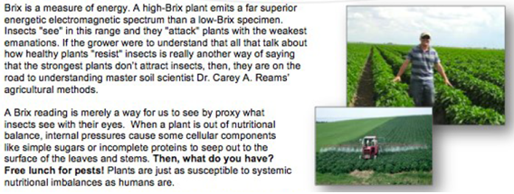
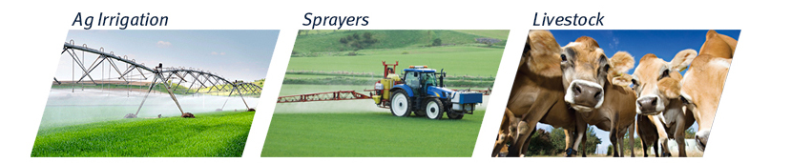

Water and Energy Efficiency for Irrigation, Healthy Soils & Crops

Slide 5

