Slide 1


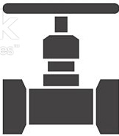
Automatic unpowered uniform NPC drip irrigation on a steep slope
How can identical NPC drippers at different levels have the same pressure?
upper dripper
The upper dripper must be open to the atmosphere as it discharges water into the vertical polypipe .
The valve is adjusted to prevent overflow at the upper dripper.
No overflow ensures that the flow rate of both the upper and lower dripper is the same.
The drippers are identical, and therefore the pressure at both drippers must also be the same.
water
supply
valve
water level
lower dripper

Slide 2
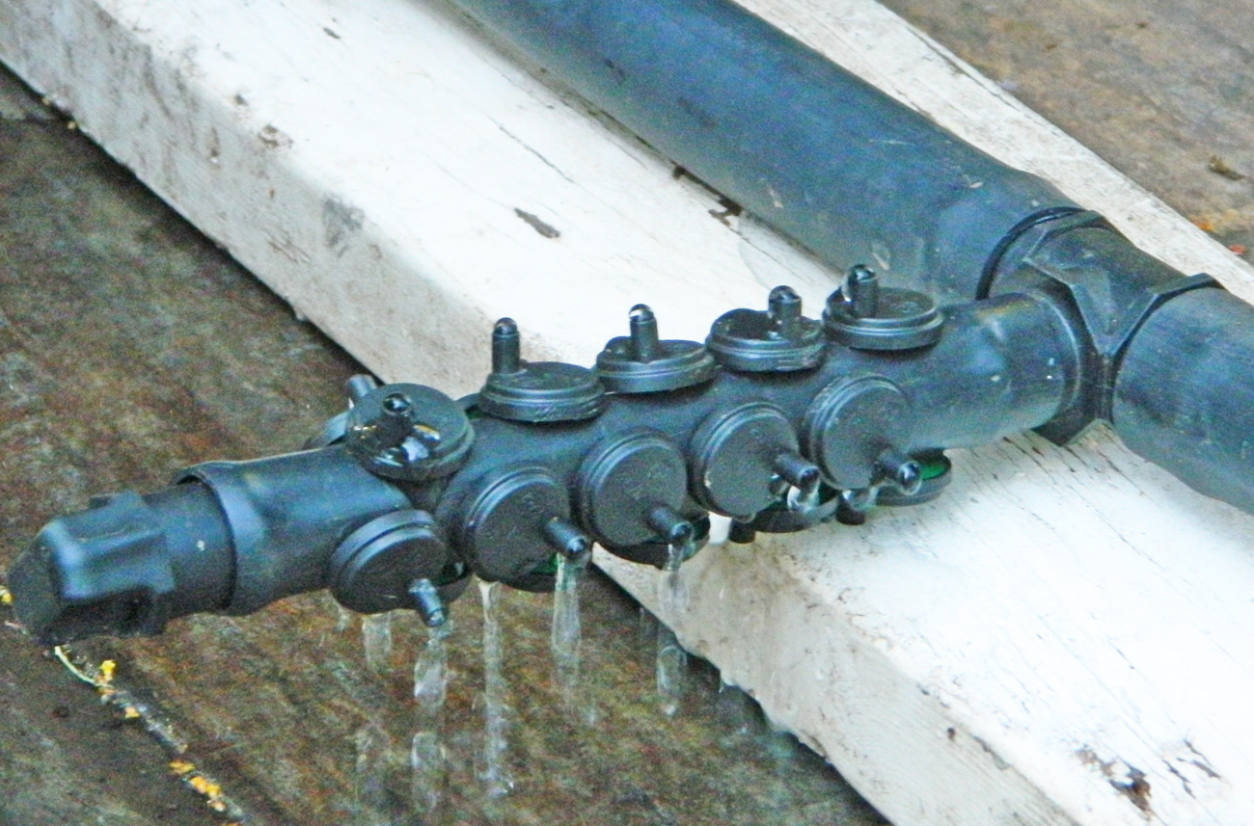
Increase the number of drippers
Replace the lower dripper with multiple identical drippers at the same level for irrigation.
Replace the upper dripper with the same number of identical drippers to form a dripper assembly that discharges water into the vertical polypipe so that all drippers outlets are open to the atmosphere.
The flow rate of all drippers must be the same.
Therefore the pressure at all drippers must be the same.
dripper assembly

Slide 3
level 0
Increase the number of levels
dripper assembly 1
dripper assembly 7
level 1
All drippers on all levels will have the same flow rate and the same pressure
level 7

Slide 4
Can we reduce the cost of the irrigation system by replacing each lower dripper with multiple low-flow drippers?
Assume the upper and lower drippers are 8 L/.H (eg Antelco Agri Drip green).
Assume the low-flow drippers are 2 L/H (eg Netafim Miniscape or Antelco Agri Drip red).
Replace each lower dripper with 8 (or 16) low-flow drippers at the same level as the lower dripper.
All of the low-flow drippers at all levels have the same flow rate and pressure.
The pressure at the low-flow drippers is one quarter (or one sixteenth) of the pressure at the upper drippers.
low-flow drippers

Slide 5
The irrigation can be automated with an Unpowered Terracotta Irrigation Controller
control dripper
terracotta pot
No solenoid valves
No conventional irrigation controller
No wires
No hose clamps (low pressure)
No high pressure pump

Slide 6
dripper assembly 1
The valve can be adjusted so that water is almost overflowing at dripper assembly 1
The seven levels can be on a very steep slope (even vertical). The lowest level can be 100 metres or more below the highest level.
Provided there is no overflow at dripper assembly 1, every low-flow dripper will discharge the same amount of water on all levels regardless of the water supply pressure and regardless of adjustments to the valve.

