Slide 1
Water is our element.
Moving Bed Biofilm Reactors and
Integrated Fixed Film Activated Sludge
Where are we coming from and where are we going
Kim Helleshøj Sørensen
Group CTO, WABAG

Slide 2
Content:
Introduction
Short history
The market situation seen from a technical point of view
Some hints on where the Technologies are going
Conclusion

Slide 3
Introduction
Speaker:
Kim Sorensen CTO, WABAG Group
> 25 year experience in the Water and Wastewater Industry and
> 20 years experience as expert in Biofilm processes. (RBC, Trickling filters, BAF, MBBR, IFAS)
WABAG Water Technology
    Systems for wastewater and water treatment
    Technologies based on internal R+D
    Wastewater
      Filtration technology (water + wastewater)
      Biofiltration: BIOPUR
      Fluidized bed / moving bed: FLUOPUR
    Further technologies
    Wastewater:
    SBR, MBR, sludge treatment, etc.
    Organisation
      Switzerland/Winterthur: 45 employees
      WABAG Group: ca.1500 employees in 20 countries

Slide 4
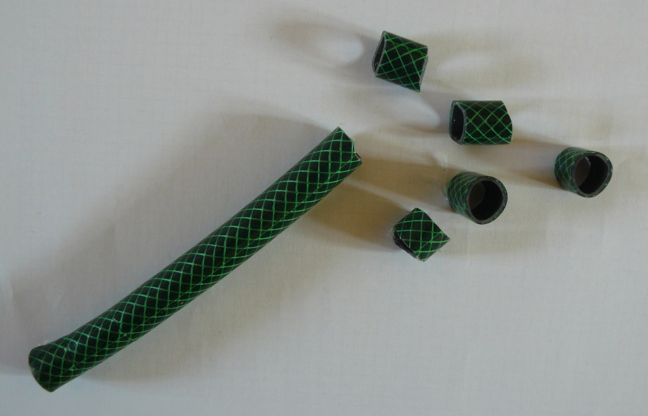
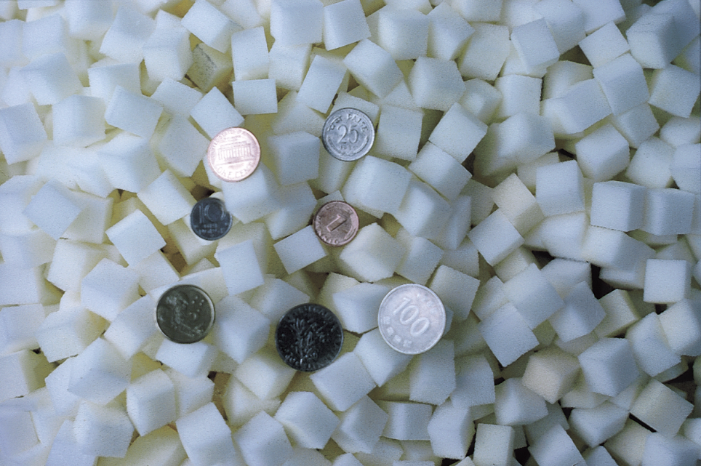
The history of MBBR
It all started out like this:
Oh well, it was quite inspired from this
Model photo: Garden hose, cut to peaces by the son of Prof. Ødegaard Christmas 1987
Linpor media First reference 1987 in IFAS Configuration

Slide 5
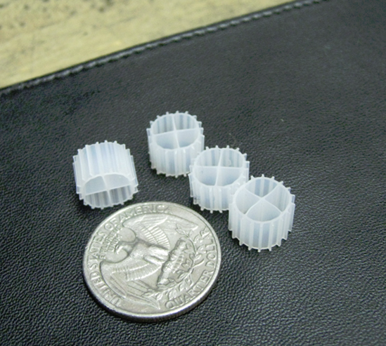
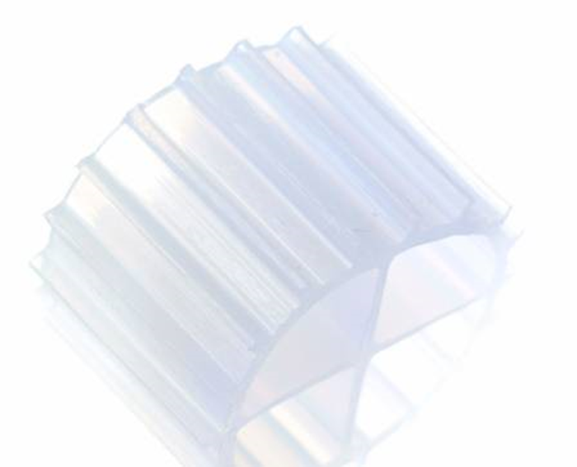
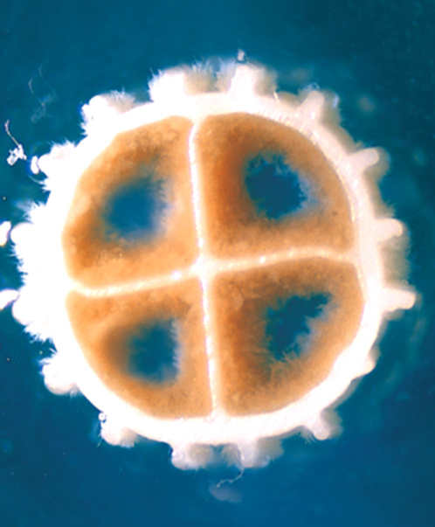
The History of MBBR
Kaldnes K1 MBBR carrier as patented by
Ødegaard et al. 1991
Well defined geometry and
specific gravity
Inner protected surface that still
allows for water flowing trough

Slide 6
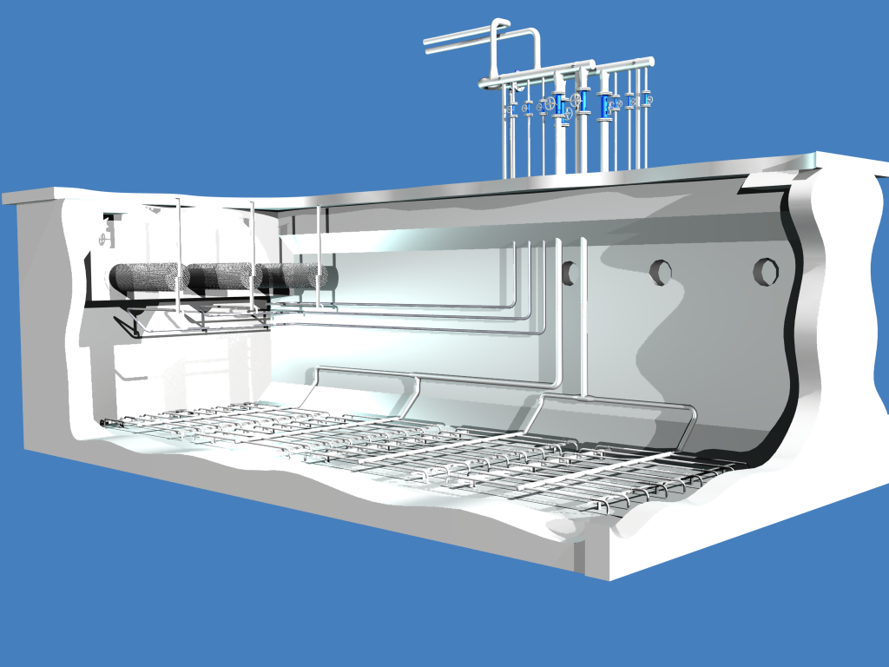
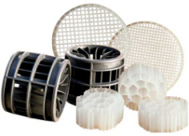
Why did Kaldnes get the reference Position they have ?
Veolia AnoxKalnes – More than 500 References world wide
Linpor 50 references world wide
1% Plastic
99% Know How

Slide 7
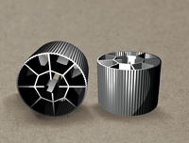
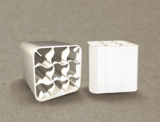
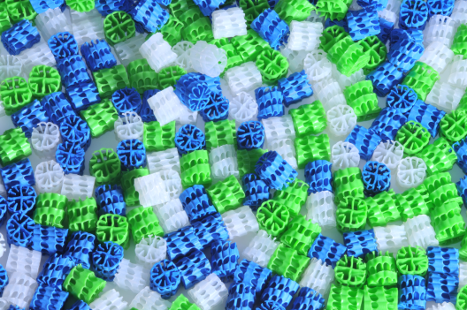
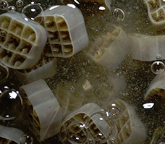
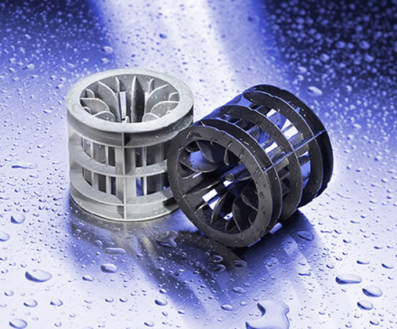
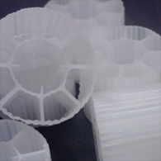
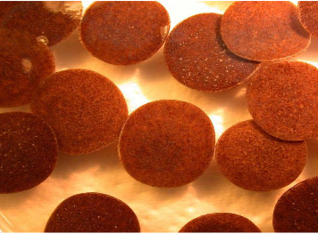
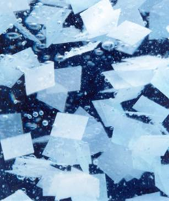
But they are not alone any more
AC 450 from Hydroxyl / Aqua Point / IDI Meteor / Headworks Bio
AC 920 from Headworks Bio
AGAR from Aqwise / World Water Works
BWT from Biowater
Floobed from Ovivo
Biofas from bioprocessH2O
Mutag Biochip from
Multi Umwelttechnologie AG
Fluopur from
WABAG Wassertechnik AG

Slide 8
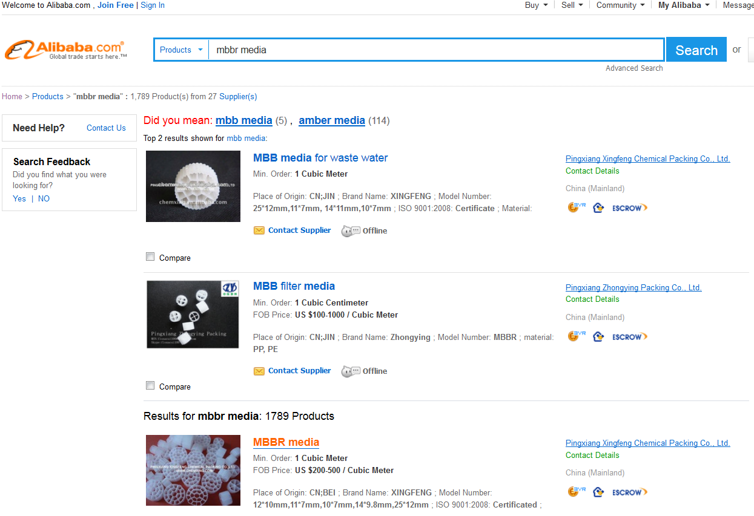
In reality it is even worse !!!

Slide 9
How to stay in the race ?
Continue the development of the Technology:
  New Media types with:
    Higher protected/active surface
    Better Oxygen transfer / Aeration efficiency
    Catalytic behaviour?
  Better screen design to avoid screen clogging and minimise Head losses
  Media Washer to control the biomass
Extend the potential market with new process combinations
  Low Oxygen MBBR-C for Carbon absorption
  Anaerobic MBBR to allow higher influent TSS were UASB has difficulties
  Very compact solutions by using low footprint TSS-removal like:
    Actiflo and other high rate lammella settlers
    UF-membranes
  Bio-P in MBBR

Slide 10
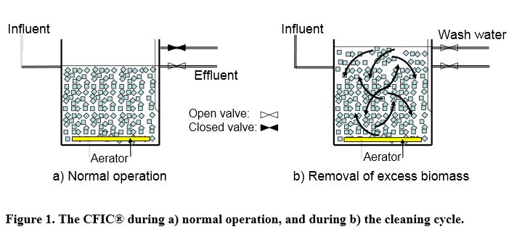
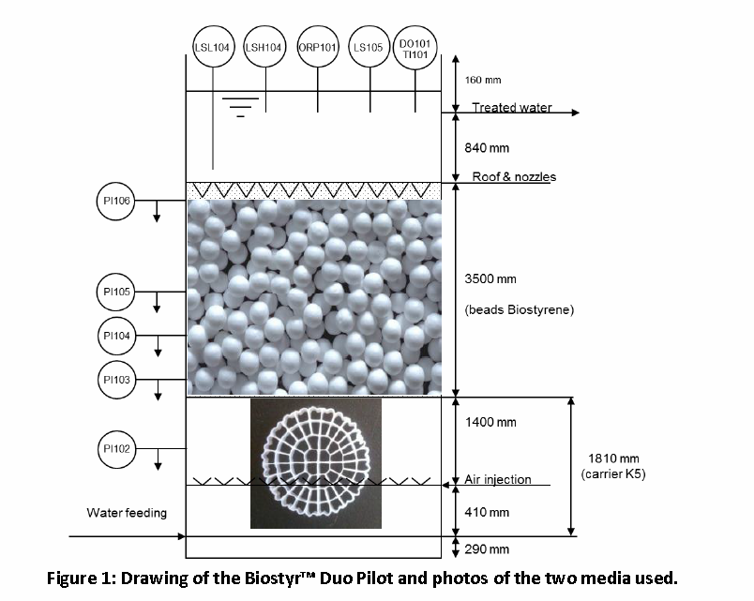
How to stay in the race
Teaming up with the enemy – If you can not beat them join them
CFIC from Biowater
BIOSTYR Duo from Veolia

Slide 11
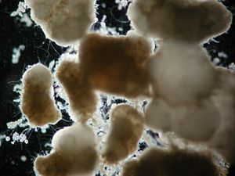
Does the future look bright for MBBR and IFAS ?
For the pure MBBR it can get difficult .
  There is a lot of Technology suppliers and only the innovative will survive
  The media price is coupled to the price of petrol
  A strong competition is to be expected from Aerobic Granular Activated sludge
Aerobic Granules
Self grown Biofilm carrier
Adds Bio-P
No clarifier
IFAS is an Ideal upgrade to existing facilities
  IFAS utilises less media than MBBR
  Only one or two set(s) of screens
  The vendors coming up with the media combining high protected surface with good Oxygen transfer will be well positioned

Slide 12
The competitors and how they compare
 | MBBR | IFAS | Activated Sludge | BAF | MBR | Aerobic Granules
Biomass type | Fixed to suspended plastic carriers | Fixed to suspended plastic carriers Free Biomass | Free biomass in suspension | Fixed on Support media | Free biomass in suspension | Fixed on self made support
Usefull surface m2/m3 | 500 -1500 | 500-1500/-- | -- | 250-1200 | -- | 2000-3000
Biomass speicalisation | Yes C; DN and N stages | Yes Nitrification on media, C- removal in AS | No, Mixed Biomass | Yes C; DN and N stages | No, Mixed Biomass | No, Mixed Biomass
Solids Inlet sensibility | 3-5 mm screening | 3-5 mm screening | 3-5 mm screening | Primary settling | 1-3 mm screening | 3-5 mm screening
Outlet Sludge concentration from reactor (g/l) | 0.3 - 0.5 | 2-4 | 2-5 | N/A | 10-12 | N/A
Sludge separation | Clarifier or flotation | Clarifier | Clarifier | N/A | Membranes | N/A
Volumetric loading kg BOD₅/m³/d | 0.7-3 | 0.6 | 0.3 | 0.2 -2 | 0.5 | 3

Slide 13
Conclusion
The MBBR and IFAS market are well behind the point of early adapters and has become very competitive
Technology supplier are working at high speed on developing their second generation solution
Newer technologies like Aerobic Granules will push the market
Having the right media with the good screening technology will still assure a sweet spot in extension of existing activated sludge plant to IFAS.

