Slide 1




Engineering, Procurement and Construction services

Slide 2
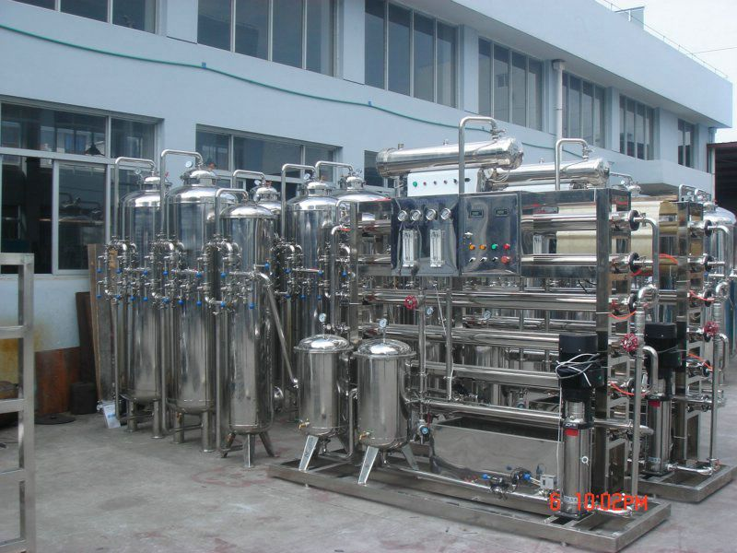

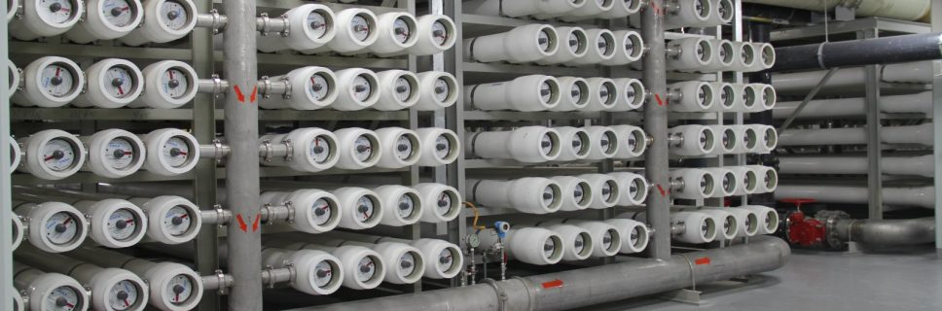
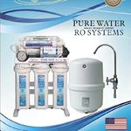
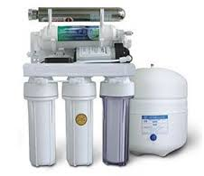
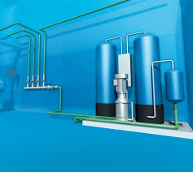
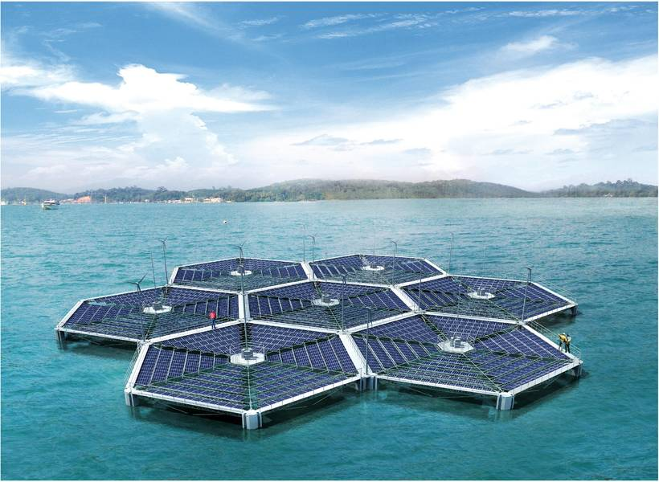
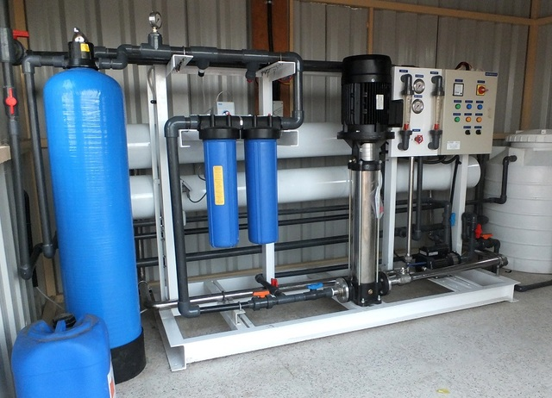
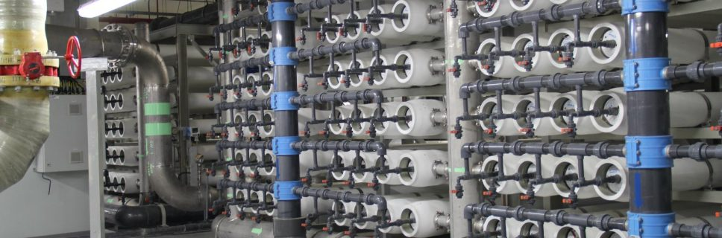

Slide 3

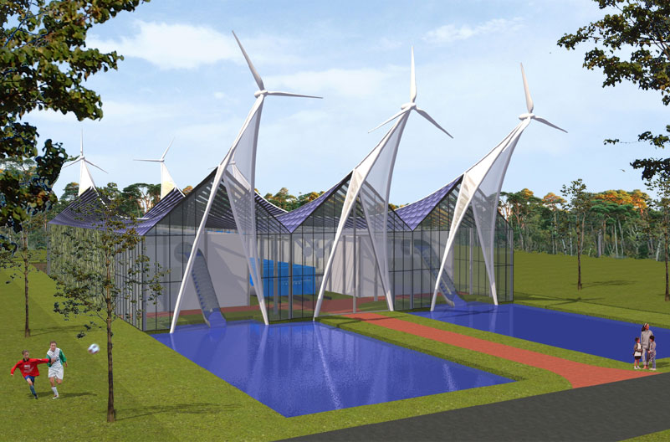
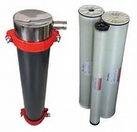
Technical evaluation
Visit the site, carry out technical survey, analytical, measurement (if required) and submit technical report with recommendation to improve the process and operations
Design review Support our client in technical to ensure that the new plants / units (supplied by others) fits to the purpose it is intended to.

Slide 4

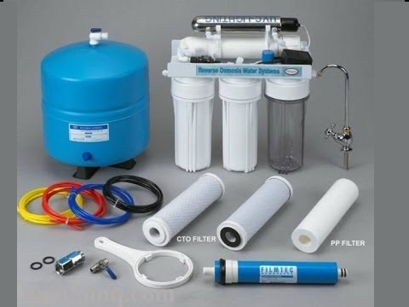

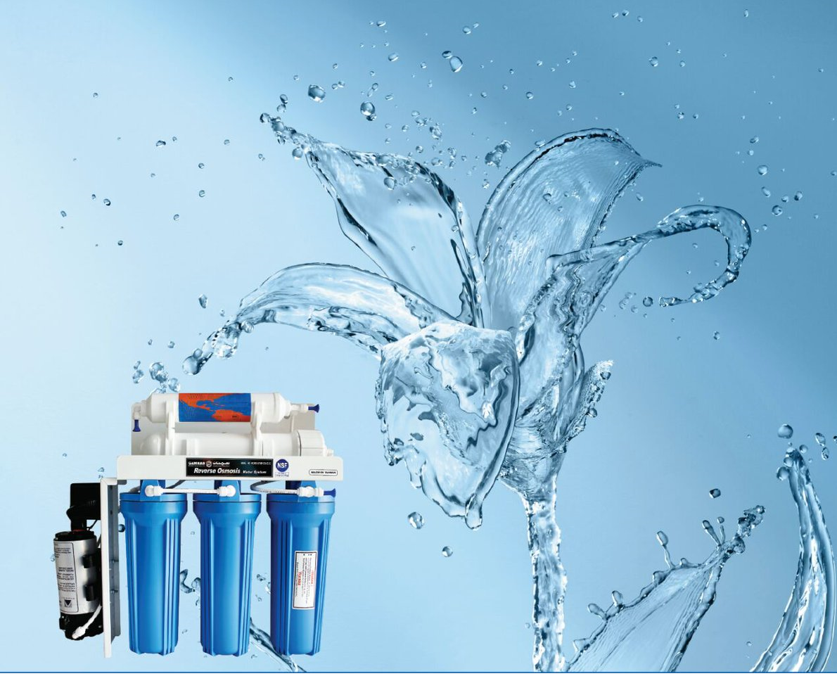
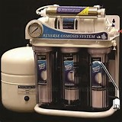

Slide 5
Operation and maintenance Services. Having qualified and trained engineers, operators and technicians allow us to provide our client one of the following services : Operation and maintenance -24/7 (OM-247) 24/7 operators available in the plant 7 days a week preventive maintenance with staffs that will visit the plant to maintain the plant as per preventive maintenance schedule/plan Available staff to call during emergency and breakdown Preventative / break down maintenance service (MS-365) Annual service agreement cover monthly visit to maintain the plant and response to breakdown and reactive maintenance. i.e maintenance activities for 365 days a year , with a monthly visit and on call basis visit Laboratory analysis (LA-365). Using high quality lab equipment’s that are regularly calibrated and manage by a qualified lab technicians Analysis for our client as a third party , either regular basis or one time only . All services are custom made and designed to meet our client requirements

