Slide 1
Streaming Current Workshop

Slide 2
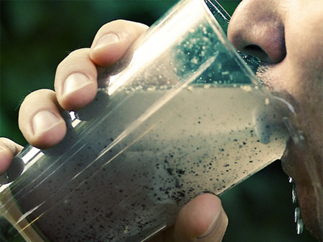
Why Our Customer Needs Streaming Current
Nothing is more important to maintaining acceptable
finished water quality than maintaining optimum
coagulation. This requires continuous adjustment of
coagulant dosing as water quality changes.

Slide 3
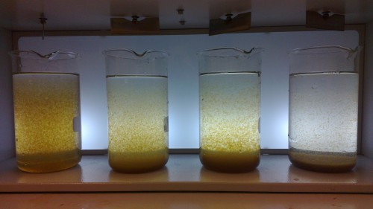
Coagulation
The use of chemicals to make very fine particulate
gather or clump together so they will settle out of the
water and be of a more filterable size.

Slide 4
Charge Neutralisation
The addition of a coagulant, at a precise dosage, will neutralize charged particles and soluble impurities, resulting in the formation of floc particles which can then be settled or filtered.

Slide 5
Double Layer Model

Slide 6
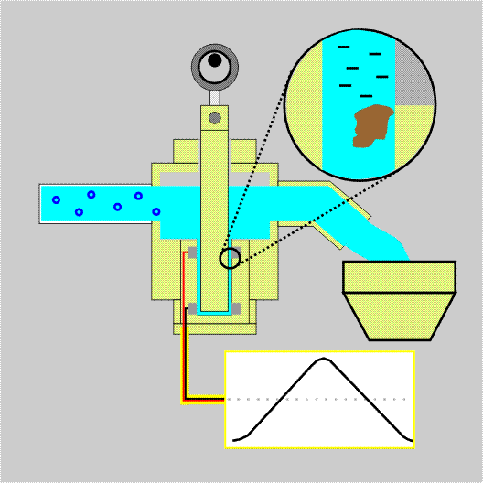
Charge Measurement
Streaming Current Technology
Reciprocating Piston
Probe With 2 Electrodes Embedded In Annulus
Colloidal / Ionic Adsorption
High Flow Velocity Causes Ion Displacement
Difference In Potential Arises Between Electrodes

Slide 7
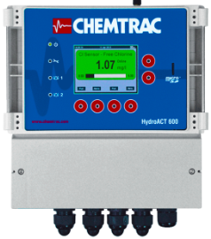
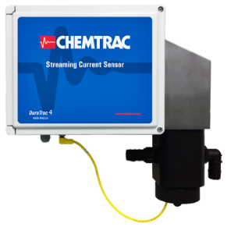
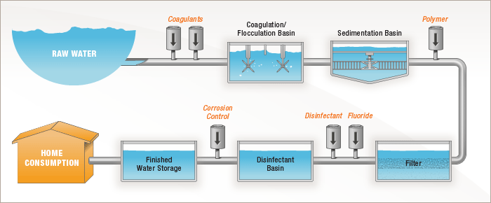
Sample Point
HA600
SCM
-250
-10
-200
-180
-120
Filter Aid
-75
Chlorine
Chlorine
Coag
MIXING
FLOC BASIN
SEDIMENTATION
FILTRATION
FINISHED

Slide 8
Manual Adjustment
Coagulant Pumped
Manual Pump Adjustments
Coagulant Demand
Notes:
ONE MUST MANUALLY ADJUST COAGULANT PUMP
NOTE UNDERTREAT/OVERTREAT PERIODS
NORMALLY OVERTREAT TO COVER PERIODIC RISES IN DEMAND

Slide 9
Chemical Feed Controlled By
Streaming Current
Coagulant Demand
Coagulant Pumped
Notes:
COAGULANT PUMPED SHOULD FOLLOW DEMAND REASONABLY CLOSELY

Slide 10
Streaming Current Facts
Measures Charge Neutralization Only
Other Coagulation Mechanisms Exist, But SCM Doesn’t Measure
If SCM Doesn’t Respond To Coagulant, Then Coagulant Isn’t Doing Charge Neutralisation (At Least Not At That Point In The Process)

Slide 11
New Developments Expanding Application Of Online SCM
Higher Alkalinity / Higher pH Water Traditionally A Challenge for SCM.
Some Plants Show Willingness To Feed Acid To Reduce pH, But Very Few Do
High Basicity Polyaluminum Chloride (PACL) and Aluminum Chlorohydrate (ACH) Are Game Changers For SCM

Slide 12
Water Quality Parameters That Impact Coagulation
Changes in:
  Coagulant Dosage
  Turbidity
  Organics
  Disinfection / Oxidation
  pH
  Temp

Slide 13
Water Quality Parameters That Impact Streaming Current
Changes in:
  Coagulant Dosage
  Turbidity
  Organics
  Disinfection / Oxidation
  pH
  Temp
Notes:
Streaming Current is the only measurement used for coagulation measurement and control that responds to all the variables that impact coagulation.

Slide 14
Benefits
Streaming Current (charge) measurement allows for the monitoring and accurate control of coagulant dosing.
Allows for immediate response to changes in raw water quality or problems with chemical feed systems.
Helps maintain consistent treatment results and reduces operating cost.

Slide 15
Streaming Current
Biggest Markets are Drinking Water Plants, Paper Mills, Power Plants, Petro/Chem Plants
The more variable the raw water quality, the more they need our technology.
In Industrial Markets, equipment is often purchased by chemical suppliers like Nalco, Ashland, Kemira, etc.
We are the only company who can sell a complete coagulation monitoring solution under one analyzer.
VERY IMPORTANT – Coagulants are not all the same, some will do very little charge nuetralization. It is critical you fill out application questionnaires and send them to us.
Notes:
15

Slide 16
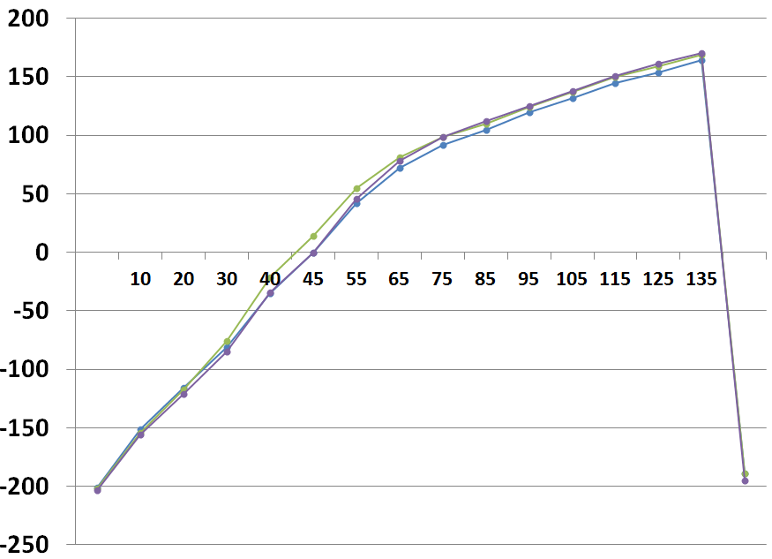

Slide 17
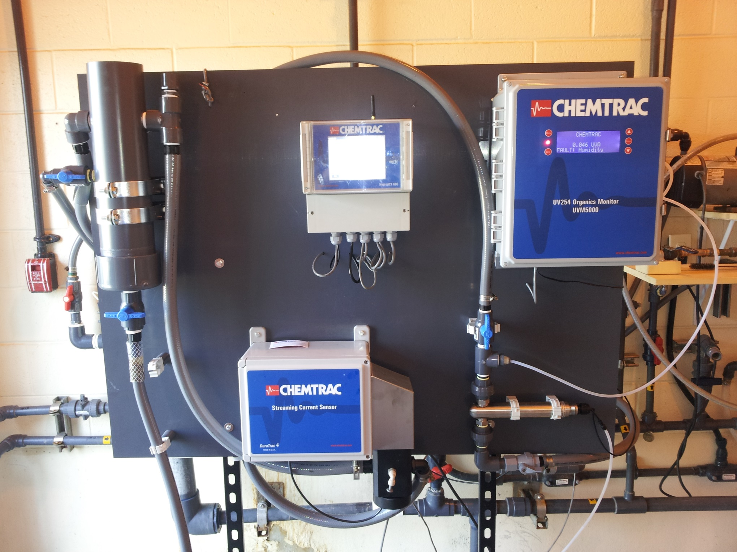

Slide 19
Canal Rd, NJ

Slide 20
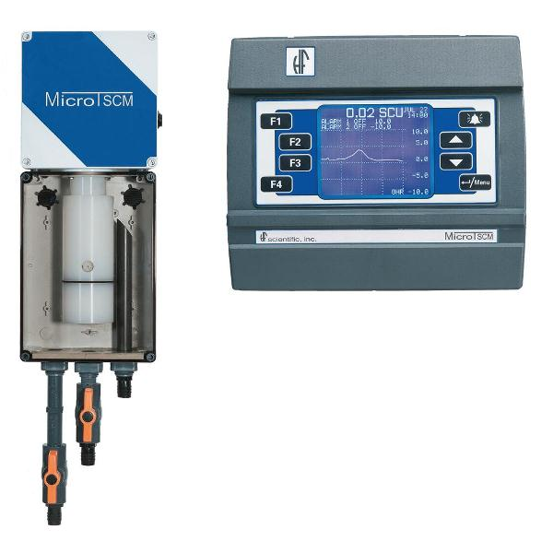
HF’s “Calibration”
Calibration Solution Is Low Conductivity DI Water With Very High Dosage Of Cationic Polymer
Equivalent To Calibrating A 0-100 NTU Range Turbidimeter Using 1,000 NTU Standard.
Does Nothing To Verify Instrument Responsiveness, Repeatability Around Neutral.

Slide 21
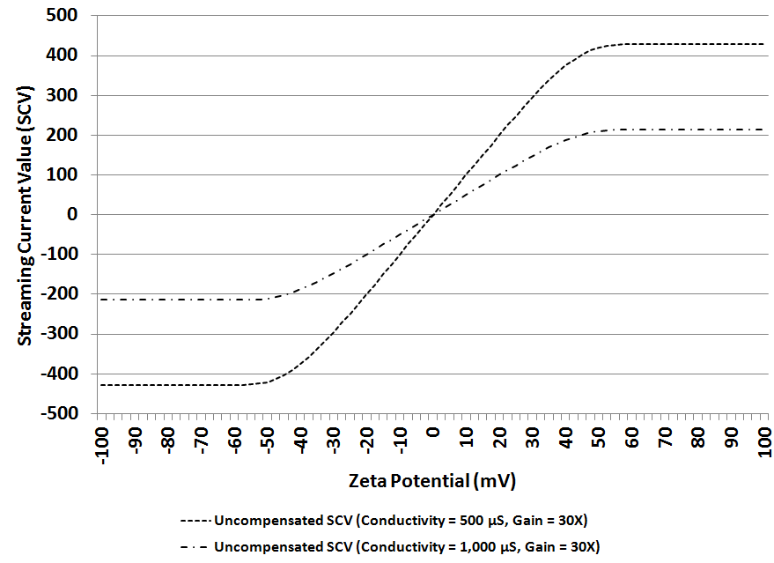
Streaming Current Response

Slide 22
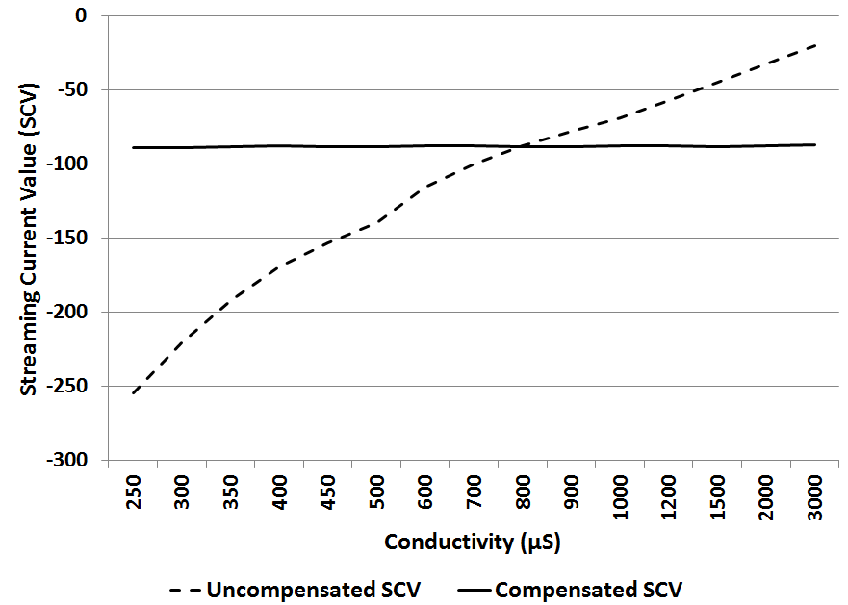
Conductivity Compensation

