Slide 1
A “Down-the-Hole” Hammer is probably the most important component on the drill rig and the DTH system holds many advantages over other alternatives, for instance: Rotary Drilling is fine for large diameter holes in softer more friable rock but less effective in hard rock or where small diameter holes are needed. Top Hammer (Drifter) drilling systems can produce satisfactory results for short hole drilling in hard homogenous rock conditions but would likely experience difficulty in deep holes and in soft ground with large diameters. The DTH system is by far the most versatile and can be used very successfully in a wide range of ground conditions from soft, through medium to very hard.

Slide 2
When you need to drill high quality holes with diameters between 100-254 mm, DTH (Down The Hole) drilling is by far the best and most effective method. DTH drilling can be performed in most types of rock, hard or soft. It's a commonly used method in the mining industry (blast hole drilling), water well drilling, construction, and in the oil and gas industry.
In DTH drilling, the drill string rotates while the drilling hammer continuously strikes down into the rock. Inside the hammer, a piston powered by compressed air gives the drill bit its striking power. This combined with the rotational movement means the rock is crushed in a very efficient manner.

Slide 3
Because the power transfer takes place down in the hole when the piston strikes directly at the bit - hence the drilling method's name - there is minimal energy losses along the drill string and holes can be drilled down to 6,000 meters in depth. DTH is a reliable method that drills stable holes with exceptional straightness.
The method is also excellent both environmentally and socially because it produces far less noise and vibration than many other drilling methods, making it a widely used drilling method in cities and other populated areas.

Slide 4
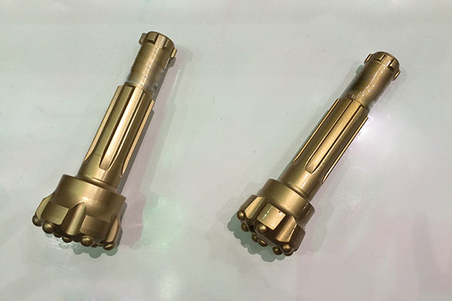
Down The Hole Drilling Tools
DTH bits and DTH hammer have various sizes and styles are available and applicable for drilling different kinds of rock formations.

Slide 5
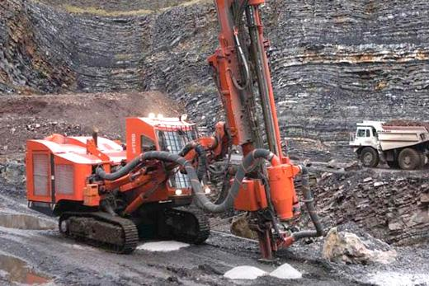
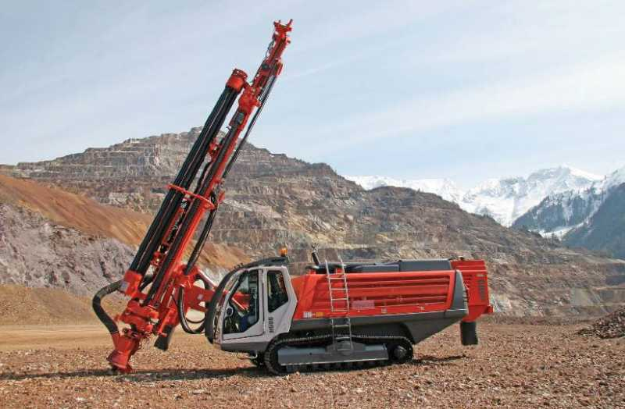
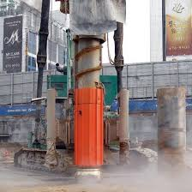
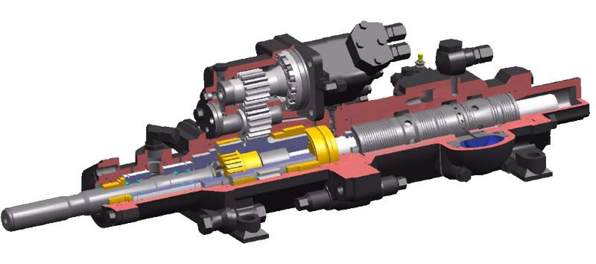

Slide 6
Some unique features of the DTH system:
1. Capable of drilling in almost all ground conditions.
2. Constant energy directly behind bit provides speed with less power loss and greater hole accuracy.
3. Rigid drill string improves hole alignment.
4. Air flow volume provides efficient flushing and cleaner holes.
5. Choice of hole diameters are available with the same hammer.
6. Easy to service and maintain.
7.Large chip drilling provides speed with minimal dust emission.

Slide 8
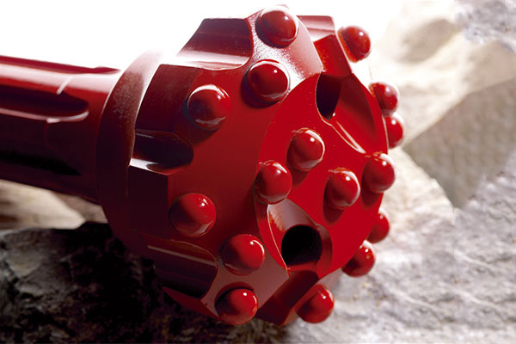
REVERSE CIRCULATION DRILL BITS

Slide 9
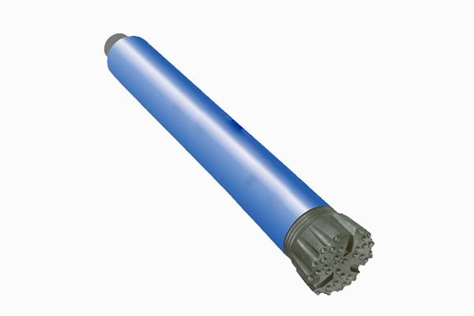
AIR DTH HAMMER

Slide 10
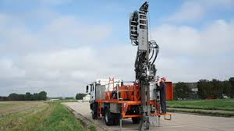

Slide 11
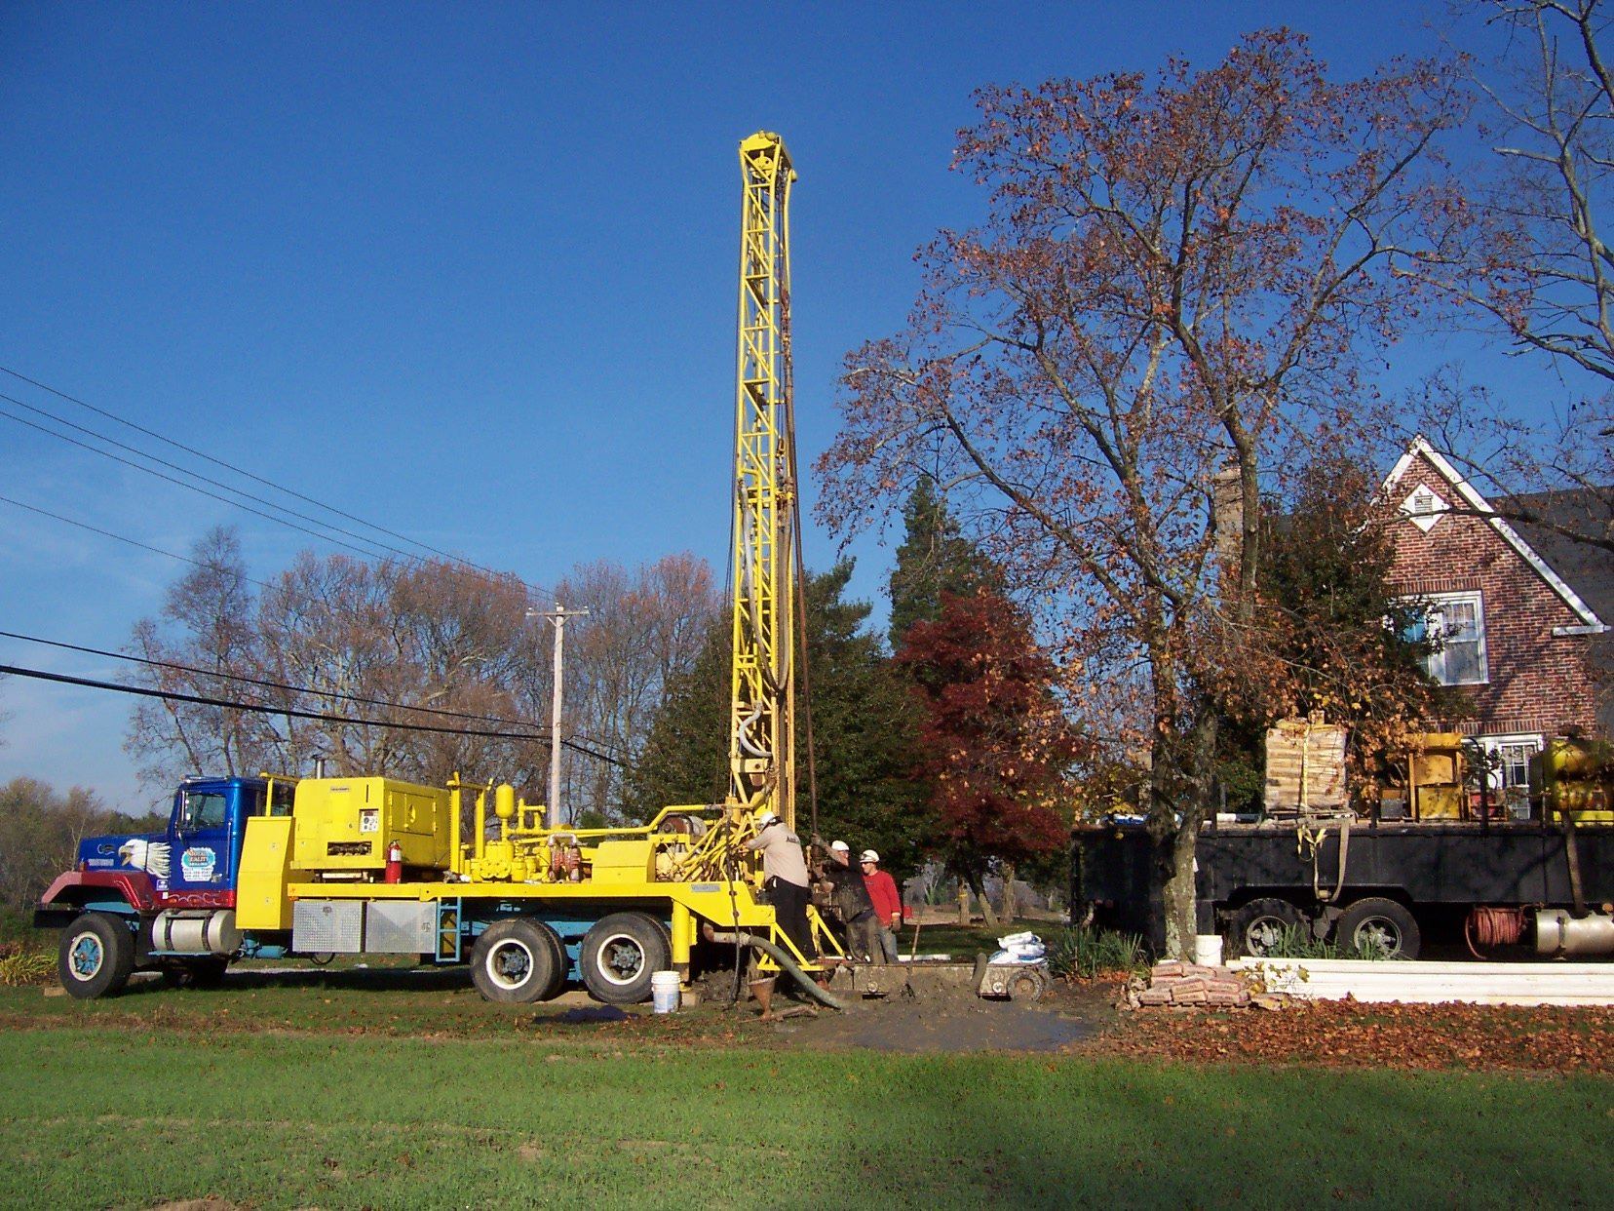

Slide 12
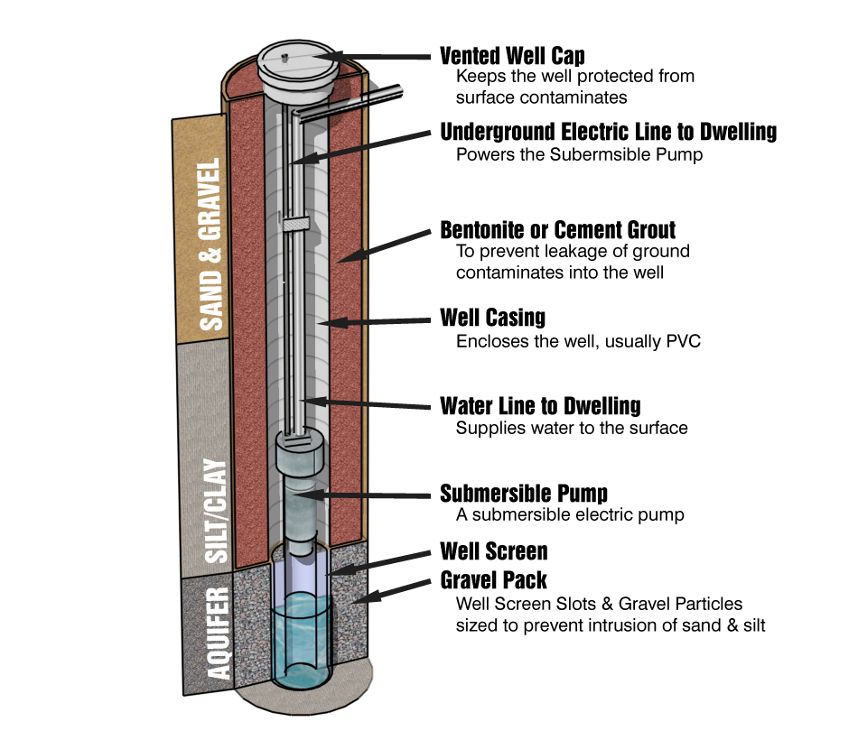

Slide 13
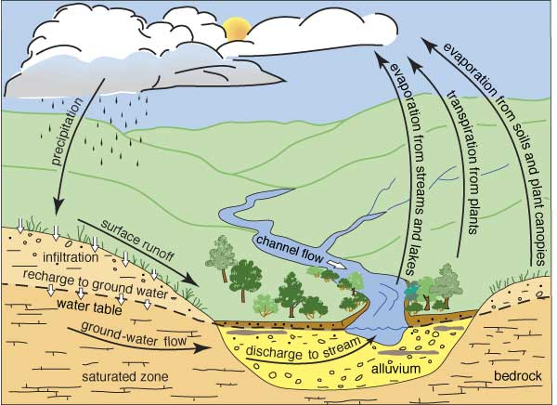

Slide 14
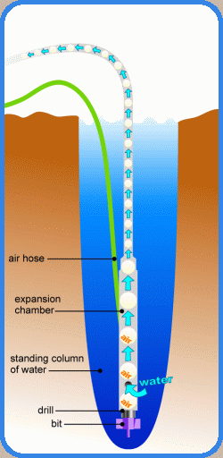

Slide 15


Slide 16


Slide 17


Slide 18
