Slide 1
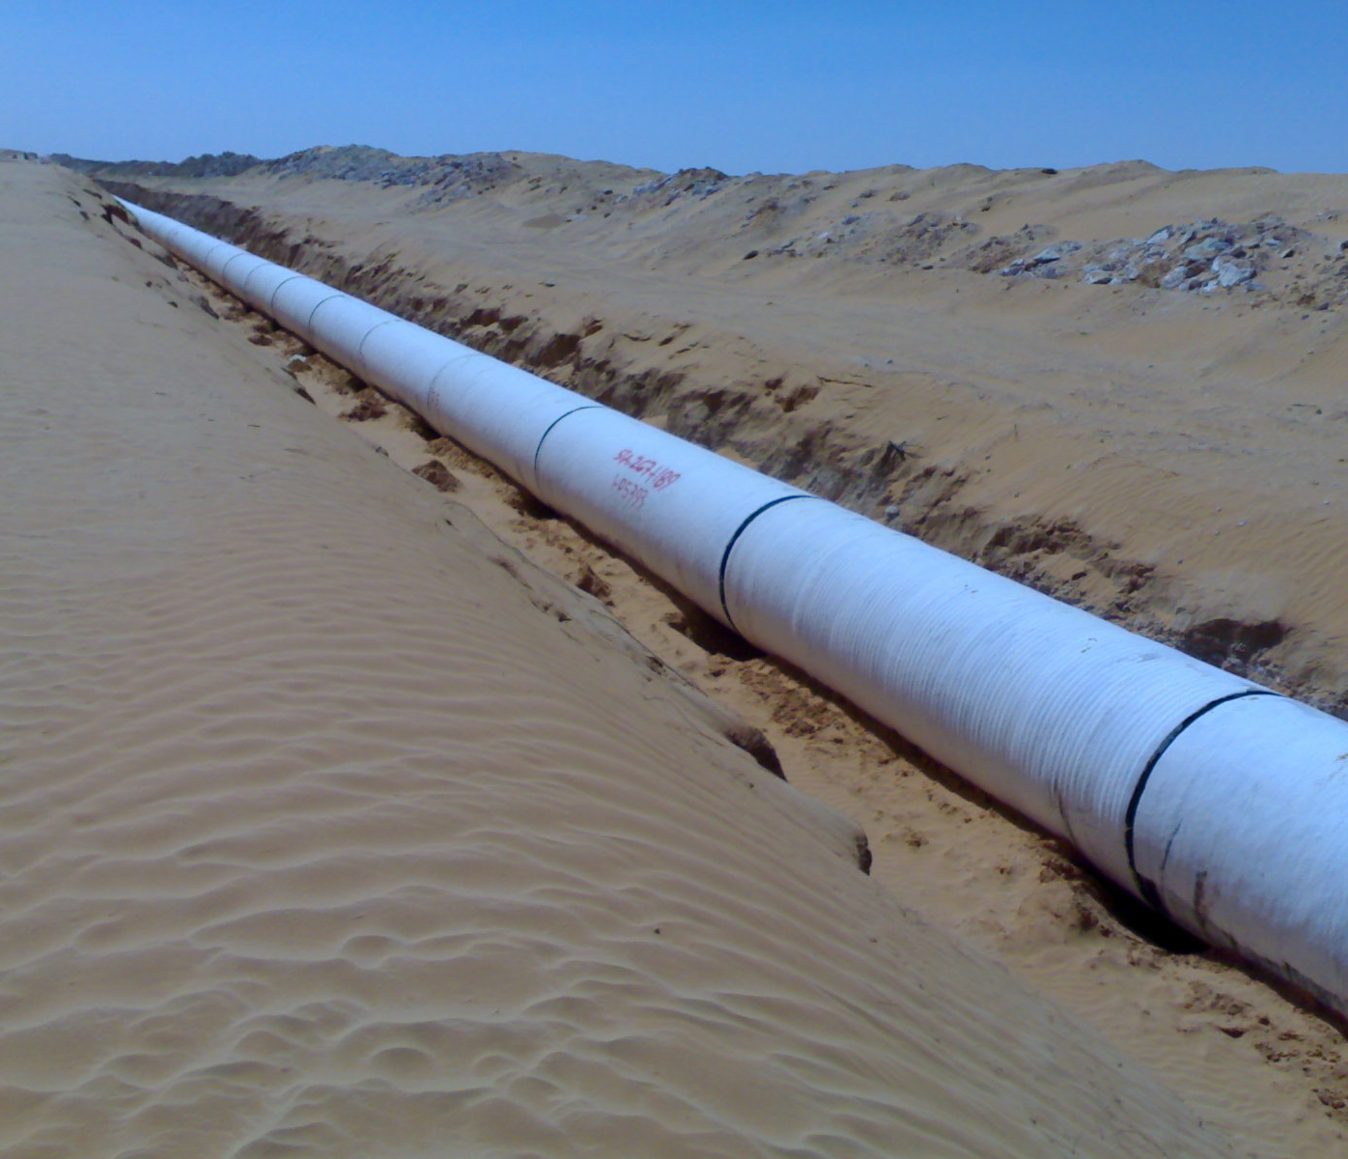
Ghadames Project – Conveyance Line
PCCP DN1600 Conveyance Pipeline used for transport of water from the Nubian Sandstone Aquifer System located in Sahara near the city of Ghadames up to coastal area of Libya.
About 423km of PCCP DN1600 pipes have been installed from Ghadames Water Well-fields over 4nr Pump Stations with associated Forebay Tanks, 1nr elevated Regulating Tank, 1nr Flow Control Pressure Break Tank, 25nr Turnouts to the coastal city of Zuwarah.

Slide 2
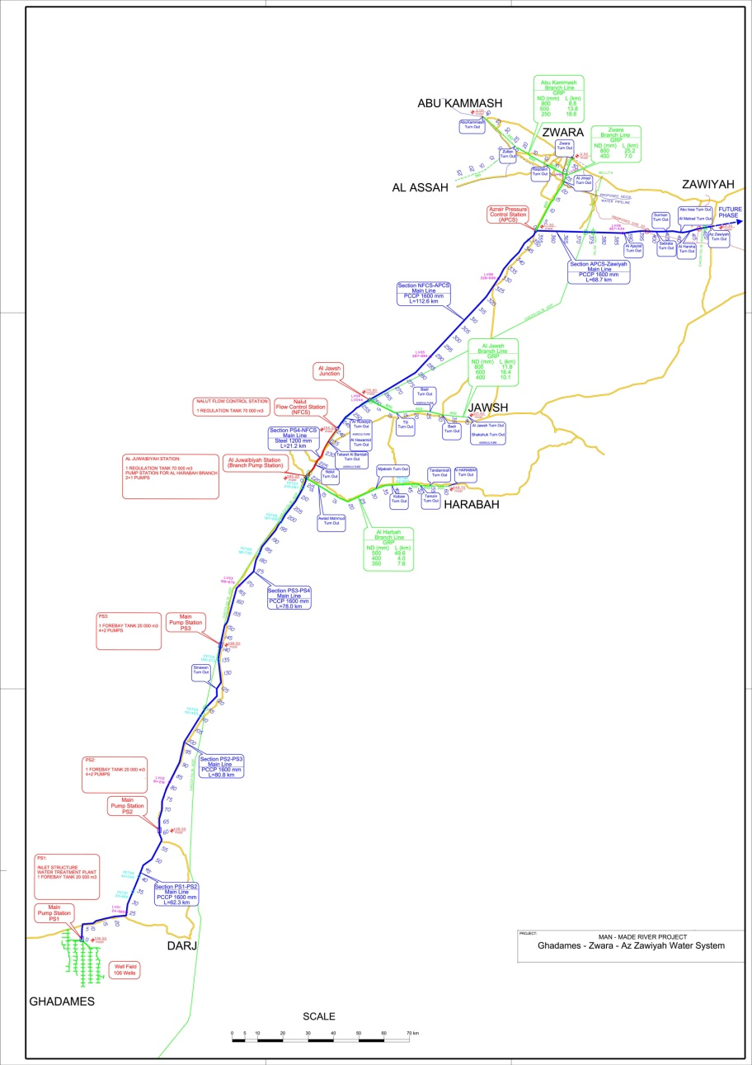
Man-Made River Project / Ghadames Project
Ghadames – Zuwarah – Azzawia Water System (GZAWS) – Coneyance Line

Slide 3
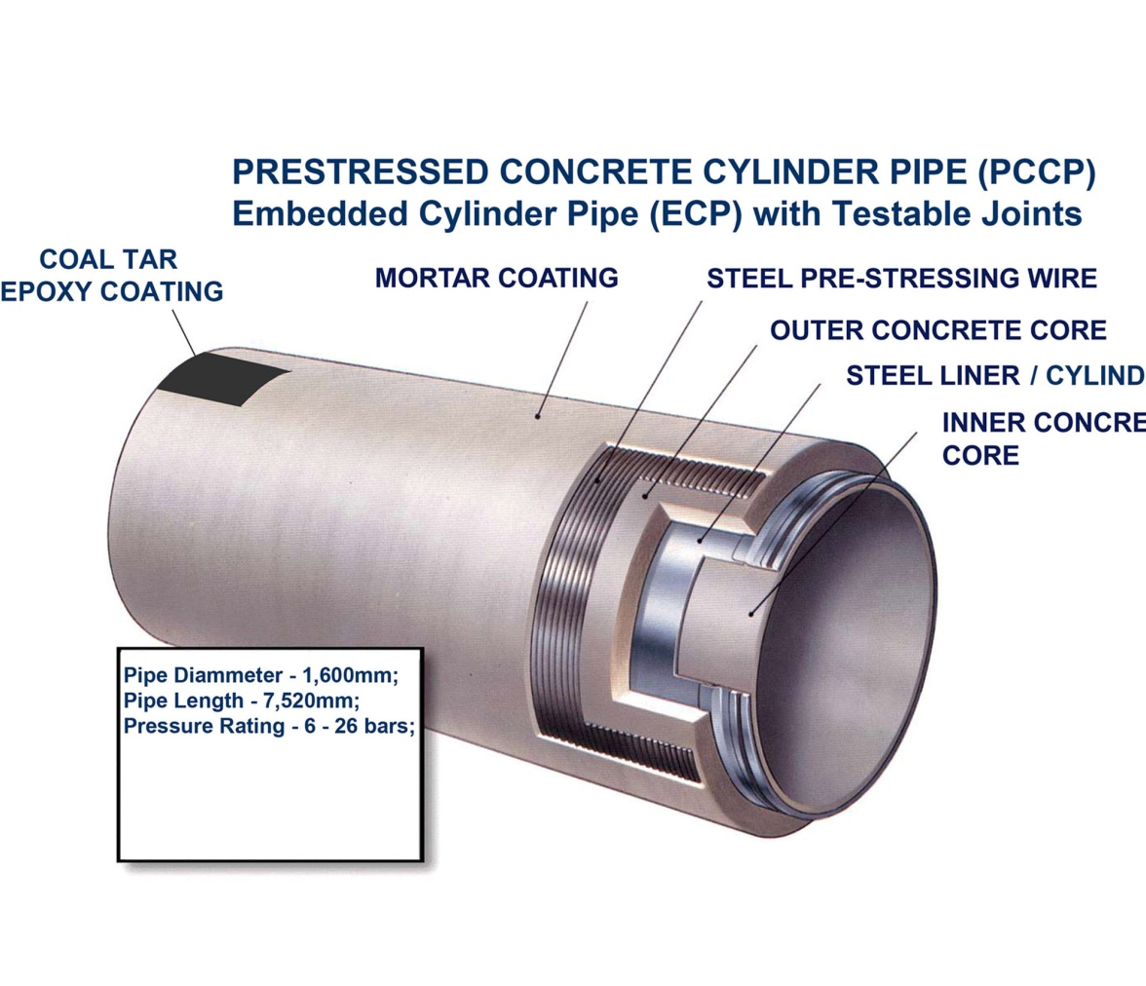
Pre-stressed Concrete Cylinder Pipe (PCCP)
PCCP Pipes DN1600 were produced by Libyan BREGA Plant, as per original design of Price Brothers (UK)

Slide 4
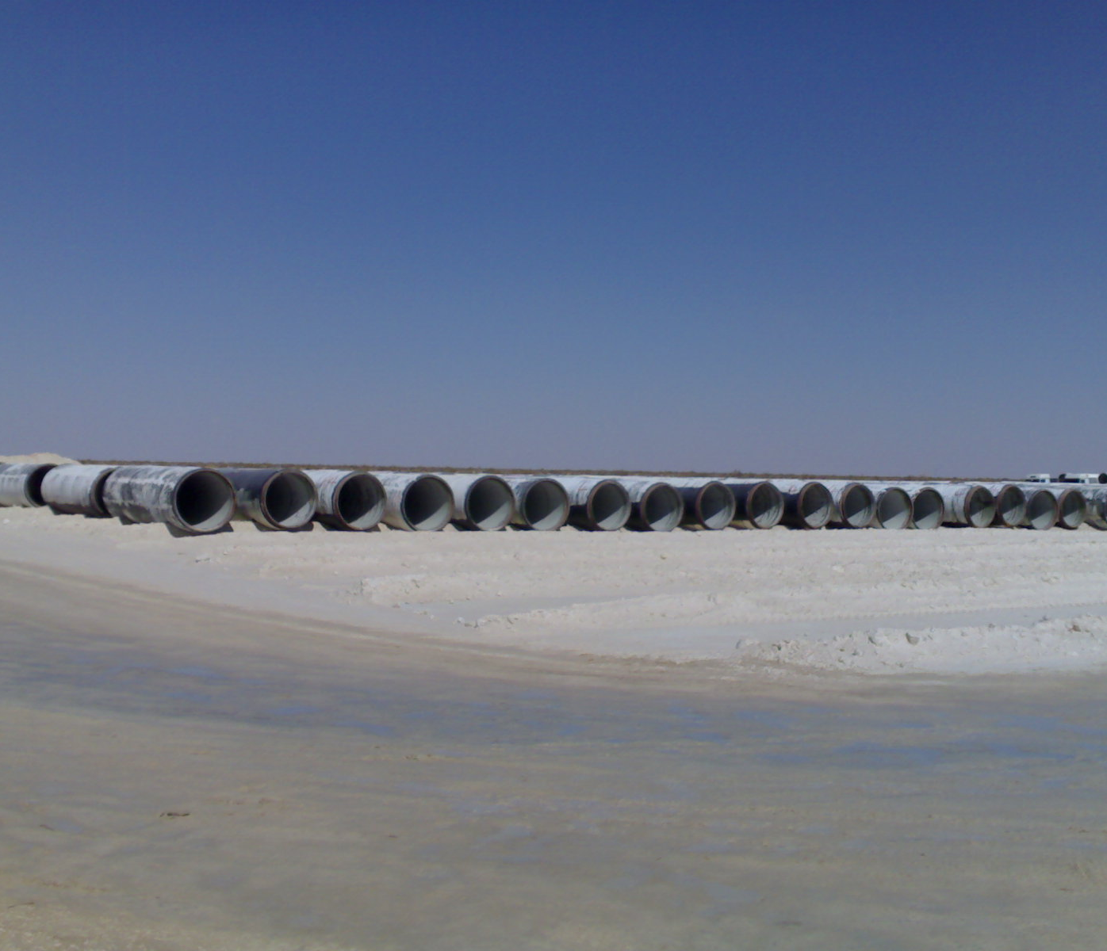
PCCP Pipes Stockyard
Along 423km long main conveyance pipeline route 4nr Camps have been erected with its own Stockyards from where PCCP Pipes have been transported along the Haul Road following the designed pipeline route

Slide 5
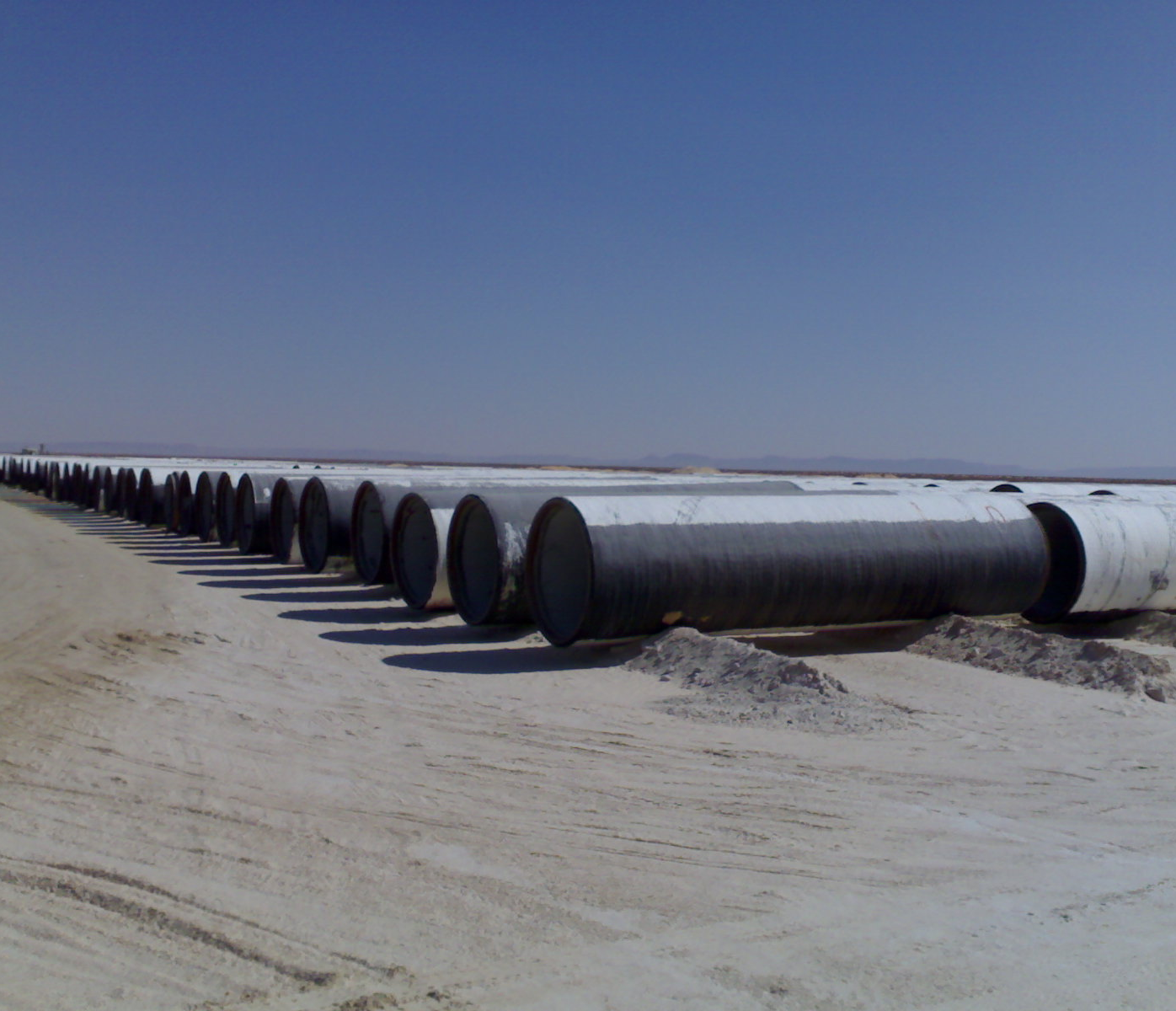
PCCP Pipes Stockyard

Slide 6
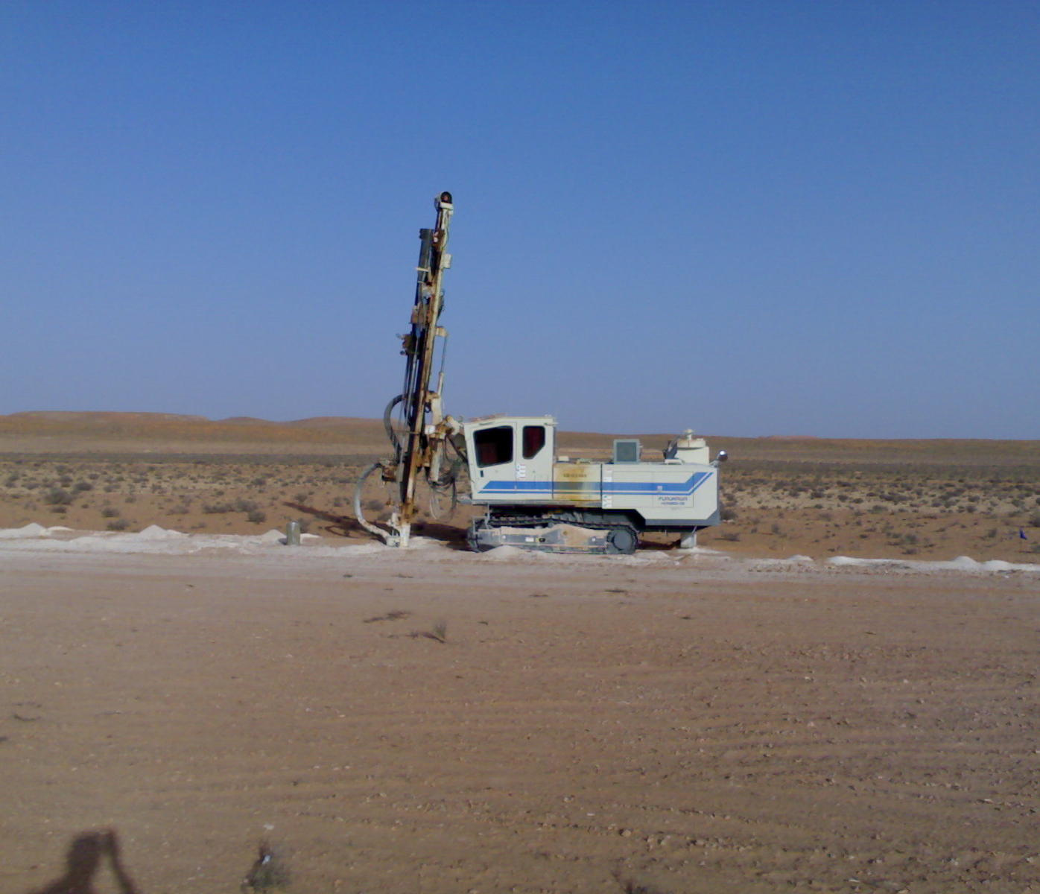
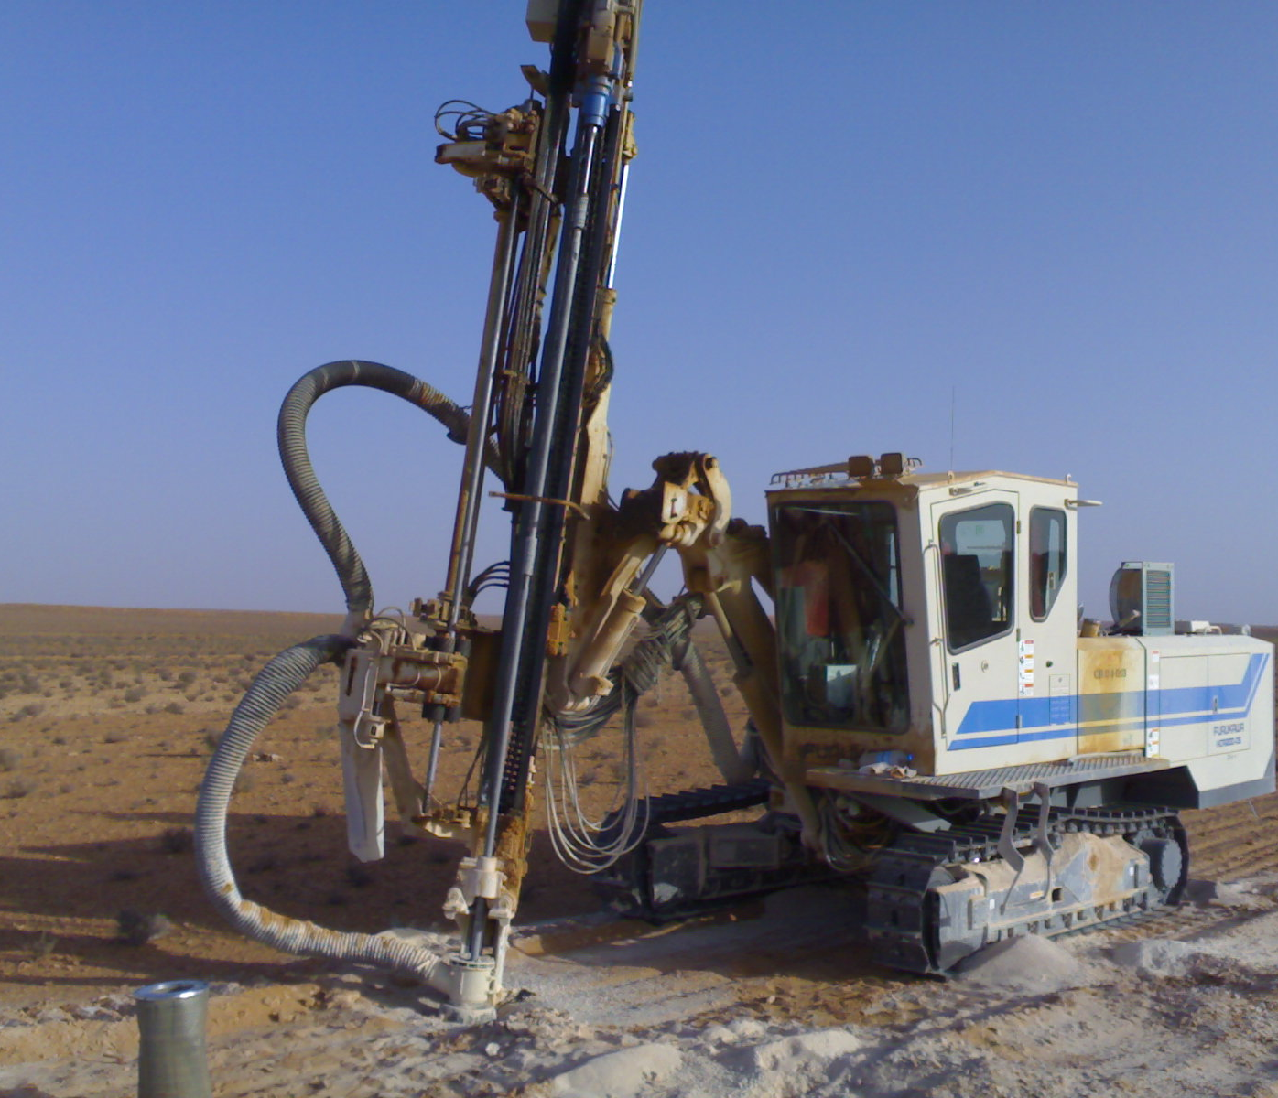
Trench Rocky Area – Drilling for Blasting

Slide 7
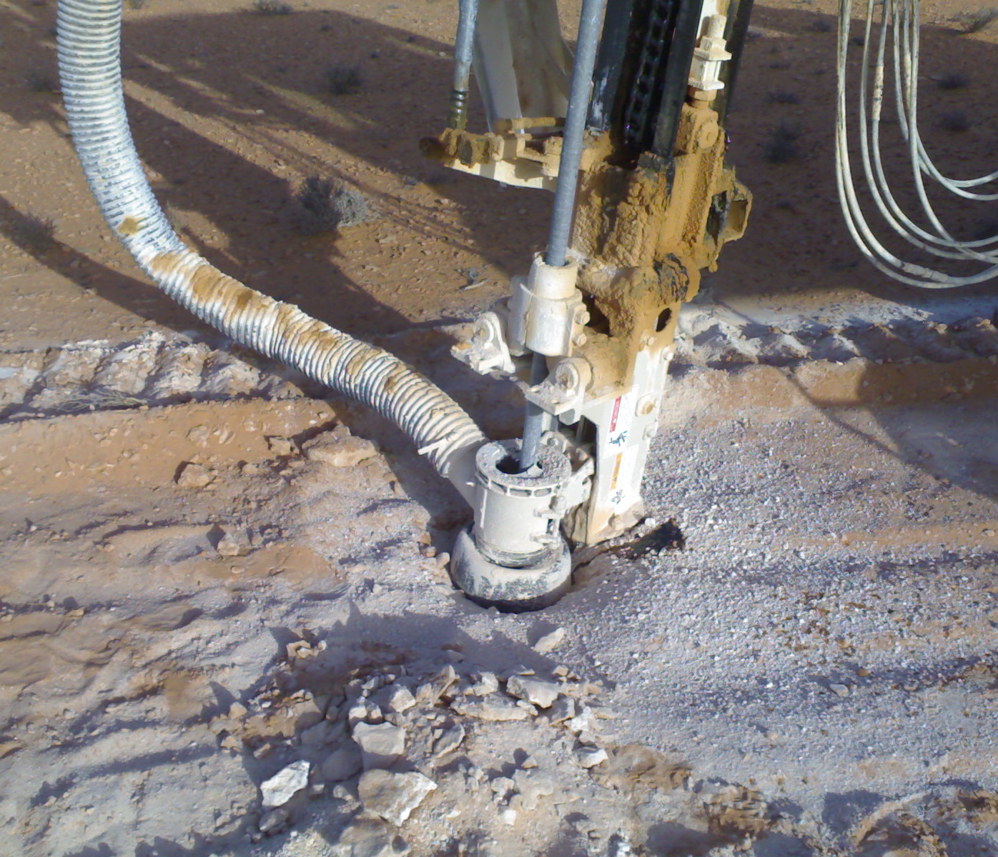
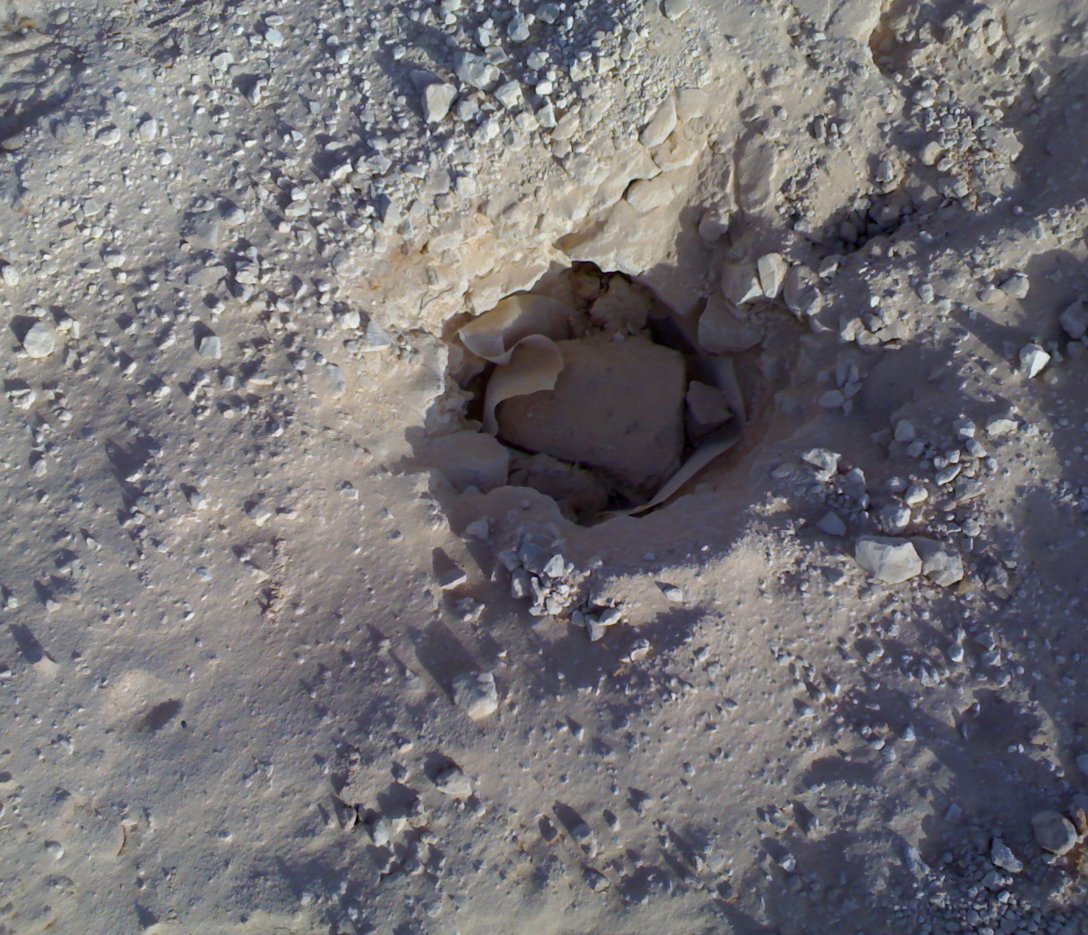
Pipe Route Rocky Areas Drilling / Blasting
Blasting Charges placed

Slide 8
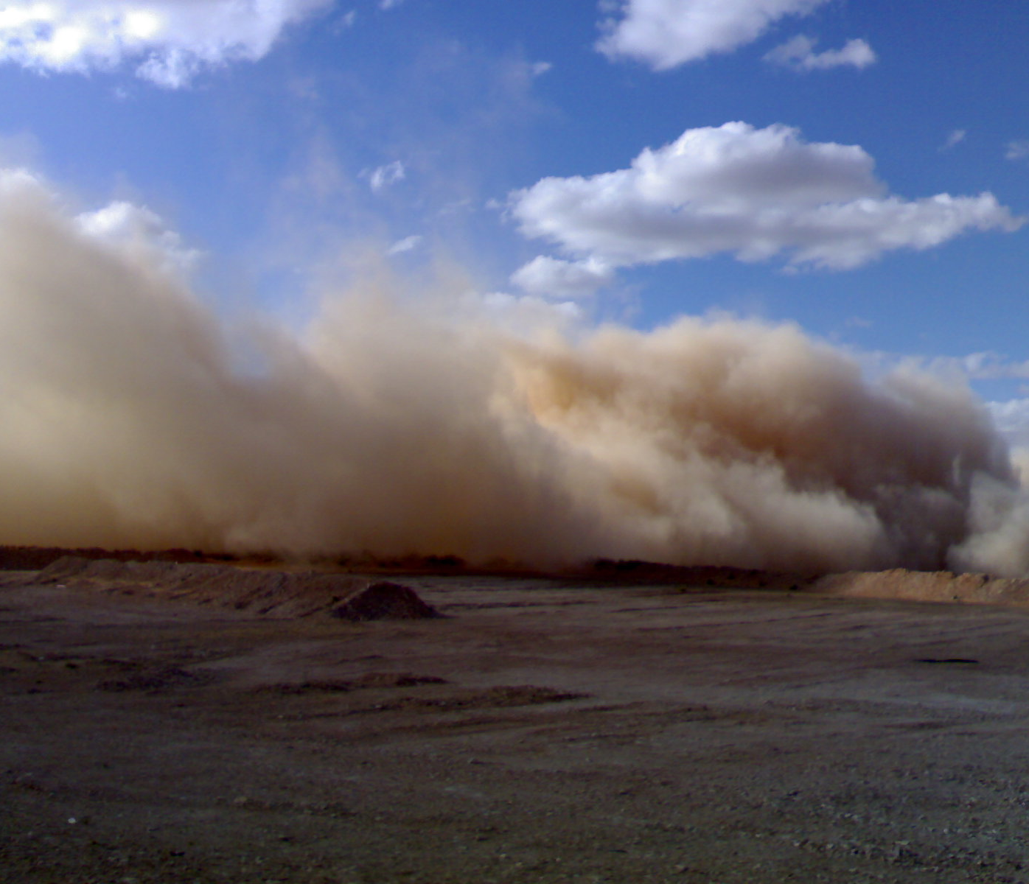
Blasting of Rocky Areas

Slide 9
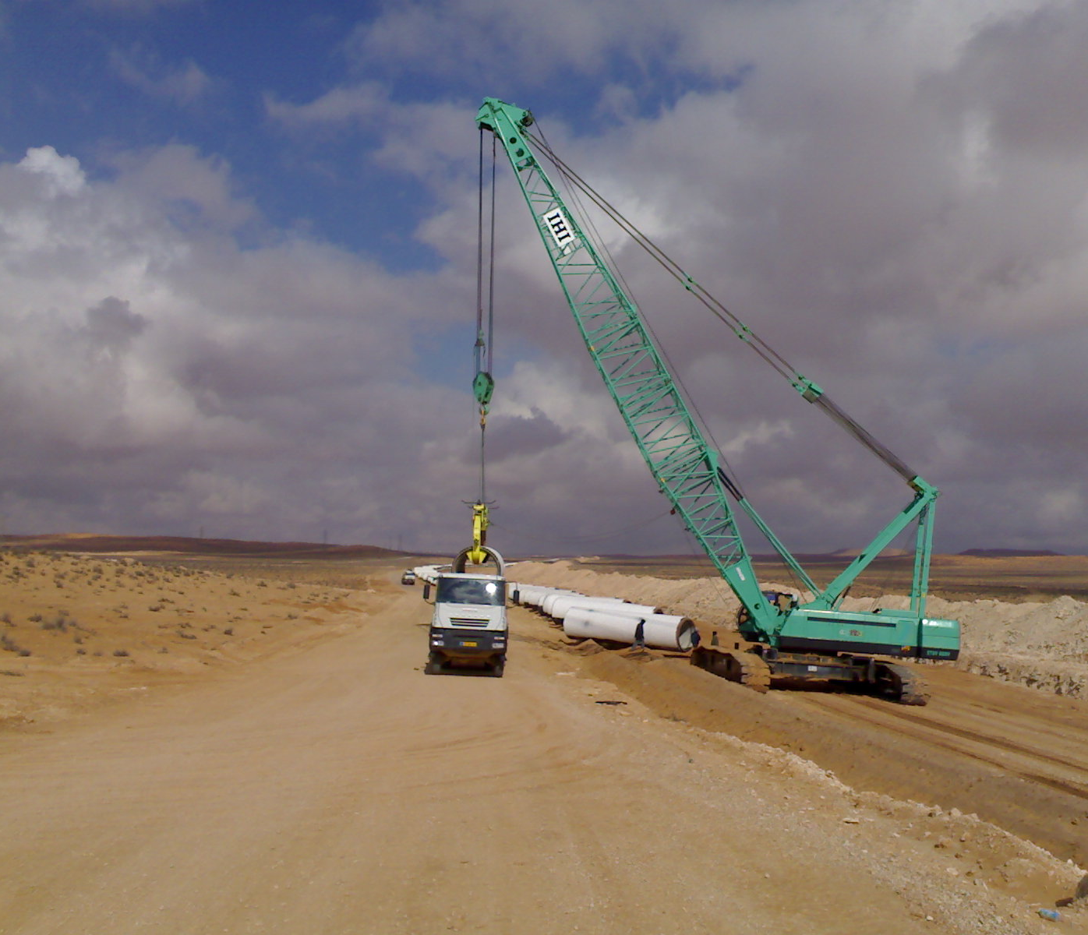
Pipe Receiving on Windrow
PCCP Pipes were delivered on windrow between trench and haul road along 422km long pipe route.

Slide 10
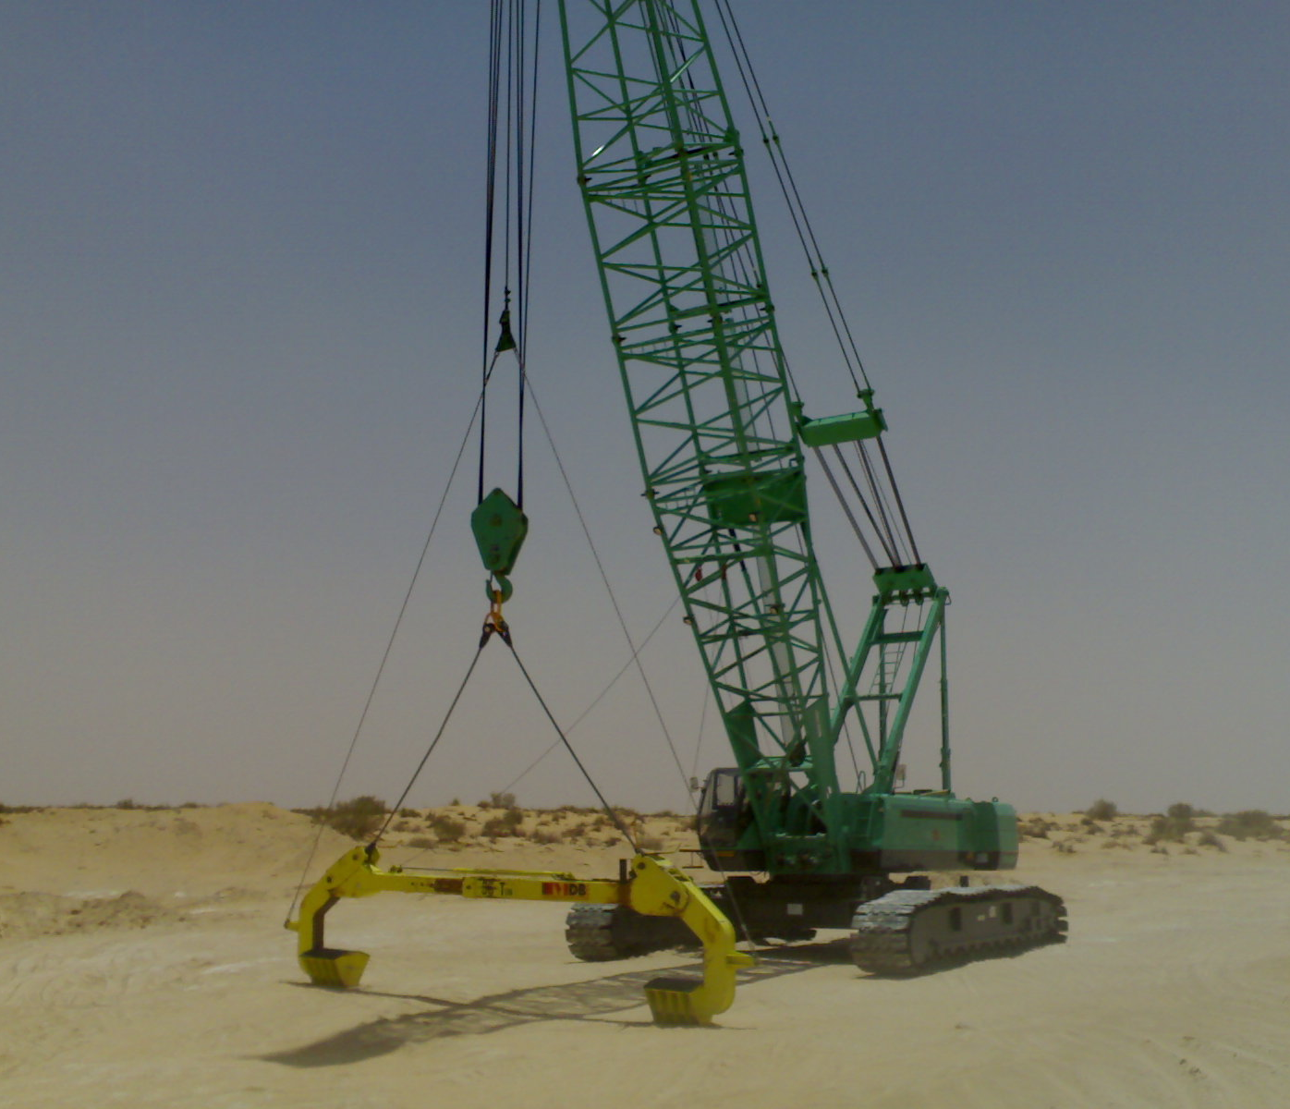
Pipe receiving crane

Slide 11
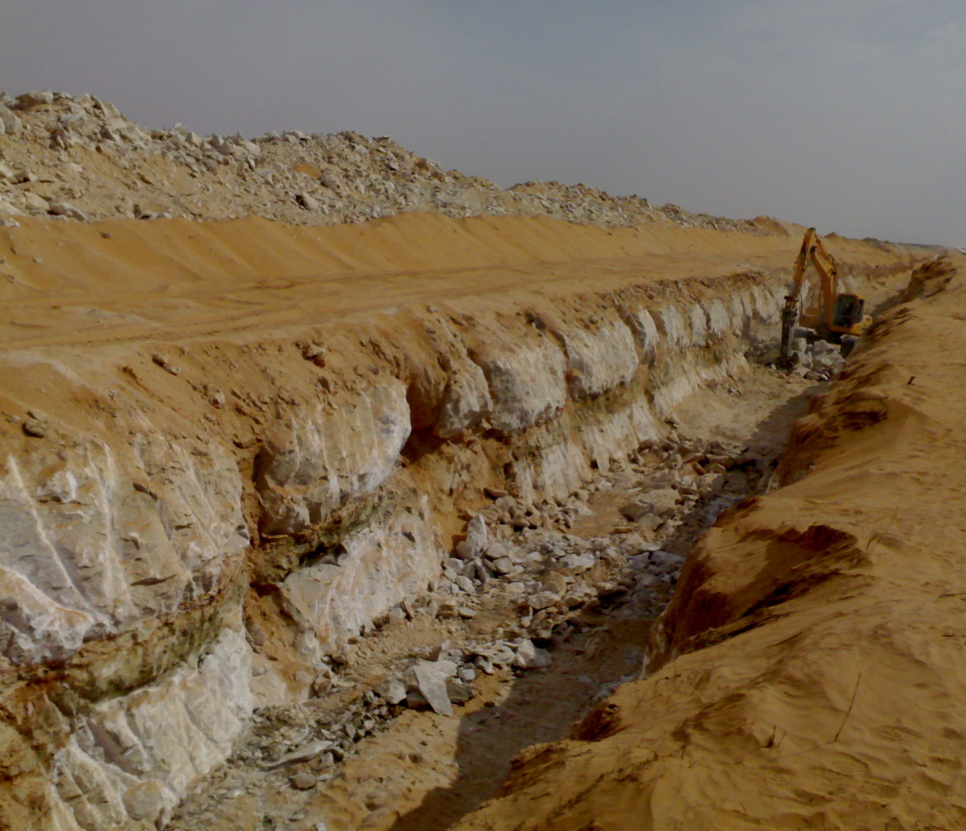
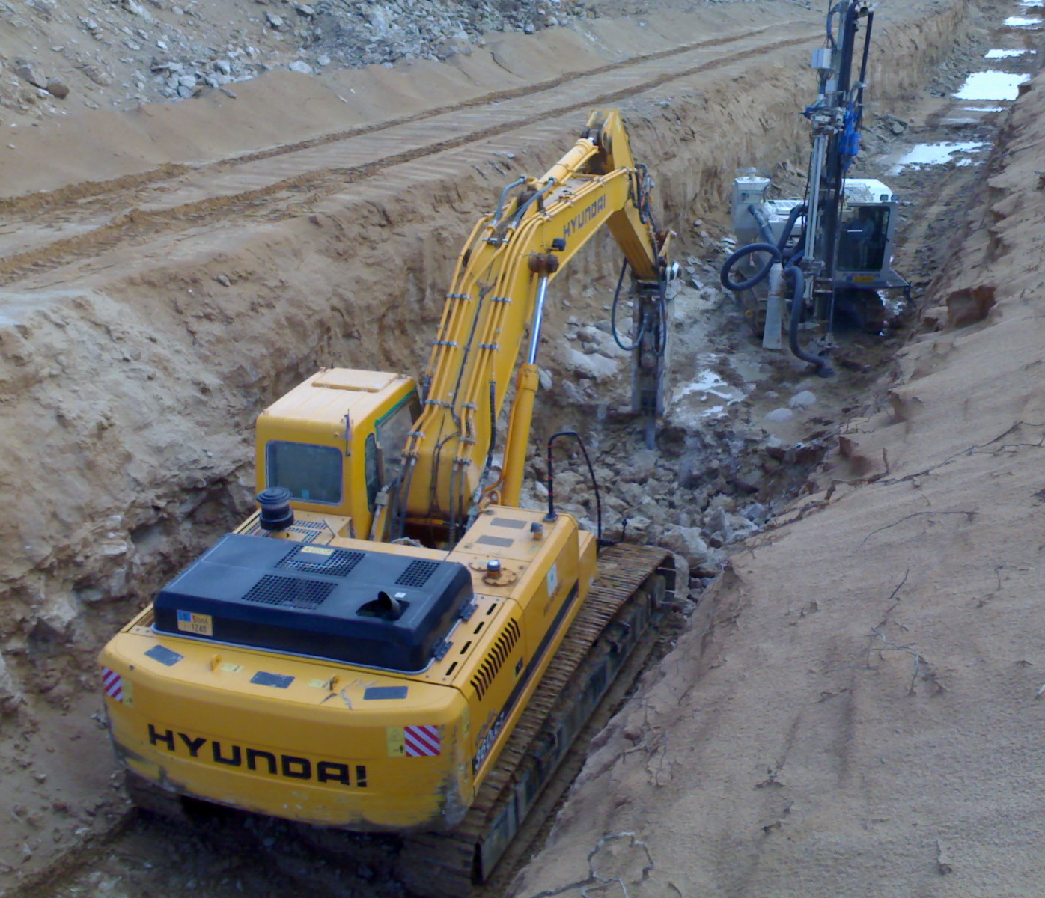
Jack Hammering / Drilling of Rocky Sub-grade

Slide 12
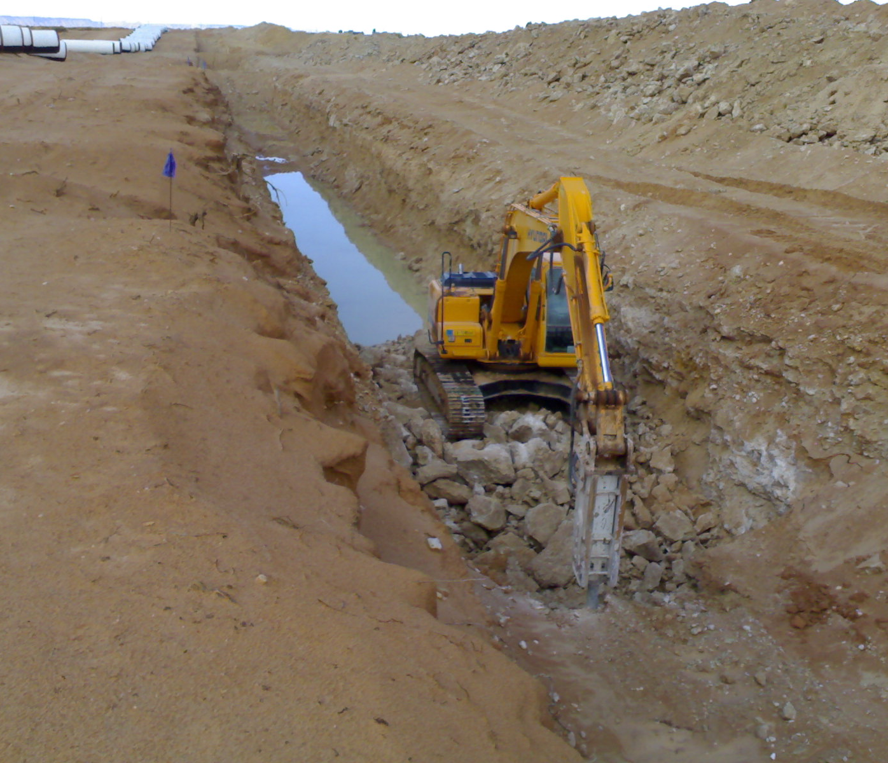
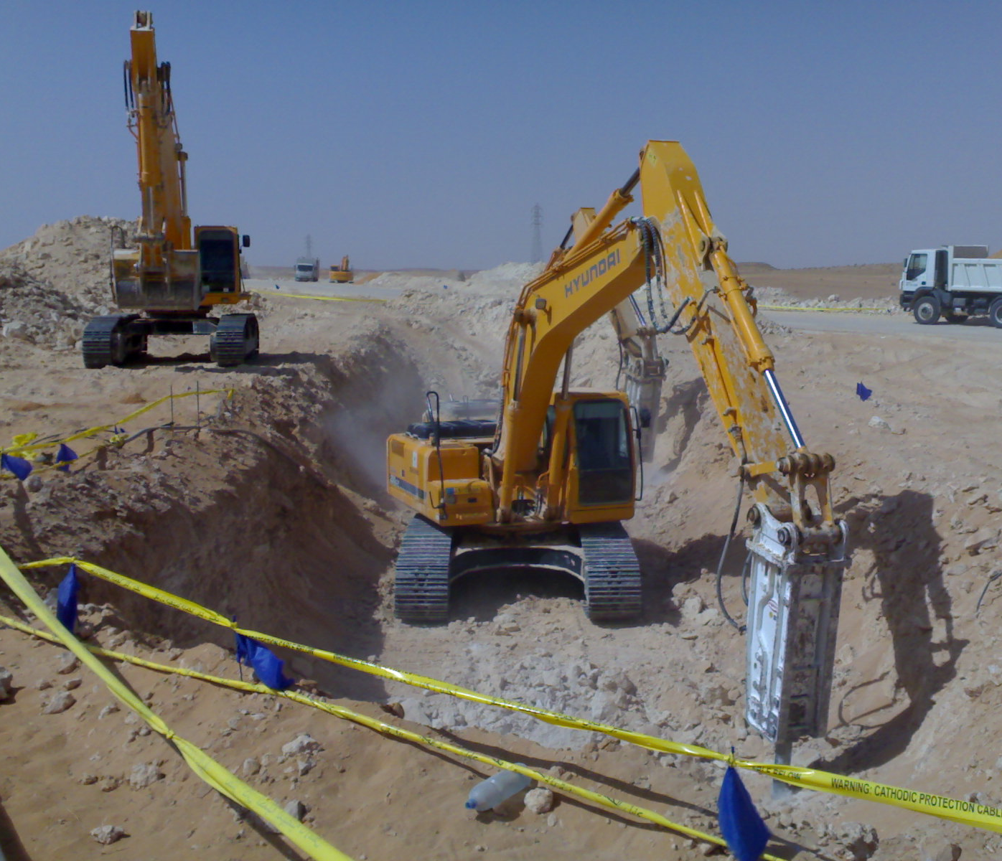
Jack Hammers in action

Slide 13
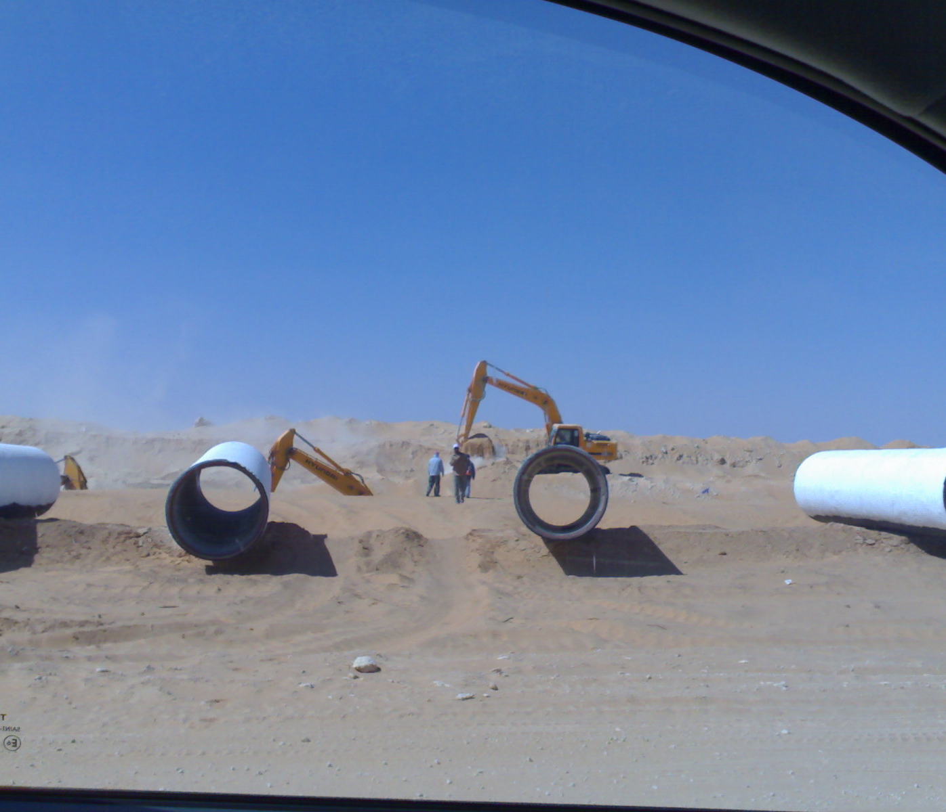
Excavation in Progress

Slide 14
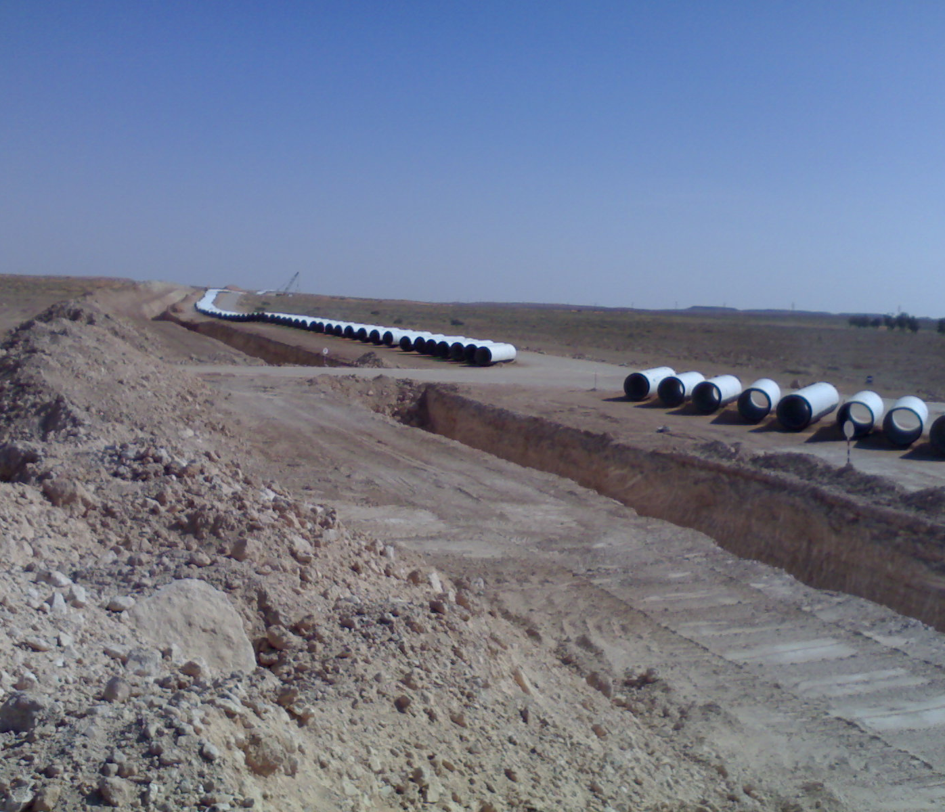
Trench excavated, PCCP Pipes on Windrow
Due to high temperatures in Sahara Desert where ambient temperature reached 52°C, PCCP originally covered by protective Coal tar Epoxy coating have been “White Washed” to decrease exposure to sunlight.

Slide 15
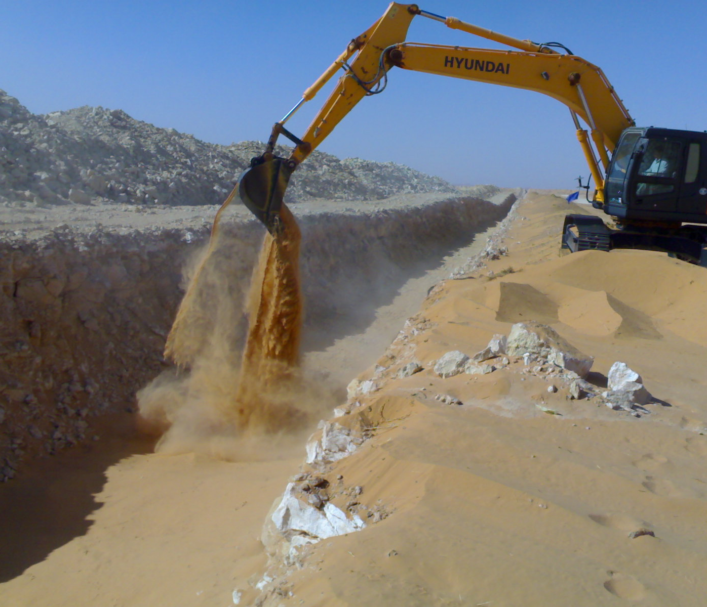
Pipe Trench Bedding

Slide 16
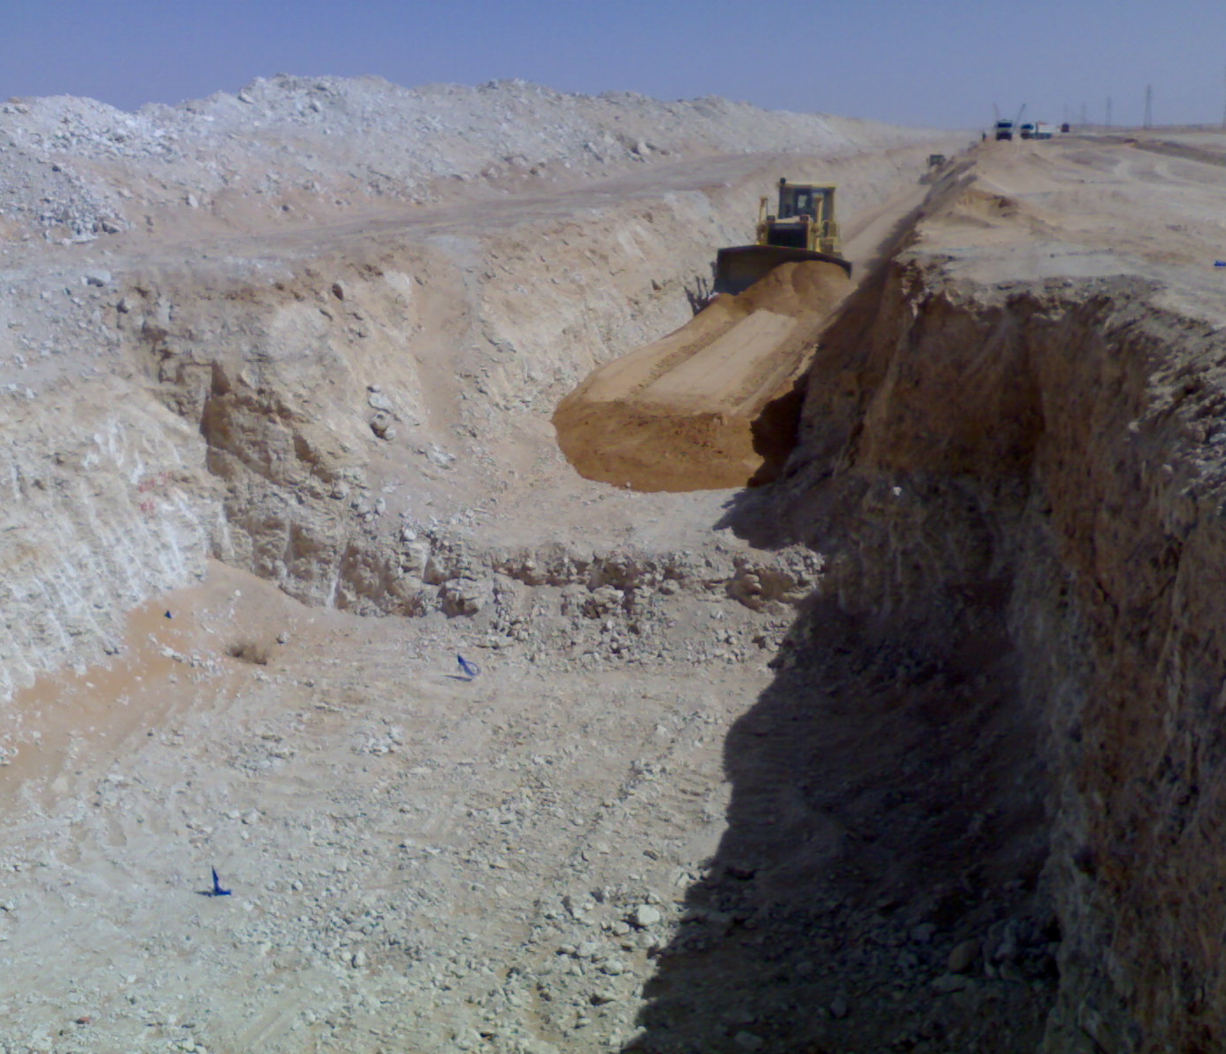
Pipe Trench Bedding

Slide 17
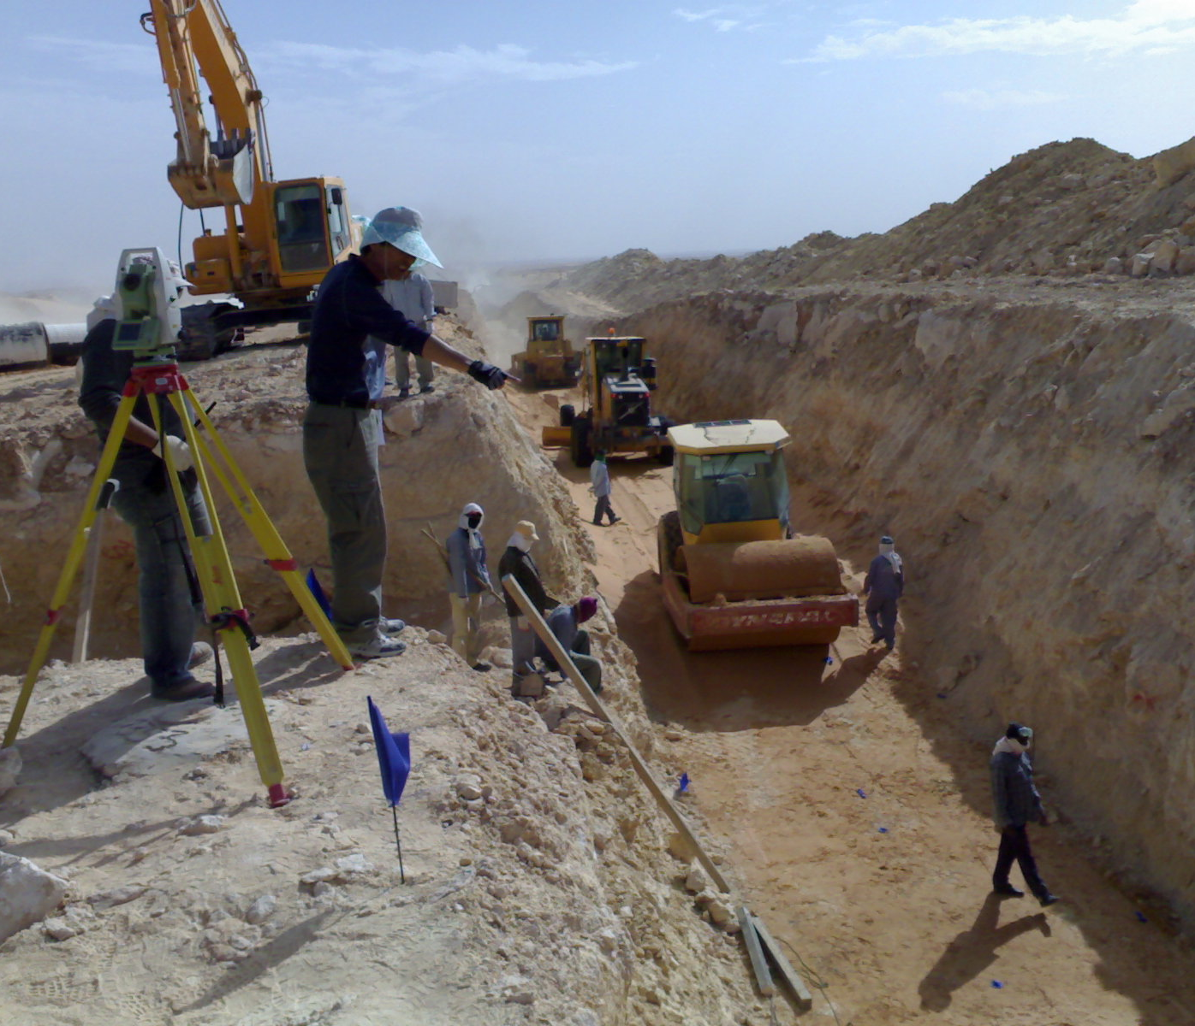
Compaction of Pipe Trench Bedding
Constant Survey verification of each layer elevation

Slide 18
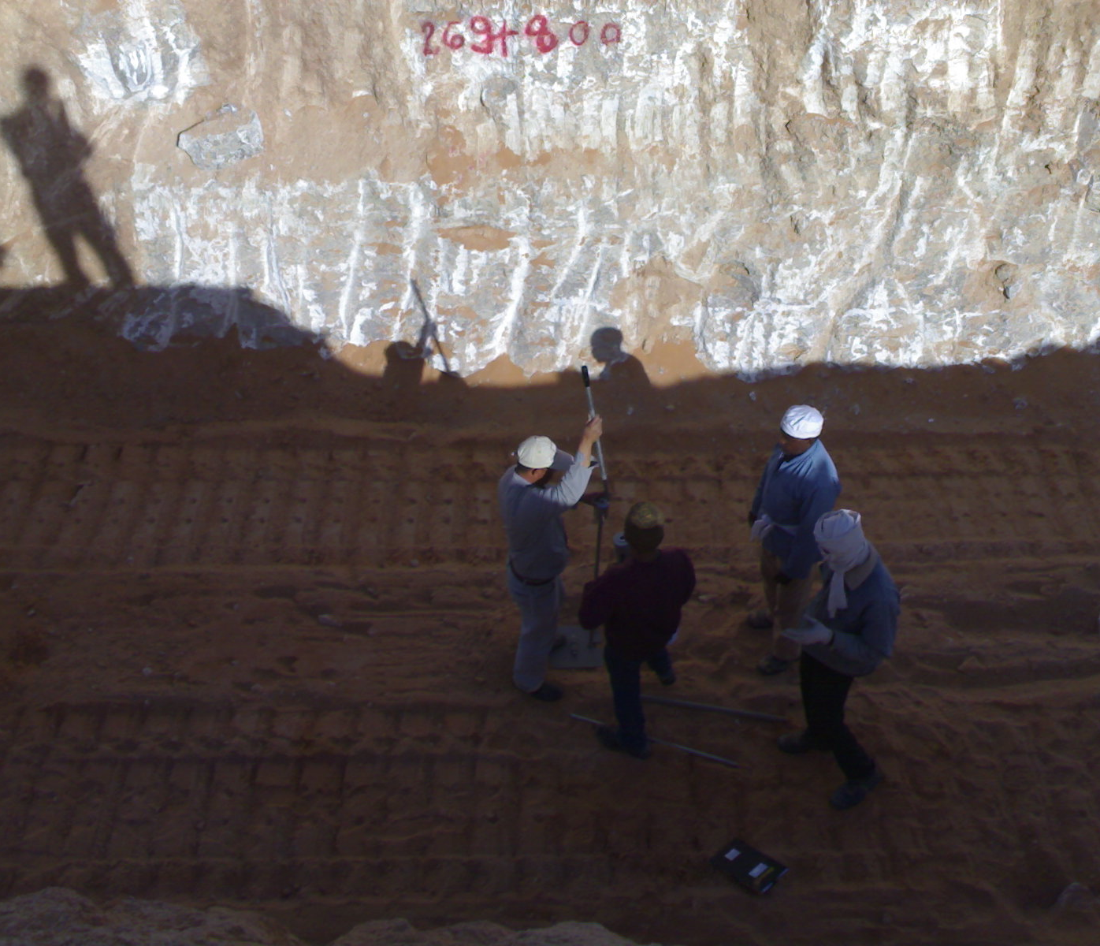
Sub-grade Verification
Standard Penetration test (SPT)

Slide 19
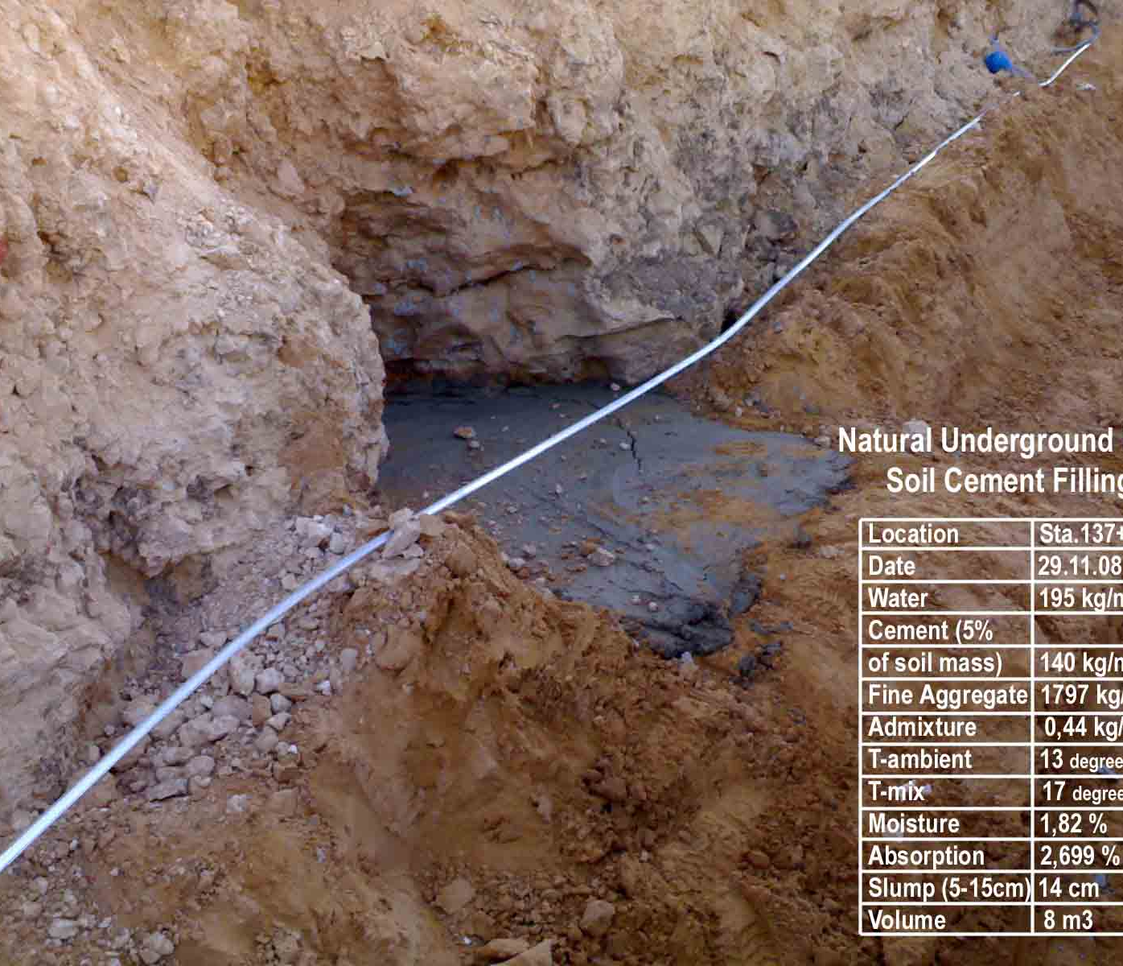
Underground Cavity Filling
Stabilization of trench sub-grade, encountered cavities explored and filled with Soil Cement

Slide 20
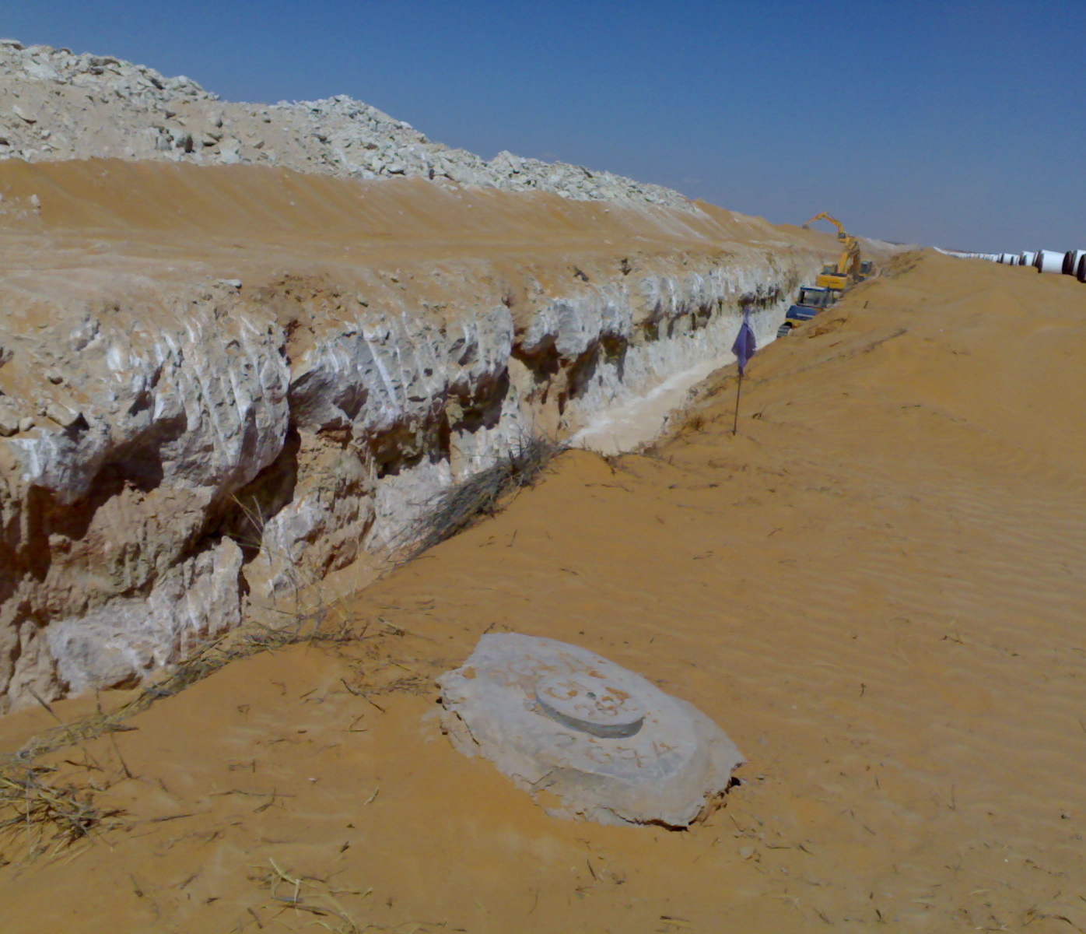
Survey Markers along the Pipe Route

Slide 21
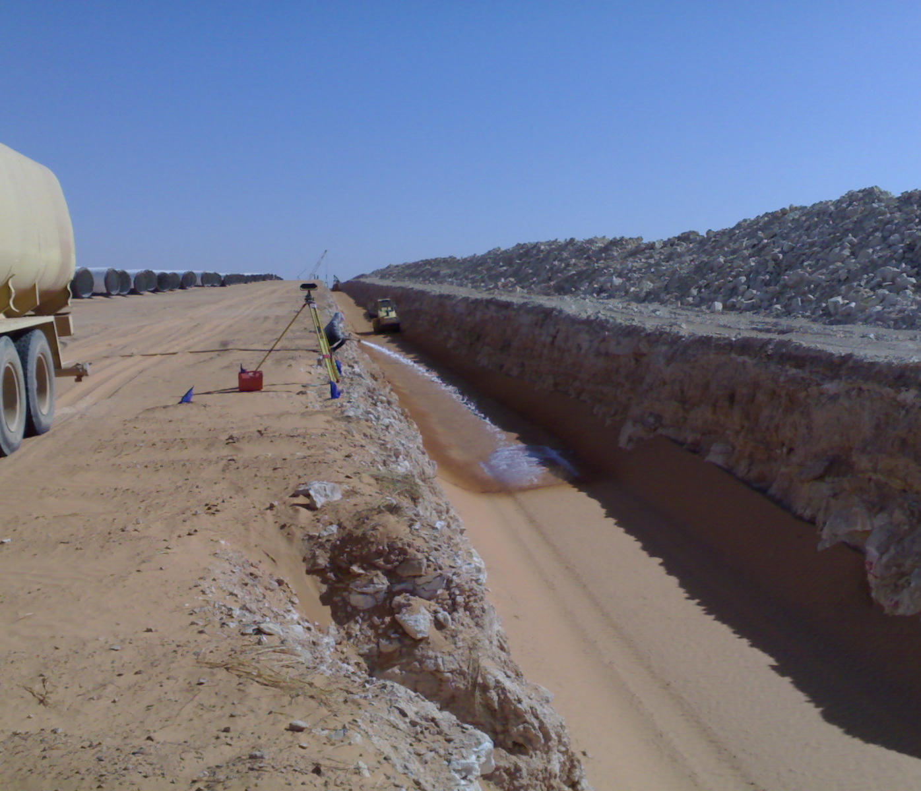
Watering of the Bedding Material
To achieve required compaction, water trucks were used for watering the sand bedding material, followed by compaction vibro-rolers

Slide 22
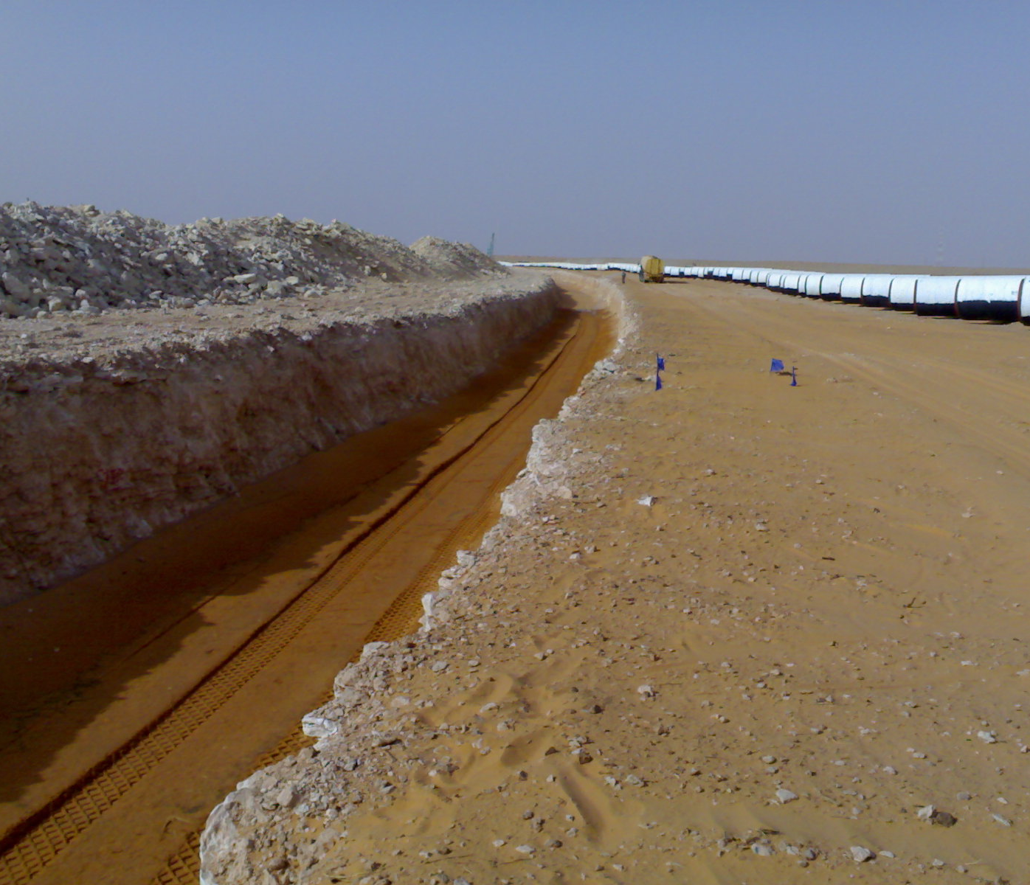
Pipe Trench Bedding

Slide 23
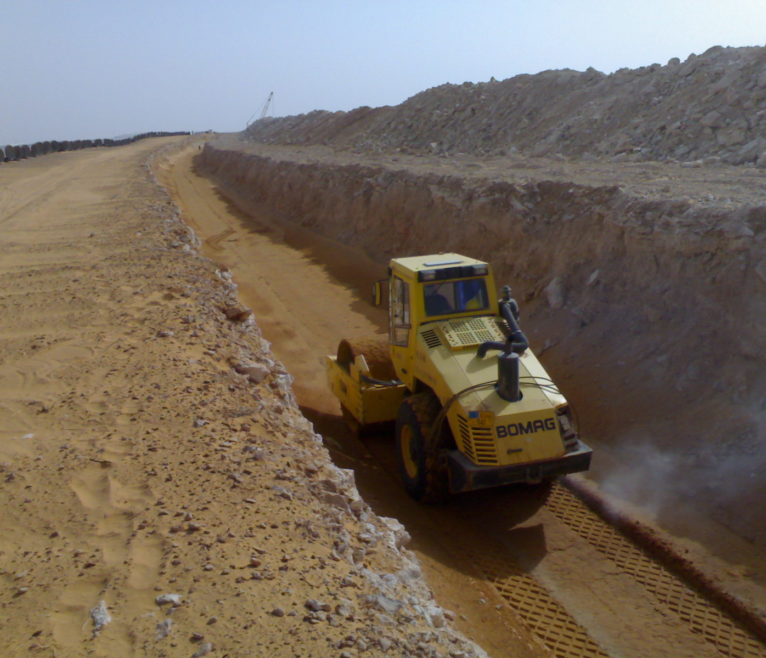
Bedding Compaction

Slide 24
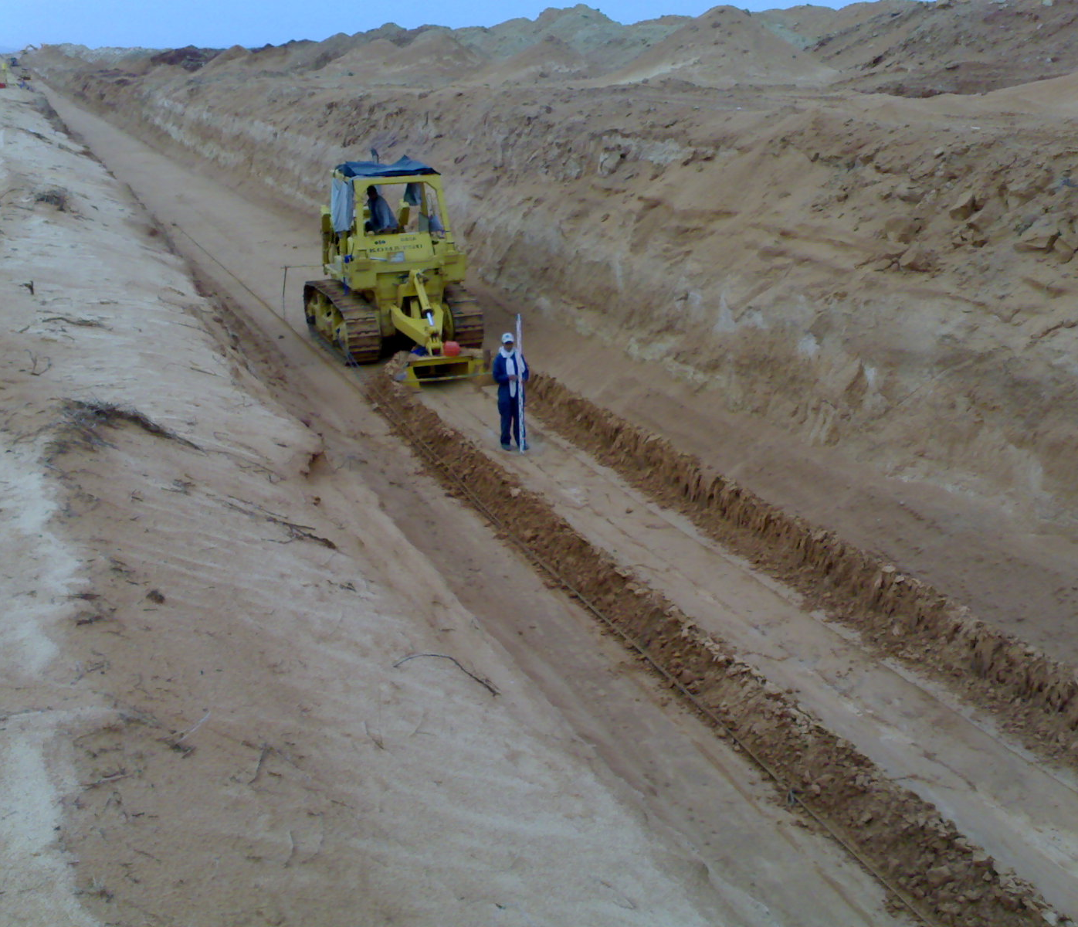
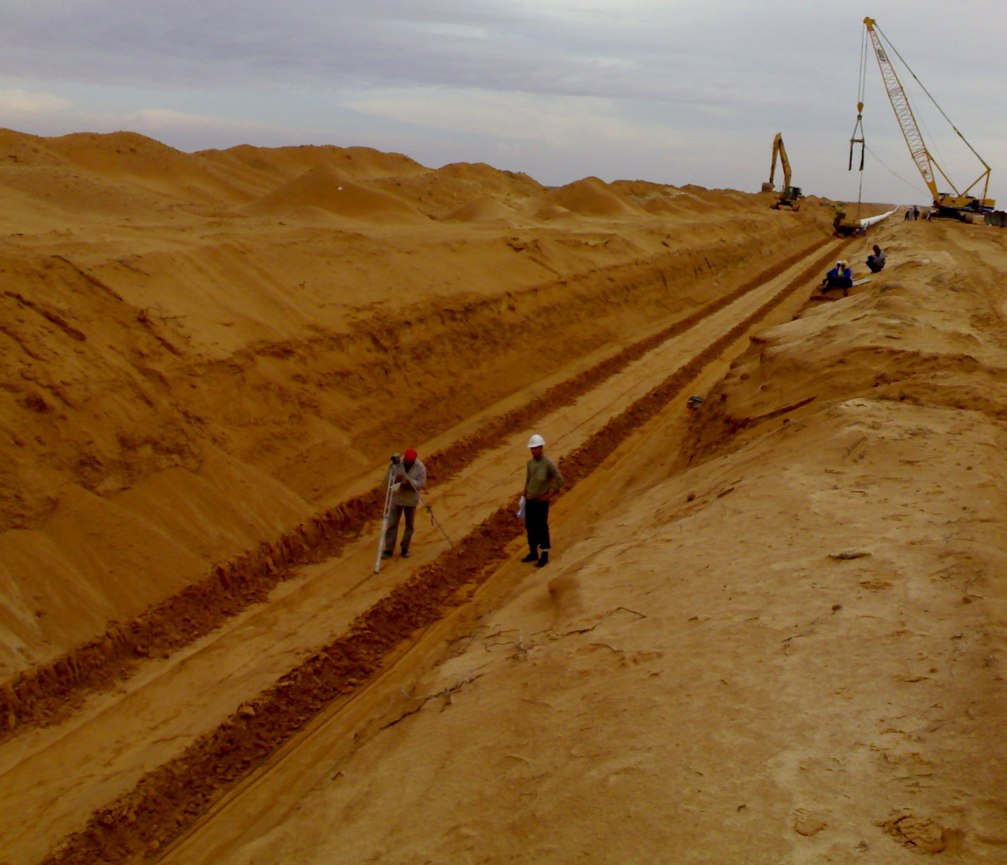
Pipe Shaped-bedding
After proper compaction of bedding material a Shape Bedding Machine has shaped-up the bedding to receive DN1600 PCCP Pipe on trench centerline
Pipe Shaped Bedding – Survey verification

Slide 25
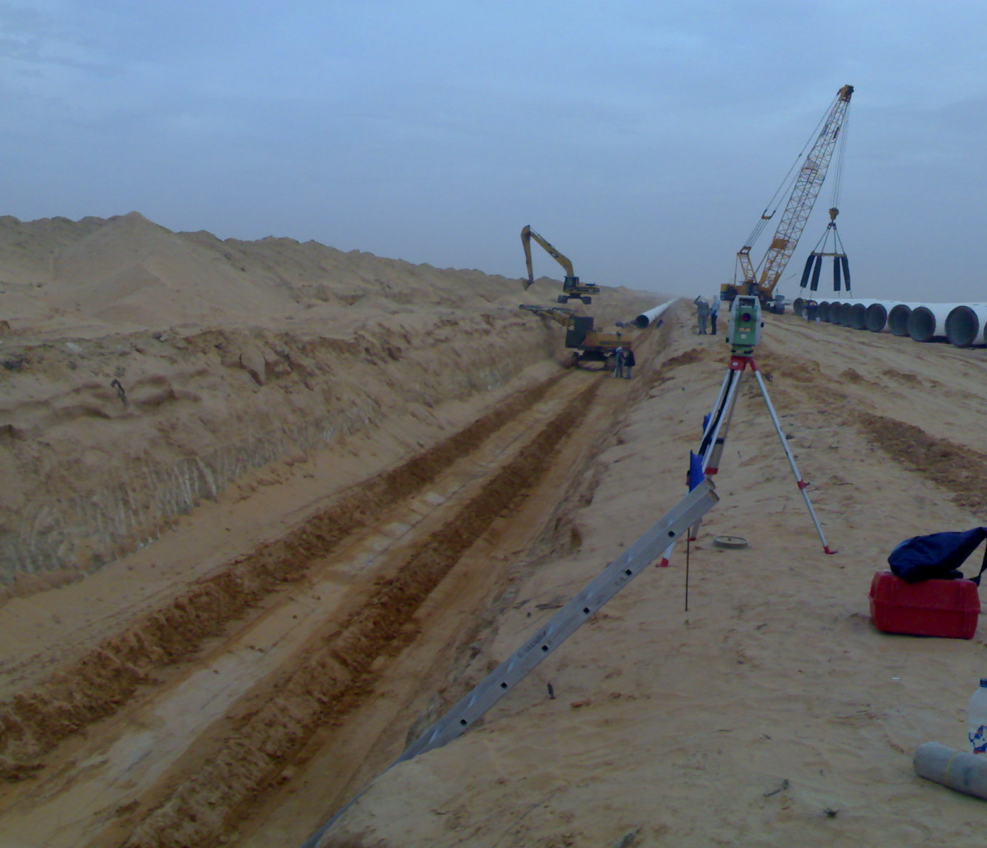
Shaped Bedding / Pipe Laying

Slide 26
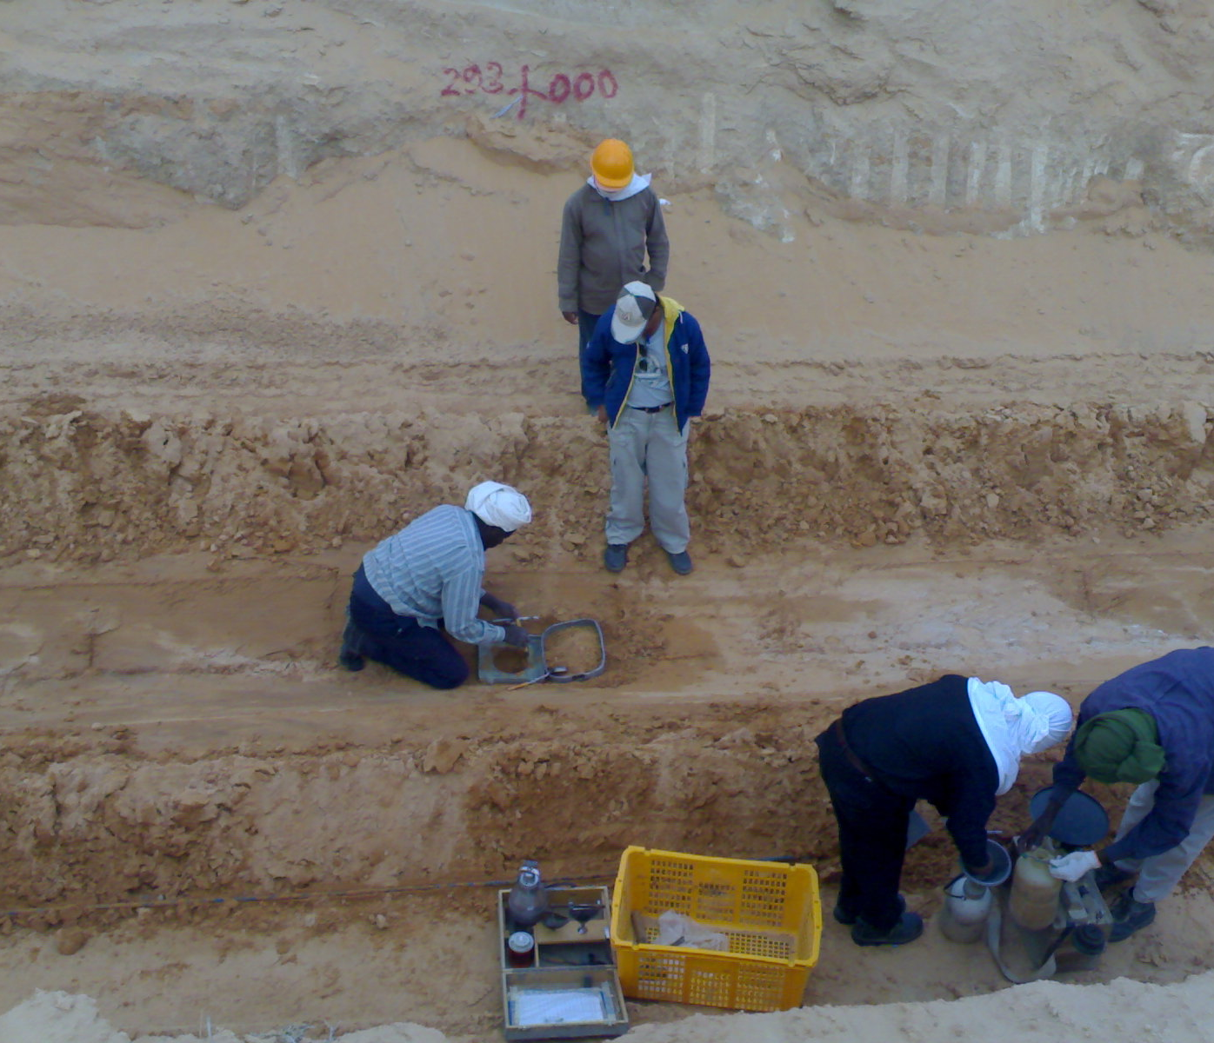
Shaped Bedding – Field Density Test
Testing the achieved compaction of bedding

Slide 27
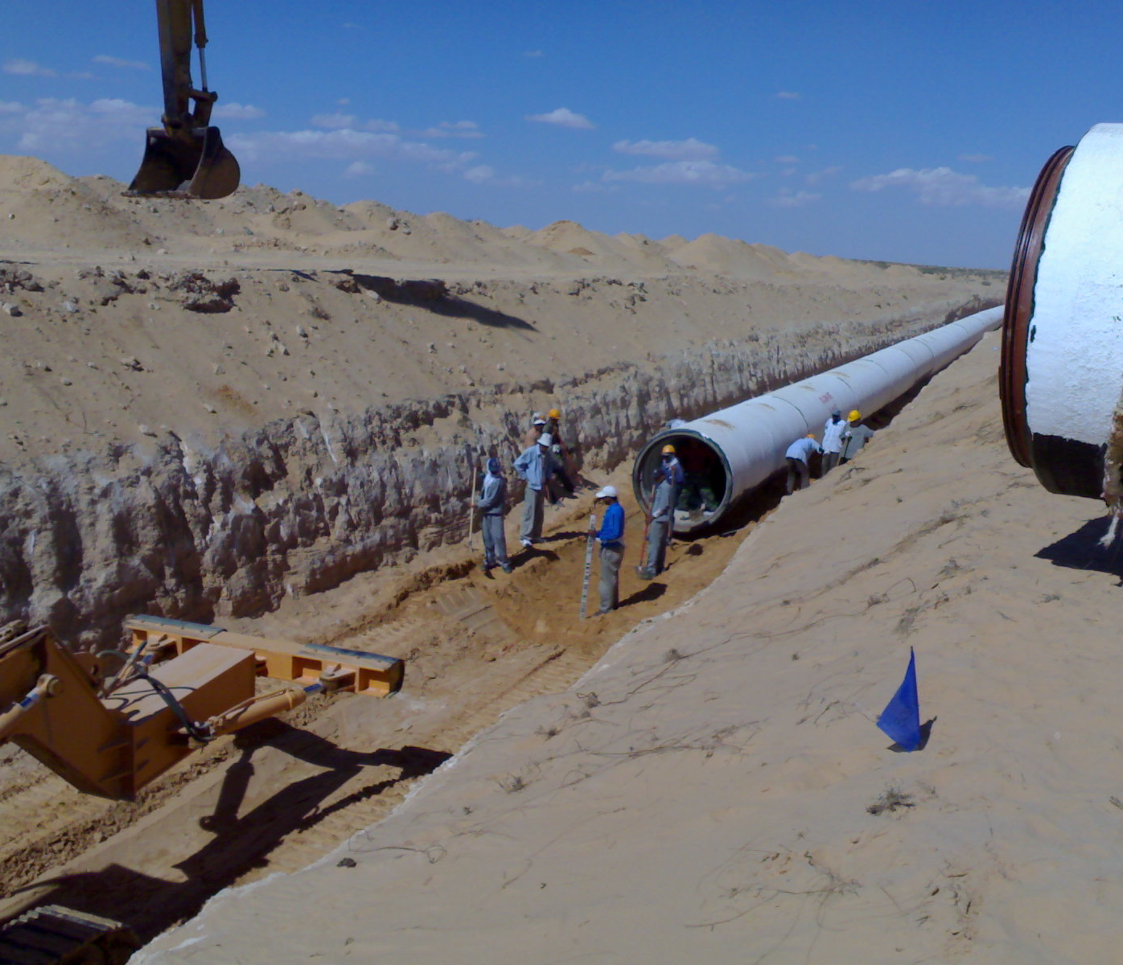
Pipe Laying – Elevation verification prior to installation

Slide 28
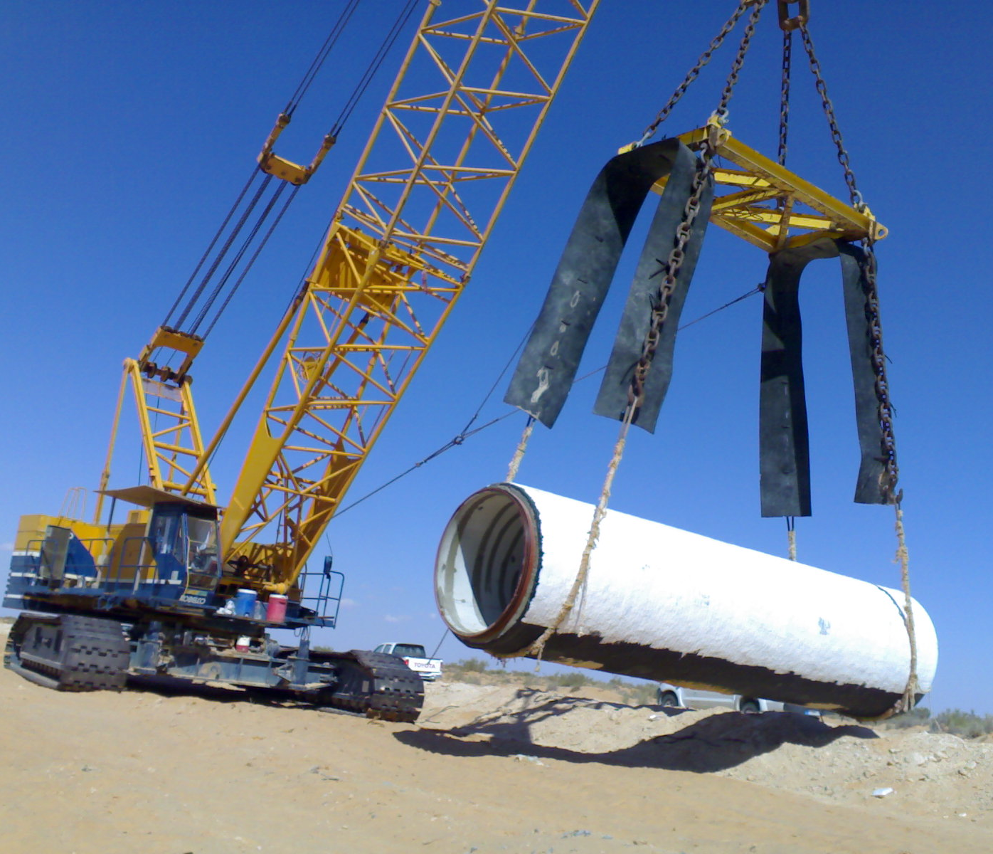
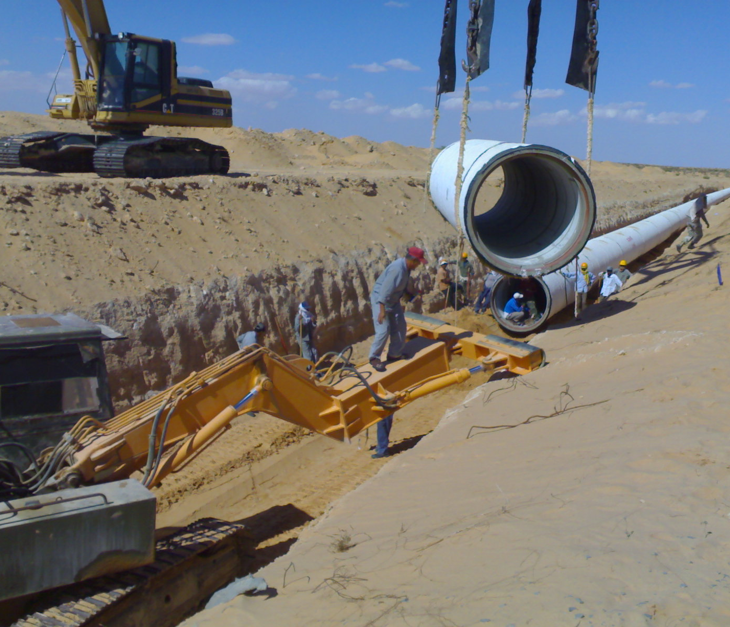
Pipe Laying

Slide 29
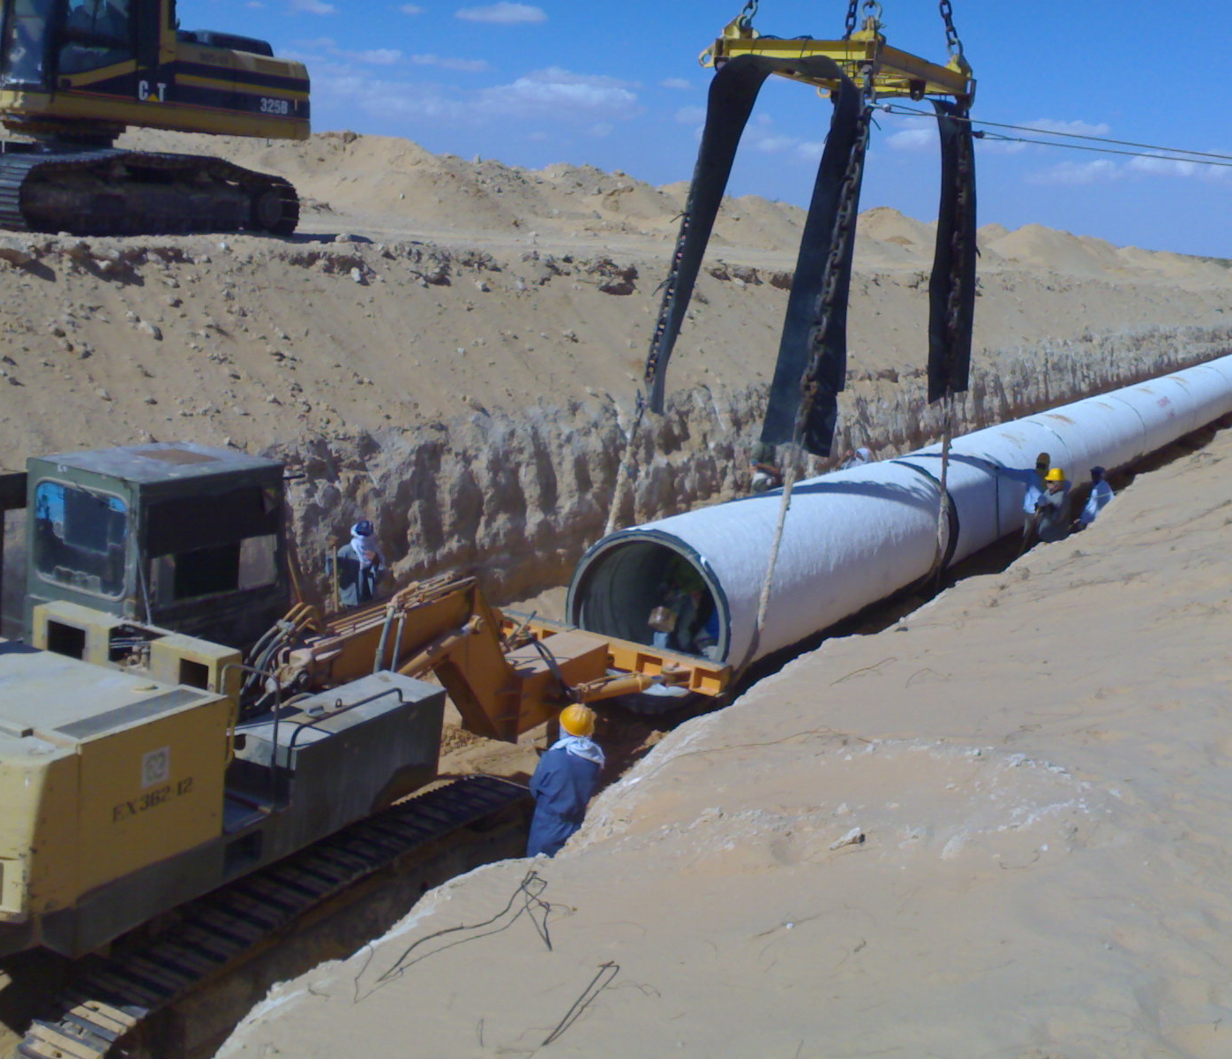
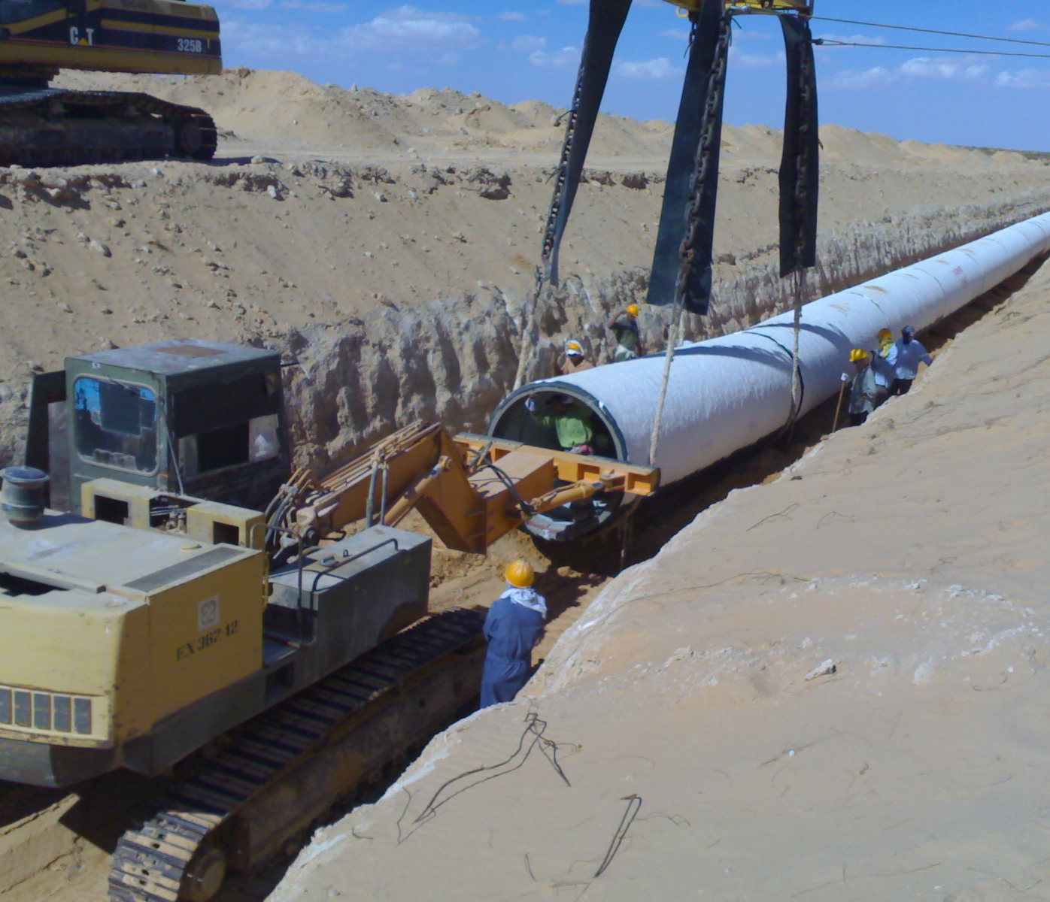
Pipe Laying
“Pusher” placing the PCCP Pipe into its final position

Slide 30
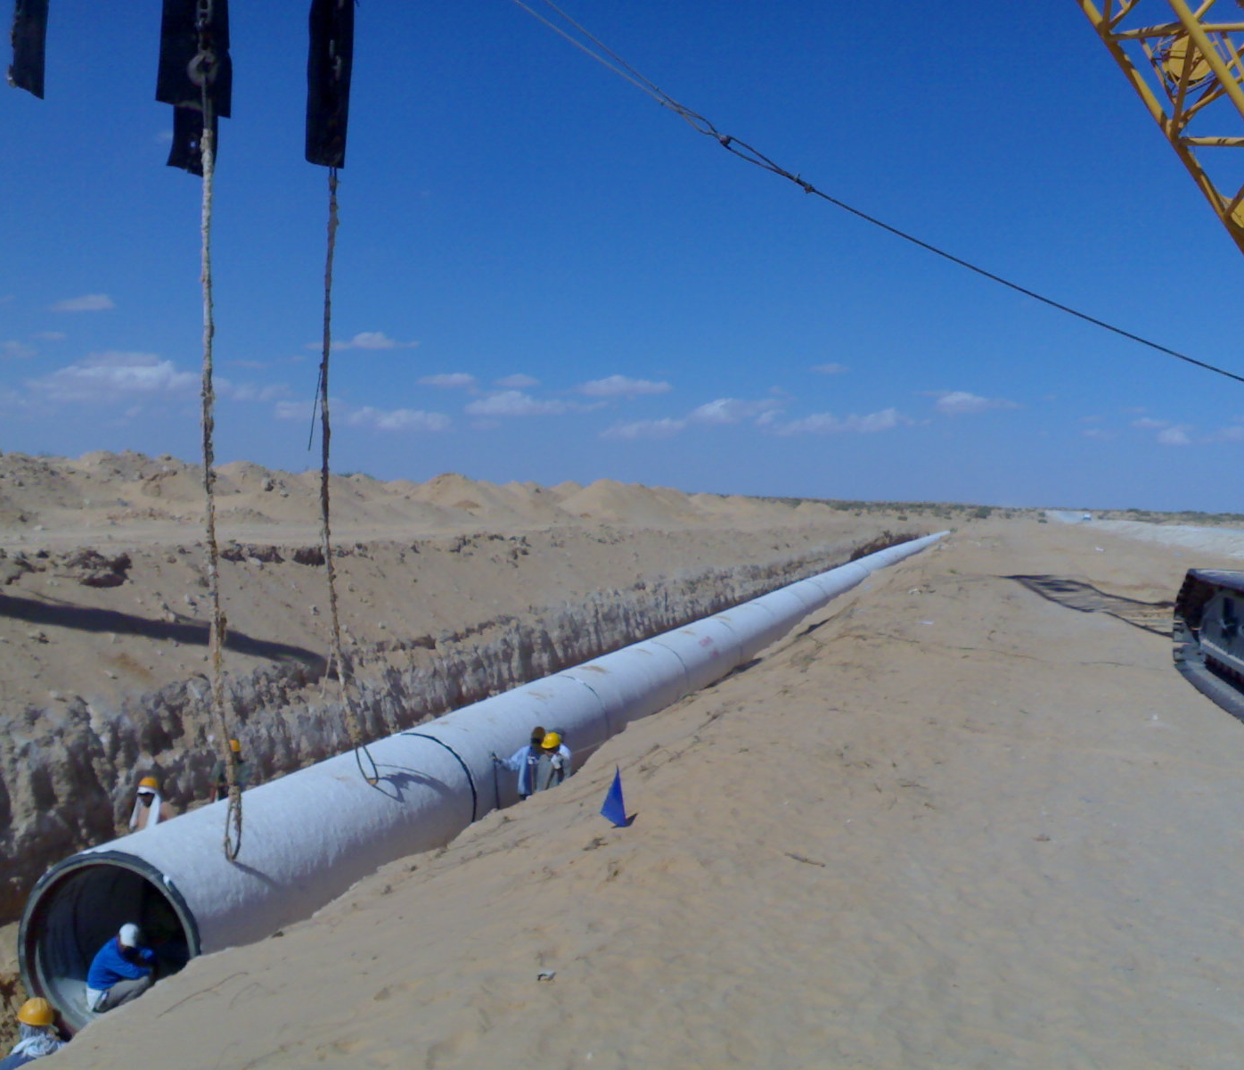
Pipe Laying

Slide 31
Pipe Laying – Installed PCCP Pipes
Ready for External Grouting of Joints

Slide 32
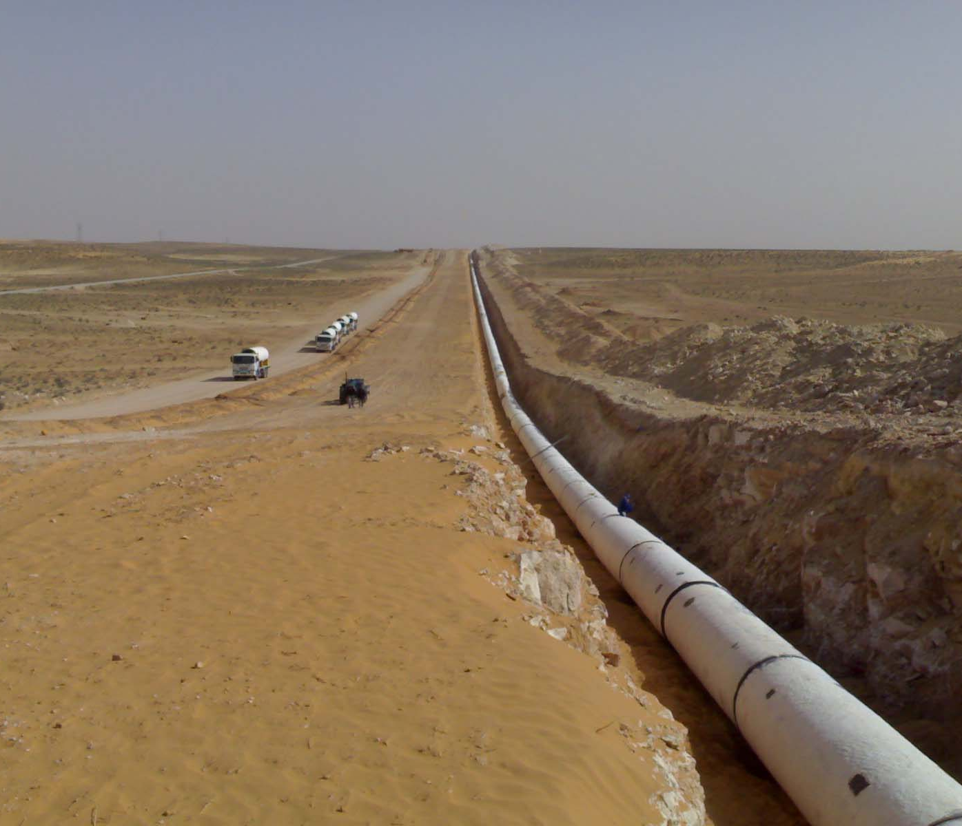
Pipe Laying – Installed PCCP Pipes
Haul Road on left side with PCCP Pipes truck delivery in progress

Slide 33
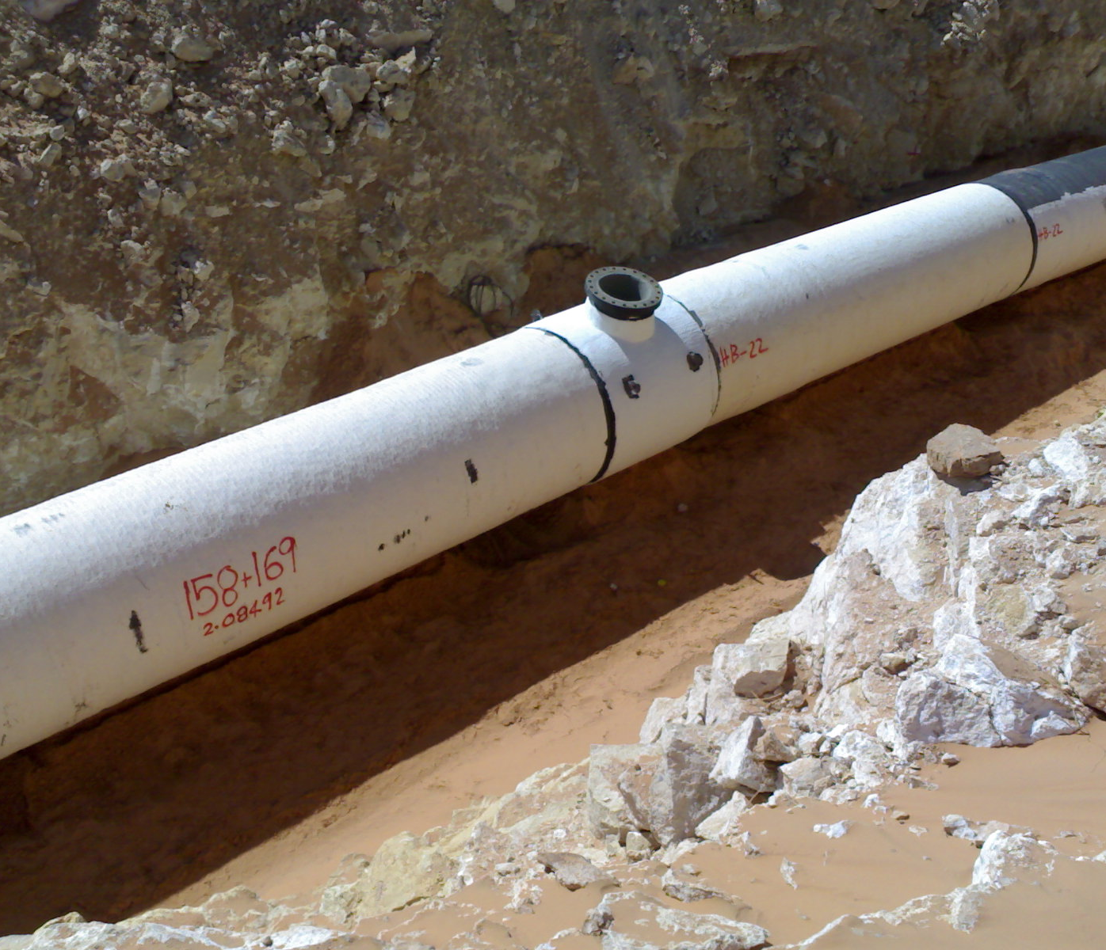
HD Piece for Manhole

Slide 34
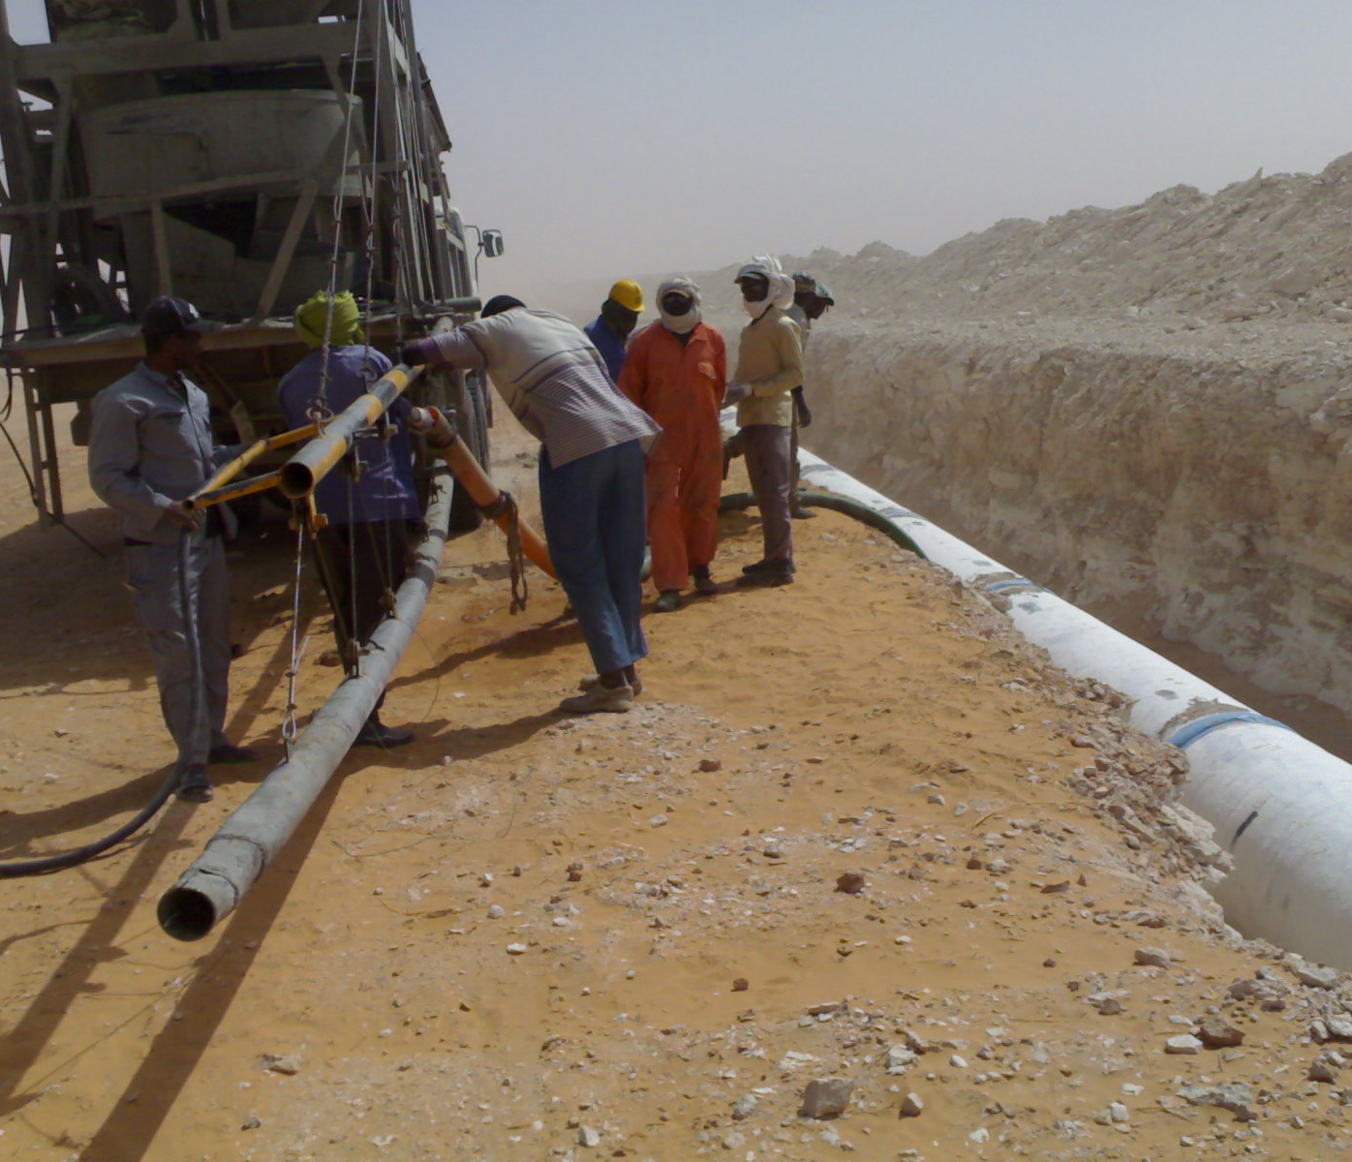
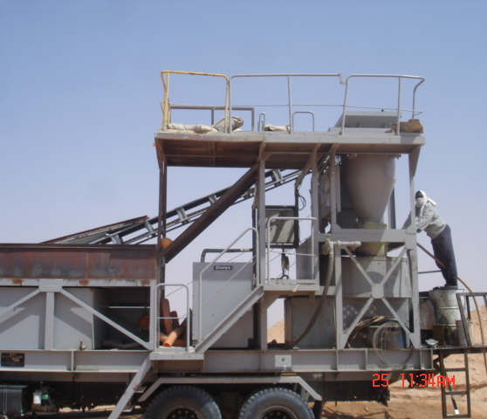
PCCP Pipe Joints - External Grouting

Slide 35
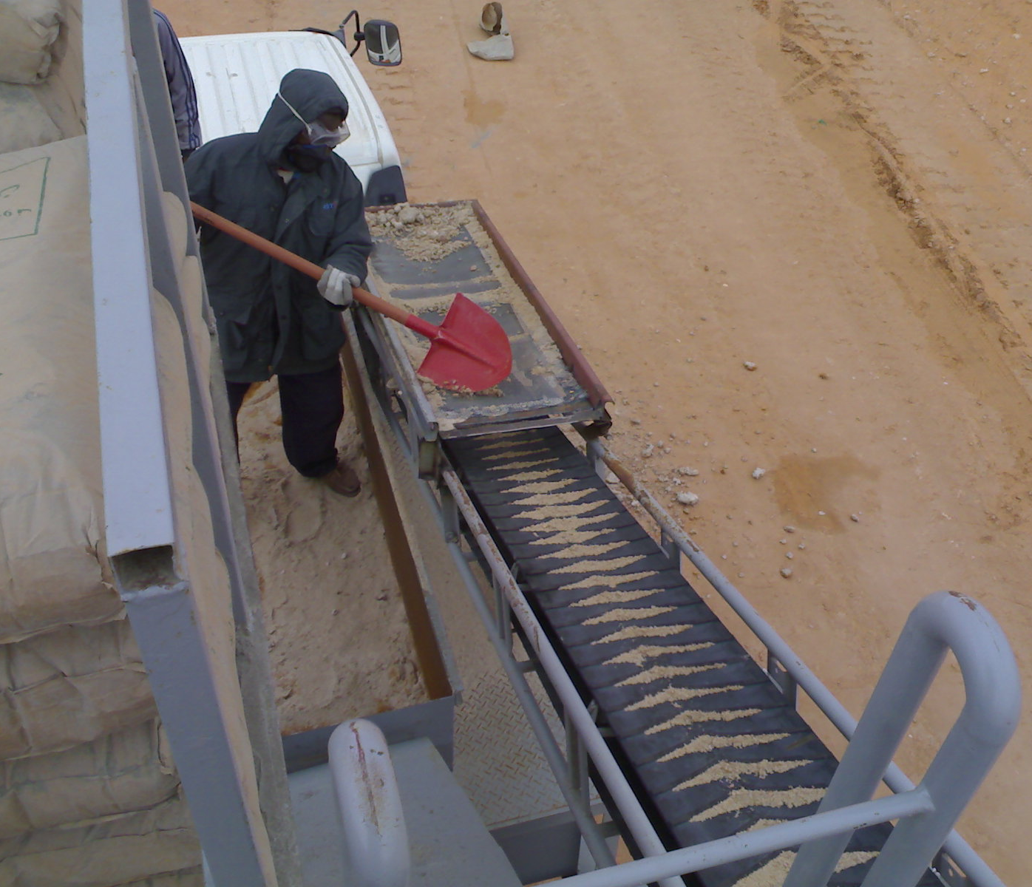
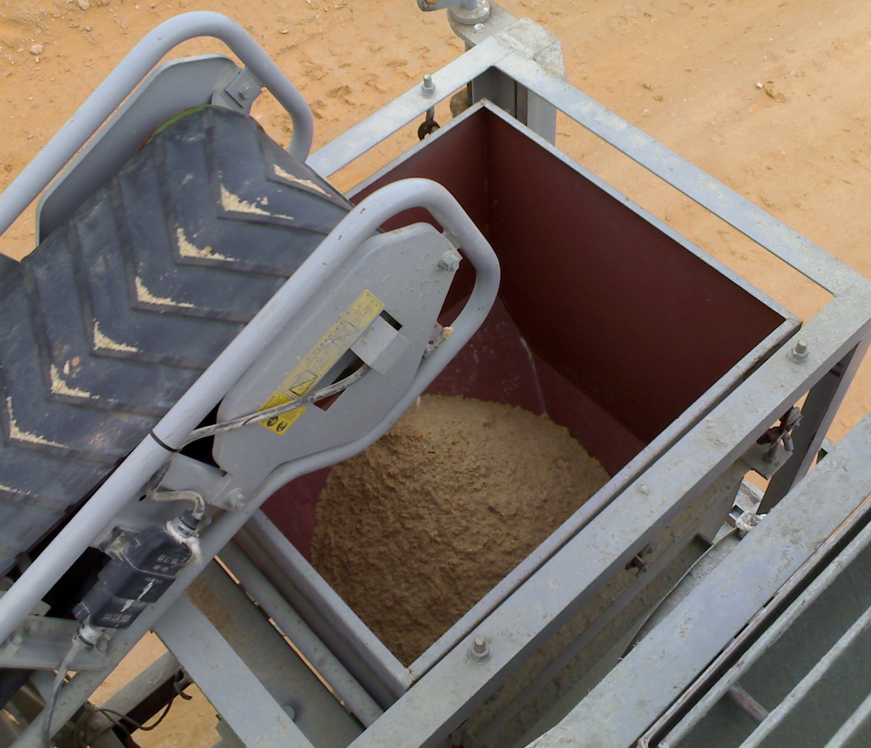
PCCP Joints – External Grouting

Slide 36
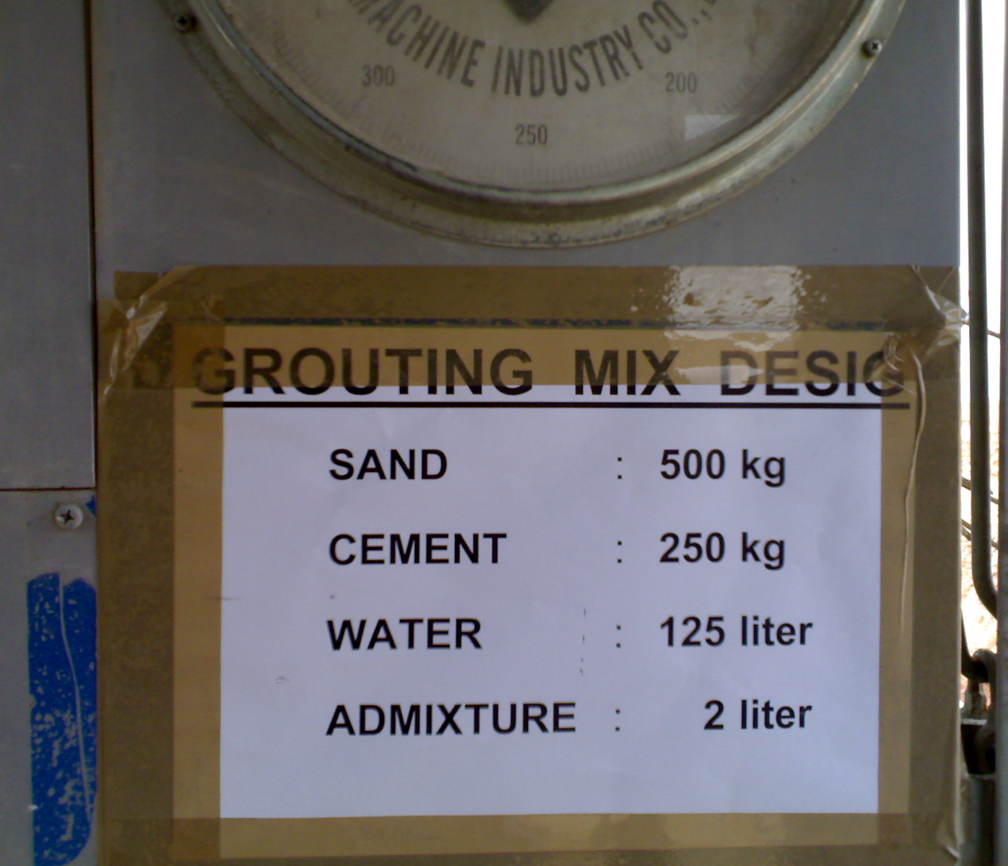
Grouting Mix Design

Slide 37
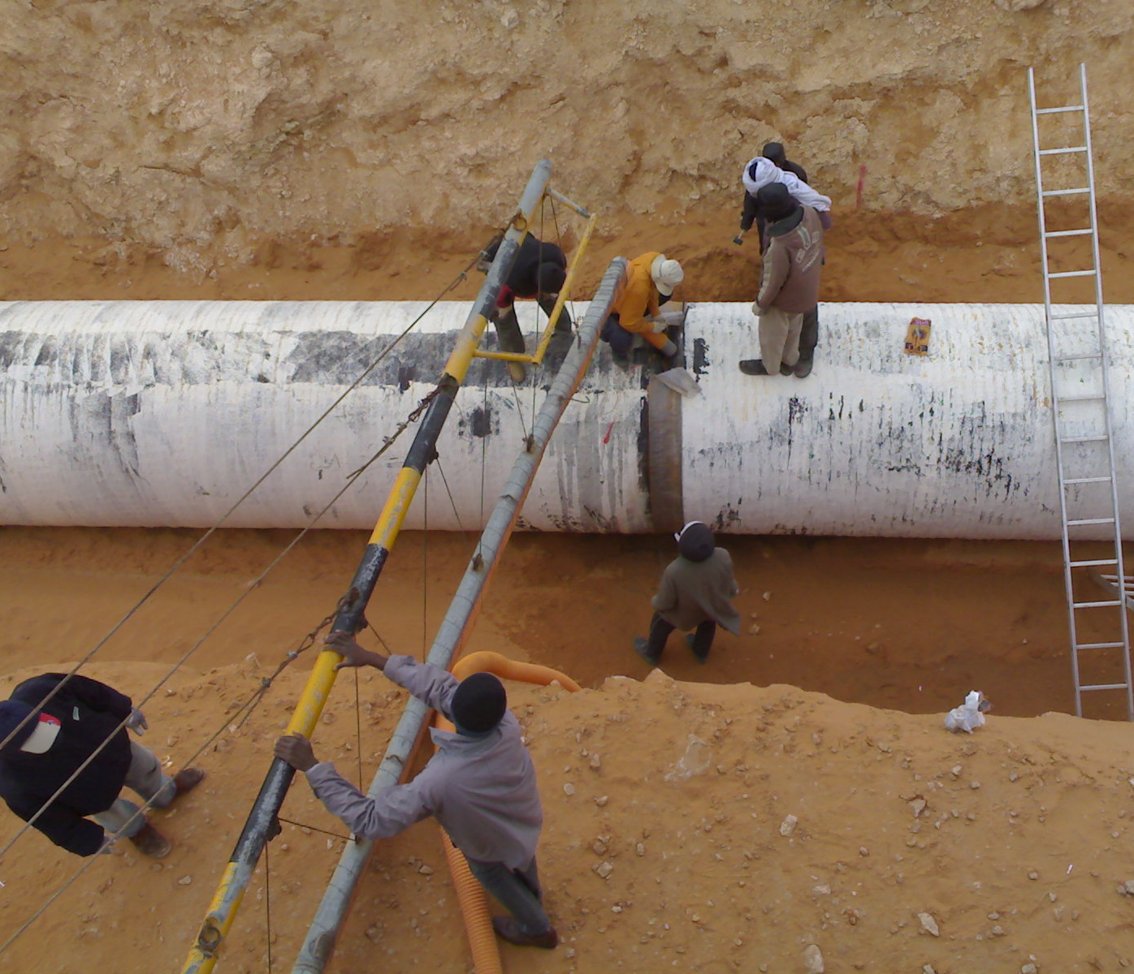
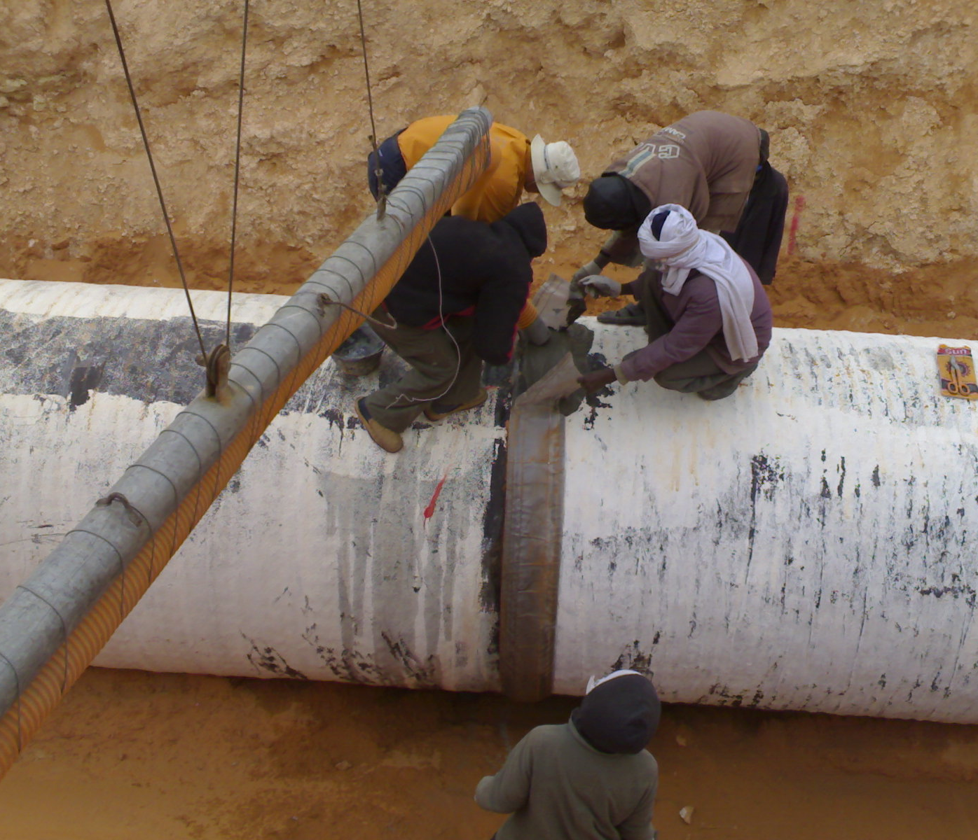
PCCP Pipe Joints External Grouting
Special plastic sheets placed around the pipe-joint, grout is to seal the gap on 2 pipes joint

Slide 38
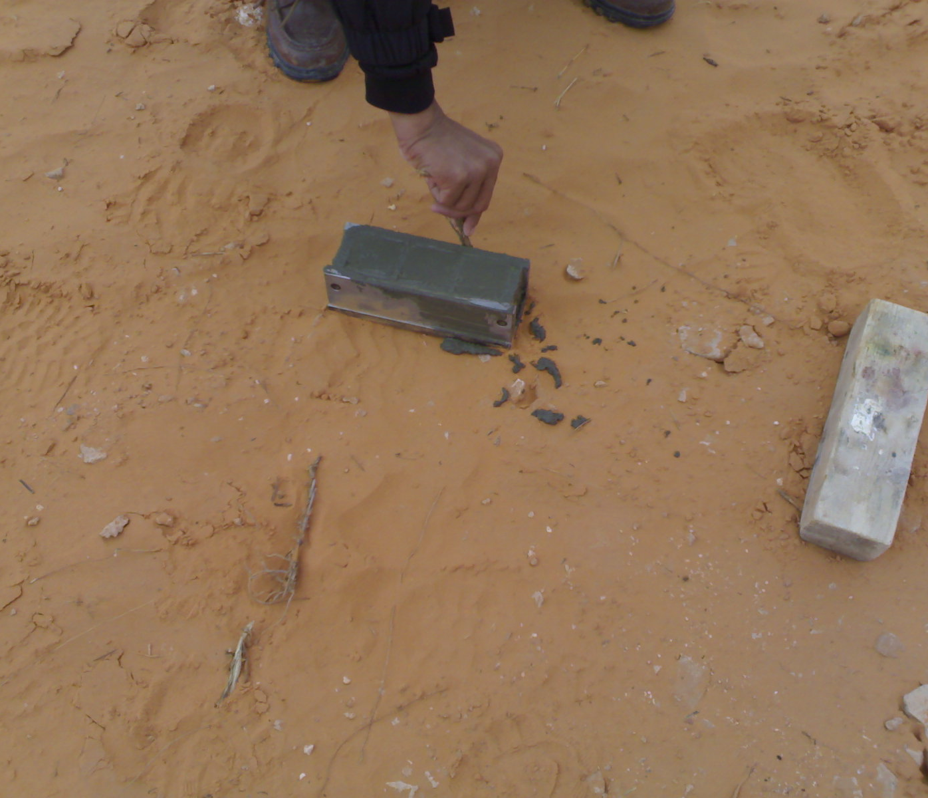
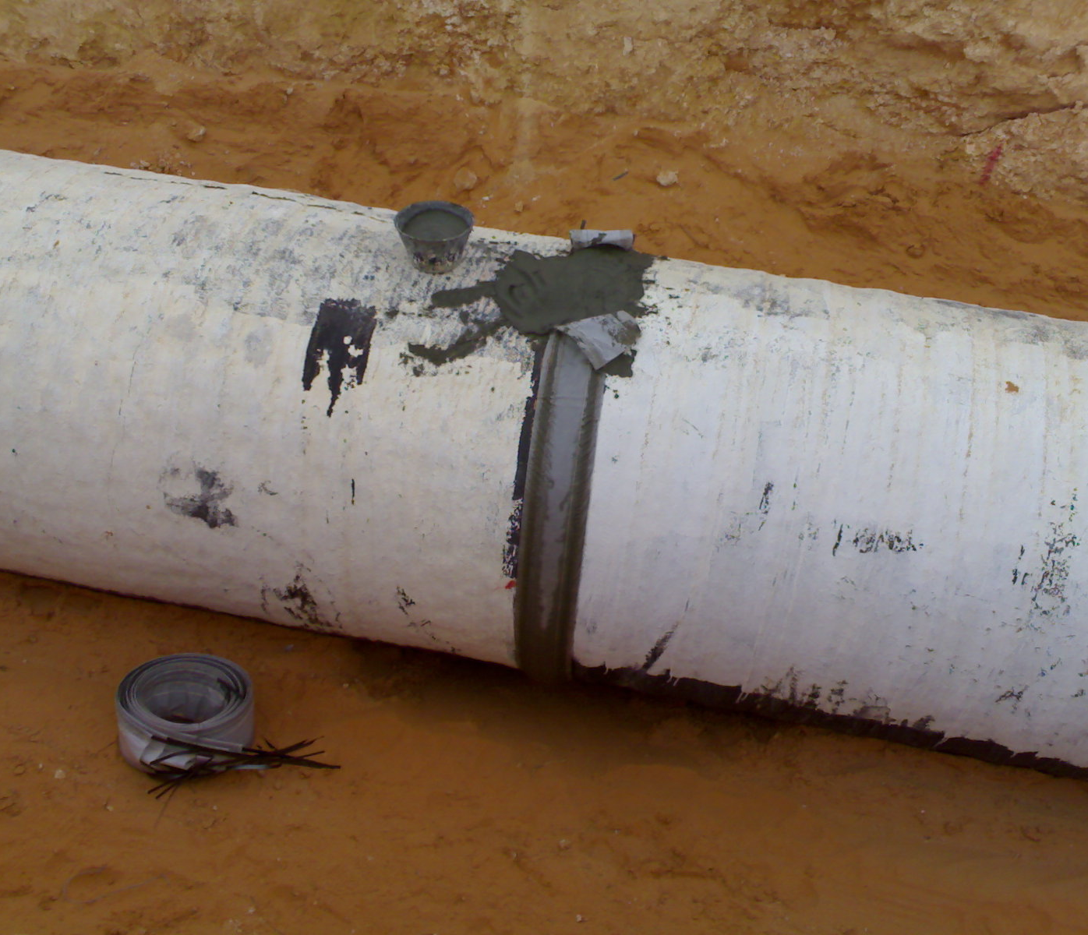
External Grouting
Sampling of Grout for testing

Slide 39
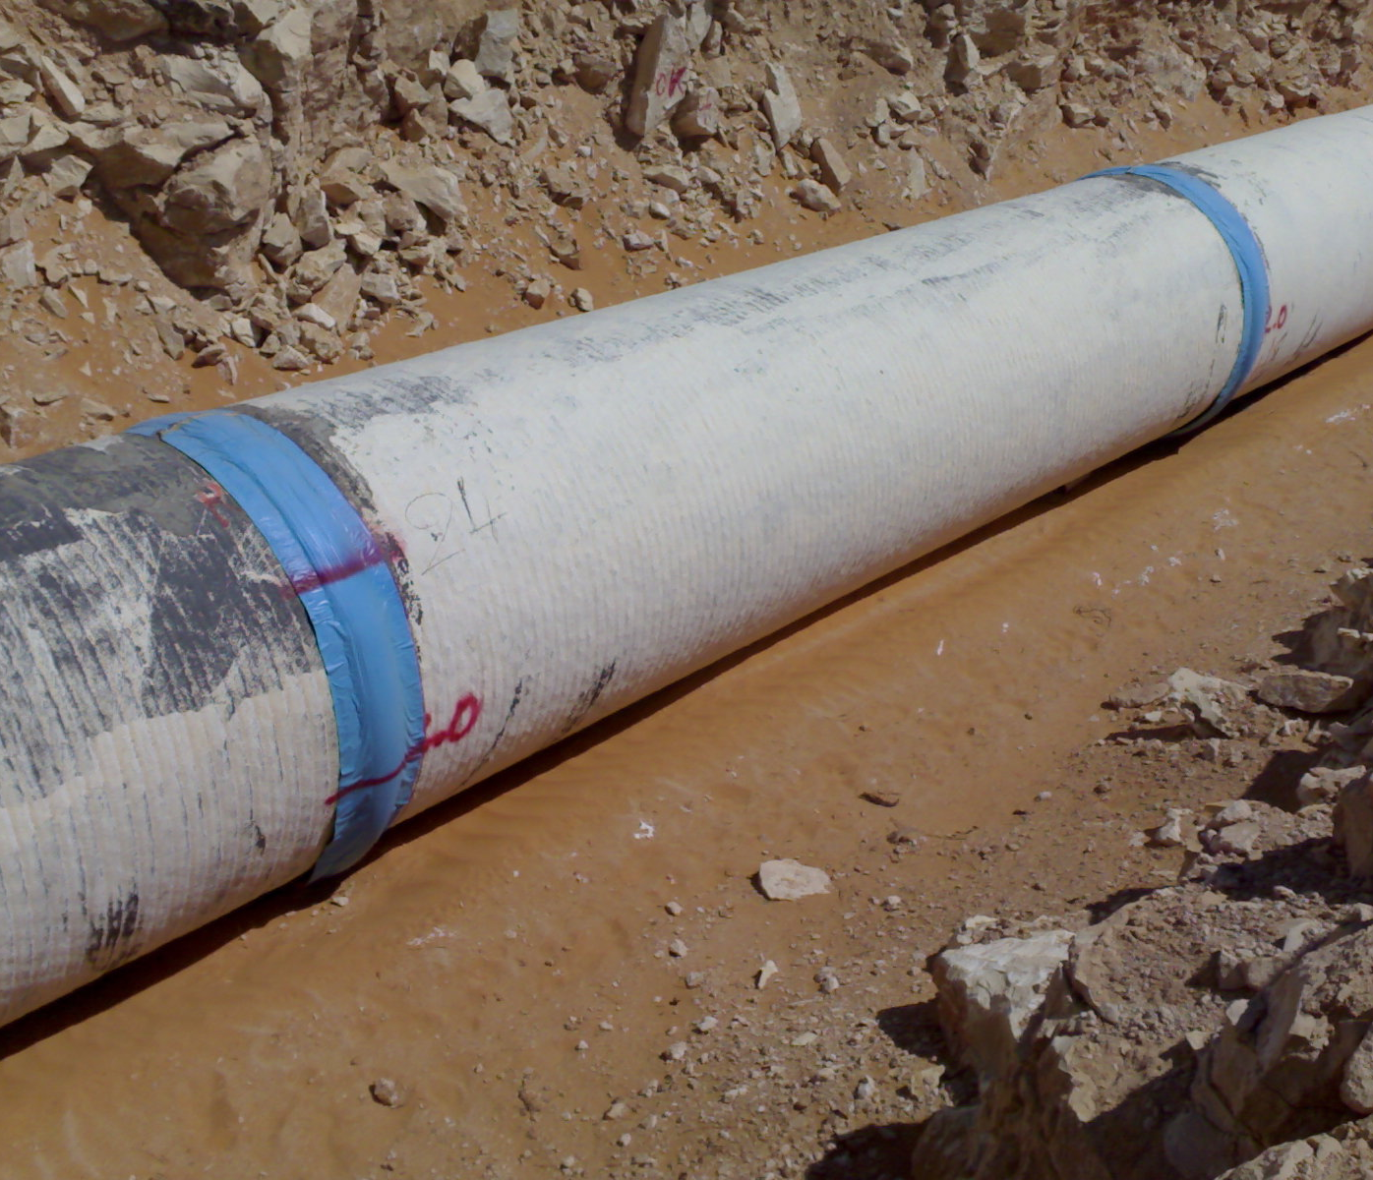
PCCP Pipe Joints External Grouting

Slide 40
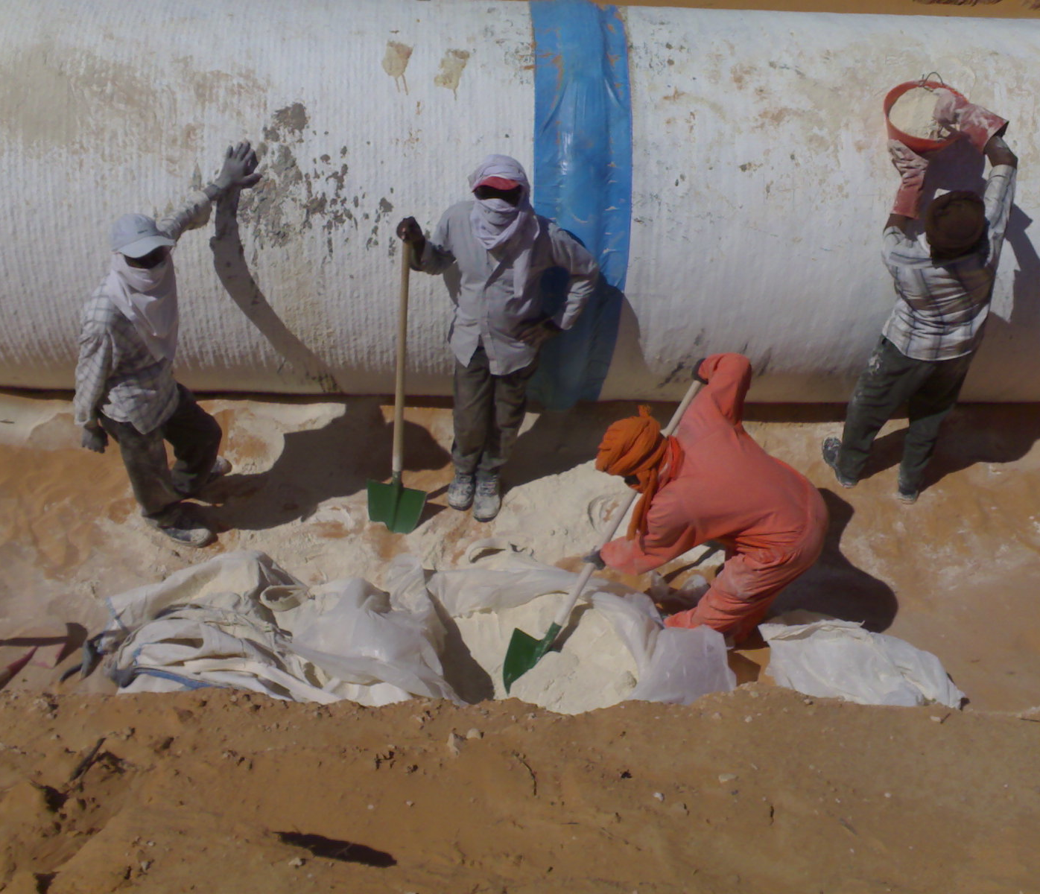
PCCP Pipeline Cathodic Protection
Prior of backfilling starts – sequential Cathodic Protection works start

Slide 41


PCCP Pipe Joints Internal Grouting
On completion of pipe-joints external / internal grouting, each joint is tested by air over the steel plug in embedded joint cylinder

Slide 42


PCCP Pipeline Cathodic Protection

Slide 43

PCCP Pipeline Backfilling
Backfilling performed in layers (zones) with compaction between each layer – to be tested (FDT) prior of next layer backfilling starts

Slide 44

Backfill material compaction

Slide 45


PCCP Pipeline Cathodic Protection

Slide 46

PCCP Pipeline Cathodic Protection

Slide 47


Flooded Pipeline
Although Libya is without any surface running waters, winter rains brings danger of flooding the pipe trenches. Hollow concrete pipes buoyancy causes them to resurface if not backfilled.

Slide 48


Flooded Pipe-Windrow

Slide 49

Flooded sections remedial actions
PCCP Pipes buoyancy during flood has caused change of centerline, affected section removed, pipes inspected and re-installed

Slide 50

PCCP Pipes Hollow Sound Defect
Hollow Sound defect” has appeared on PCCP Pipe mortar coating covering the high tension pre-stressed wires, as a hollow sound encountered when knocking over the pipe surface.

Slide 51

PCCP Pipes Hollow Sound Defect
Sahara Desert climate with intense temperature differences (day / night) have caused delamination between layers of mortar and pre-stressed wires around the outer concrete layer of the PCCP Pipe.

Slide 52

PCCP Pipes Hollow Sound Defect
Some 850nr PCCP Pipes were affected by Hollow Sound Defect (mortar coating delamination.
The original repair by Gunite (dry mix Shotcrete) procedure of an affected pipes with delamination, was only allowed (approved) and applied to area defected with delamination up to (4% out of total mortar area of 42m2). Later adjustment was made for repair of pipes with larger defective area (up to full body surface) by Gunite.

Slide 53

Gunite Repair Method of Hollow Sound
Applied over cleaned area of Hollow Sound affected PCCP pipe.
Verification of the repaired PCCP Pipes was repeated 26months after full backfilling , results indicating no damage or delamination on the inspected pipes.

