Slide 1
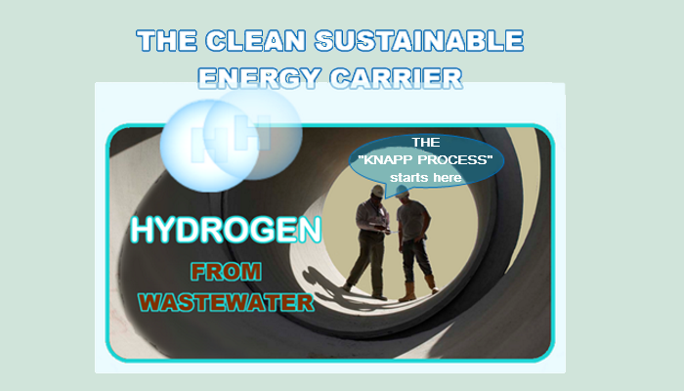

SIMULTANEOUS
PRE-TREATMENT
AND
ENERGY EXTRACTION
FROM
HYDROGEN SULFIDE (H₂S) IN WASTEWATER
Notes:
The hydrogen sulphide (sulfide) that is directed through the “Knapp Process” is rendered ineffective at producing the acid that erodes the wastewater infrastructure.

Slide 2
Opportunity for EQUITY PARTNERSHIP
Wastewater treatment plants are under increasing pressure to become “energy positive” in addition to facing increasing environmental regulations.
Current solutions are based on recovering biogas from digestion Unfortunately, that produces methane CH₄ plus equal amounts of CO₂. That is followed with combustion of the CH₄ which creates CO₂ emissions; negating any energy benefit for the community.
Hydrogen Sulfide (H₂S) is a naturally-occurring gas produced by bacteria in anaerobic environments . When oxygen is present H₂S forms sulphur dioxide SO₂ which in three steps forms sulphuric acid H₂SO₄ that destroys wastewater infrastructure.
A New approach: The Knapp Process will enable a wastewater plant to extract hydrogen directly from dissolved hydrogen sulphide (H₂S_{aq}) in the wastewater stream while simultaneously improving the treatment process and, by reforming H₂S before it forms H₂SO₄ and thereby significantly reduces costly infrastructure replacement.

Slide 3
A Novel Approach…
Electrolysis is typically used to extract hydrogen from water (H₂O). However, renewable energy required to break the H₂S bond is lower (381 kJ/mol). than renewable energy required to break the H₂O bond being (486 kJ/mol). Net positive energy yields by targeting H₂S than negative energy H₂O.
In addition to applying the proven process of electrolysis to his target Dissolved hydrogen sulfide (H₂S) he subjected the cathode to a NOVEL TECHNIQUE which significantly increased the yield of hydrogen.
The “Knapp Process (patent pending) applies the demonstrated process of a combined electrolysis & novel technique to extract hydrogen from dissolved hydrogen sulfide (H2S). The inventor Knapp is a retired 35-year veteran of Dupont Canada’s Research & Development Centre
This patent pending “Knapp Process” is able to produce Hydrogen from ubiquitous dissolved hydrogen sulfide, yielding both a zero-carbon fuel for fuel cells while also simultaneously reducing H₂S to a benign by-product which renders an overall reduction in wastewater treatment costs.

Slide 4
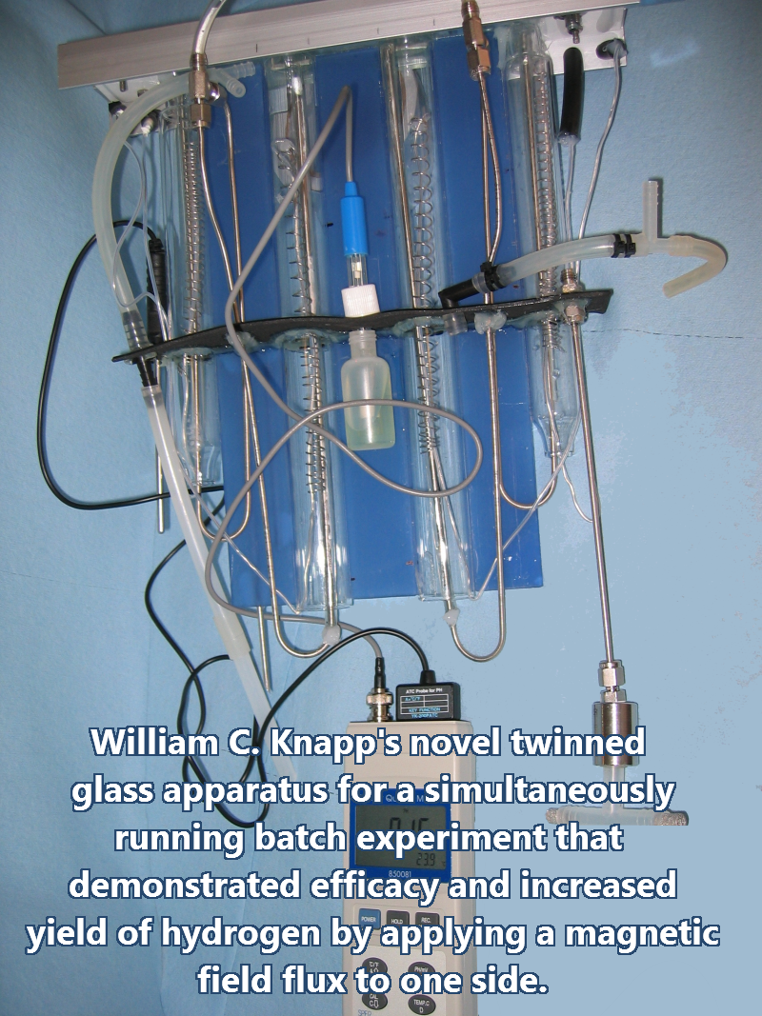
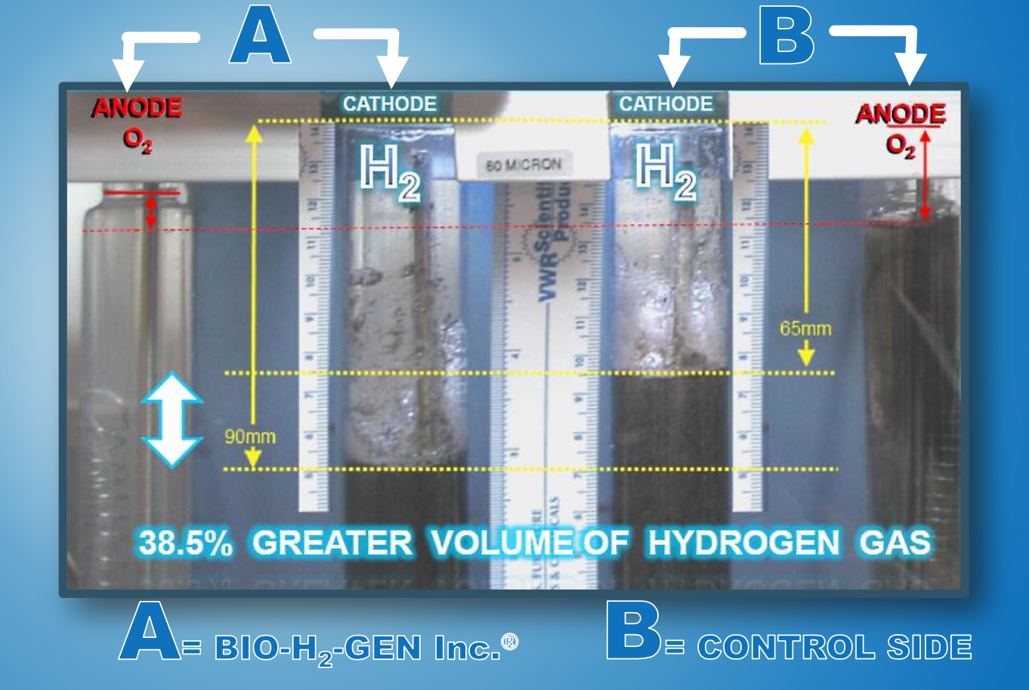
Proprietary Technology: The “Knapp Process”
THE NOVEL BATCH EXPERIMENT APPARATUS THAT VALIDATED KNAPP’S HYPOTHESIS USING A NOVEL TECHNIQUE.
The result of the novel technique was depicted in a batch experiment using a twinned glass apparatus shown on the left.
The proprietary modification, to a conventional electrolysis process, uses a novel technique to improve process yield by over 38%.
A ZERO-CARBON PROCESS

Slide 5
Electrolysis of H₂S is a “Game Changer”
Utilities can reduce biological & chemical oxidation costs (BOD & COD) while simultaneously adding the benefit of producing hydrogen the “zero-carbon” energy carrier.
Rapidly develop an on-site energy generation capability – produced energy can meet other utility needs including zero-carbon electric vehicle fuel.
Potential for reduction of H₂S formation in wastewater collection network where corrosion is a major issue and cost.
Leverage incentives provided by carbon cap-and-trade and emission reduction programs.
Reduce downstream treatment energy consumption due to lower aeration energy costs.
Reduce potential for corrosion damage to expensive wastewater collection infrastructure by locating electrolysis points within the collection network.

Slide 6
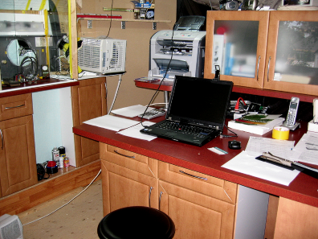

Progress to Date
Lab-scale prototype developed:
  A twinned simultaneous experiment provided a successful comparison of the “Knapp Process” novel technique influence to the identical control side.
SMALL LABORATORY BUILT TO CONDUCT THE EXPERIMENT
Patent applications filed:
“Method for Producing Hydrogen Gas from Aqueous Hydrogen Sulfide”
  US Provisional patent application: Date of filing: June 19th, 2015
  Patent Cooperation Treaty Application (PCT) Filed.
Next step is an engineering firm will be engaged for our modular pilot plant that will include in-line process design and package pilot plant design. They provide a “turn-key” operation that includes testing as well as delivery, set-up and training.
Receipt of the “turn-key” tested pilot plant will greatly facilitate country-wide implementation of the added “Knapp Process”.

Slide 7
Market Opportunity for the “Knapp Process”
The US alone has 14,748 wastewater treatment plants and Canada, in 1992, was known to have 2,800. The worldwide market would add tens of thousands more.
Additional markets include:
    Industrial wastewater treatment facilities.
    Large scale animal farming waste lagoons.
    Breweries, commercial juice production and food processing wastewater.
    Centralized locations of massive sources of H₂S; e.g. The Dead Sea contains trillions of kilograms of dissolved H₂S in its anaerobic depths.
Source of differentiation for wastewater treatment system concession operators – They are able to offer:
    greenhouse gas reduction impact,
    reduce vehicle fleet carbon emissions,
    reduce energy consumption
    and dramatically reduce infrastructure repair costs.
    Reduction in biological & chemical oxygen demand. (COD & BOD costs)
Notes:
*https://www.infrastructurereportcard.org/cat-item/wastewater/ for information on United States wastewater. In 1992, there were approximately 2800 MWTPs in Canada (Municipal Wastewater Treatment Plants) https://www.ec.gc.ca/eu-ww/default.asp?lang=En&n=6E4ACEEE-1

Slide 8
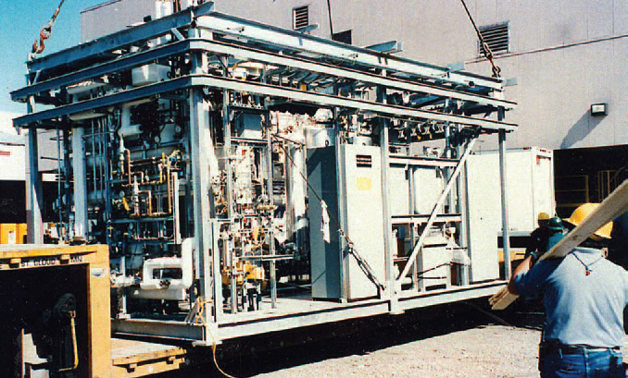
Development Strategy
Design a standardized modular ”package plant” that can be deployed at even small wastewater treatment facilities to support waste-to-energy extraction with simultaneous reduction in H₂S treatment costs.
An example of a modular pilot plant. Our selected Canadian engineering firm
designs them to fit on a flat bed transport for delivery.
Notes:
https://www.epicsysinc.com/
https://pilotplantdesign.com/

Slide 9
Future Requirements
We require a strategic partnership/investment to:
Develop prototype modular packaged pilot plant to demonstrate batch-to-inline scale-up, process yield increase, lower effluent treatment costs. Can leverage potential grants from several organizations.
Capital & operating expenditures [CapEx & OpEx] are estimated at ~$3.5M (USD) for delivery and operation for 2 to 3 years. Marketing engineering data, for scale-up, expected within that timeframe.
OpEx support will also enable international-phase patent filings.
    We will select countries for patent application filings to receive patent cooperation treaty (PCT) date protection from June 19th, 2015. Legal fees estimated to be ~$ 50K (USD).
Select initial pilot plant demonstration site(s).
    The selection could also serve as a research and development centre for process optimization and the incorporation of further cost cutting innovations.
Design-build-operate (DBO) of package plants in staged global rollout.

Slide 10
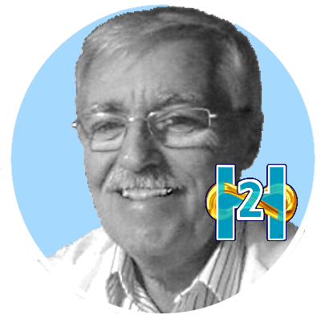
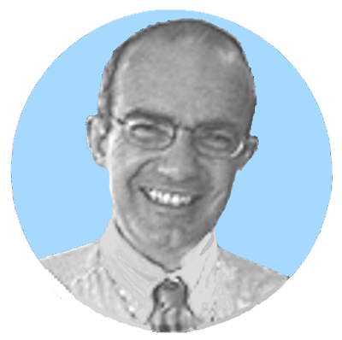
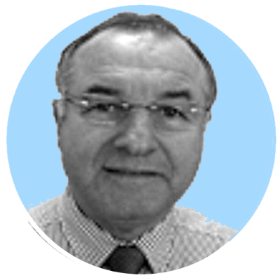

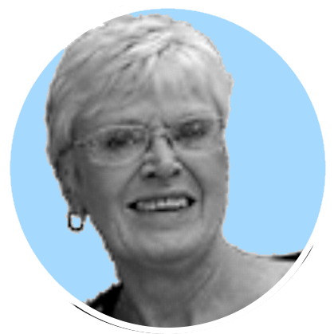
Mr. William C. Knapp, Officer of BIO-H2-GEN Inc.
Inventor, Co-Founder, President, C.E.O
Retired from DUPONT CANADA’S Research & Development Centre, Kingston, Ontario, 8 Patents, co-authored paper in Polymer Science Journal
BIO-H2-GEN Inc.
An Ontario Canada corporation
Mr. William A. Spurr, Officer of BIO-H2-GEN Inc.
C0-Founder, Chairman
Retired as President of Bombardier Corporation’s
North American Land Transportation Division ,
Montreal, Quebec EMAIL:waspurr@bioh2gen.com
Mr. Santo P. Mazzeo, Officer of BIO-H2-GEN Inc.
Chief Financial Officer, CFO
CPA Kingston, ON EMAIL: spm@spmca.ca
MANAGEMENT
TEAM
&
CORPORATE
OFFICERS
Mr. Sean Fitzpatrick, Officer of BIO-H2-GEN Inc.
Chief Information Officer, CIO EMAIL: dnsguru@gmail.com
Ms. Margaret E. Knapp, Executive Assistant
BIO-H2-GEN Inc.
Kingston, ON EMAIL: marknapp@bioh2gen.com

Slide 11
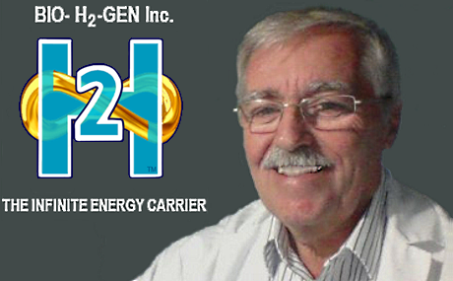
THANK YOU
Bio-H₂-Gen Inc.
CONTACT:
William C. Knapp, President and C.E.O.
Email: wcknapp@bioh2gen.com
LinkedIn: https://ca.linkedin.com/in/william-knapp-445a3084
Web site: http://www.bioh2gen.com (to be edited, and updated)
Address: BIO-H2-GEN Inc.
1687 Harten Lane
Kingston, Ontario
Canada K7L 4V1
Phone: +1-613-767-7099
THIS “ROCKET” STILL HAS SOME BOARD ROOM

