Slide 1
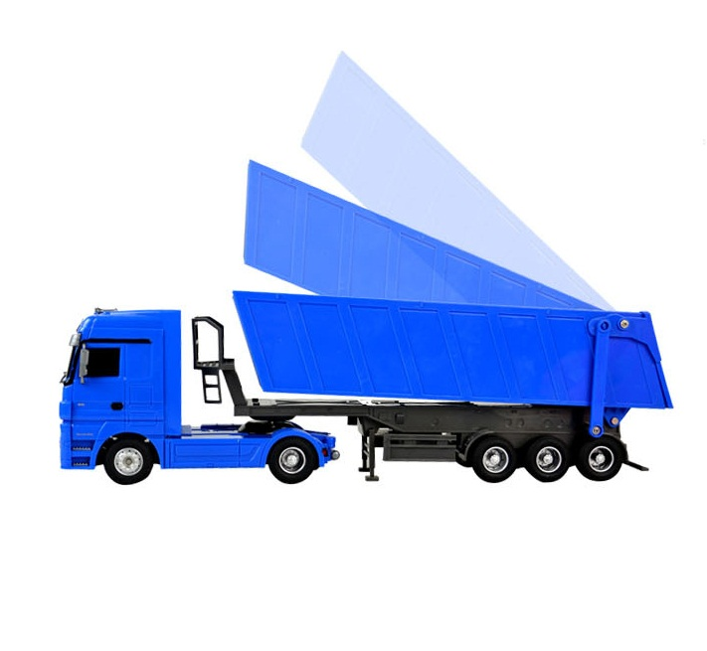
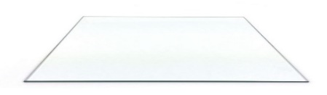

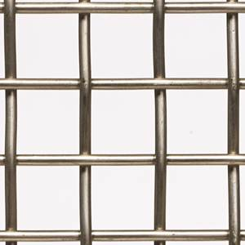

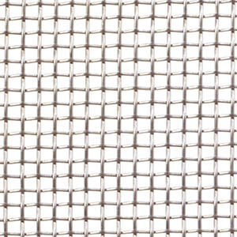
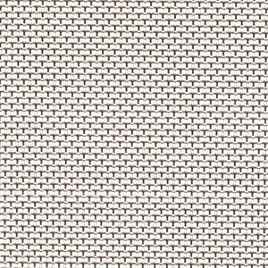
NEW
Waste Water Dehidration
For Waste Water
Triple tilted – progressive – mobile - filters
and solar drying
Blue Fin
Water Technology
Model
WW
Tel: 210 485 4326
Fax: 210 247 9499
San Antonio, TX, USA
Sales@BlueFinWater.com
Solids removed are also solar dried (heat treated),
before fertilizing application, in truck bed.
Equipment Description:
Salinity resistant inner lining
Specially designed high quality
Magnetic paper.
Laminar flow equalizing inner spiral
High efficiency pumps.
Salinity resistant pipes and valves.
Easy of Maintenance
Replacement of: adsorbent, FDA approved plastic, sleve about 9 months.
55 Gallons per day minimum, depending on desired conductivity
Commercial Terms:
Minimum 12 units
Staged delivery, 4 per shipment
Advanced payment of 50% & 50% before delivery.
Unit price; US$ 27,000
APPLICATIONS
Decentralized users
Fishing Villages
Beach Camping Sites
Eco friendly sites
Remote resorts
Disaster relief
Remote camps
Farming, Cattle, Wineries
Large energy black outs
(solar panel or small generator powered)
Gradient on
parking bay
Quick hose
connector
Water to bio
treatment
Pivoting support axis
Successive mesh arrangement inside truck’s bed
Progressively finer mesh Across the truck’s bed
ENGINEERING
  Consulting
  Project Management
  Licensing
  Engineering, Specific Design
  Project Integration
ADVANTAGES:
70 % Lower Electricity Consumption - Does not require high pressure pumps.
98% of the water is treated - Back wash is done with high velocity air.
Simpler System - Does not require ultra filtration.

