Slide 1
Sewage Treatment System
XERODROP
By
Aeolus Sustainable Bio-Energy Pvt Ltd,

Slide 2

Sewage Treatment- Present Approach
Biological treatment for sewage
Bio-Methanation
Bio-Composting of solid sludge
However
These approaches are not sufficiently effective
Statutory requirements are not fully complied

Slide 3
Limitations of Conventional Microbial Treatments for STP
Dependency on “mood” of microorganisms
Large land requirement
Inconsistency of results due to multiple factors
High maintenance costs
Depletes atmospheric oxygen, generates green house gases
Spreads pungent smell, large quantity of solid sludge
Most of the plants are not scalable

Slide 4
Sewage Treatment –
The Novel Approach
Aeolus now presents
XERODROP
The modern approach
Based on
One Century old Faraday’s Laws

Slide 5
XERODROP - Introduction
Proven Technology
Based on Electro-Chemistry
Advanced approach to time tested principles
Core Competence
Team of distinguished Technocrats
Three years of R&D
Successful Pilot plant demonstration

Slide 6
XERODROP- Advantages
Effective removal of pollutants
Always dependable
>90% water recovery for recycling
No smell, no noise, compact size
No chemical addition
Simplicity in operations, Low O & M Cost
Low solid sludge generation
Recovery of valuable soil nutrients from solid sludge – revenue generation

Slide 7
XERODROP – Un-comparable advantages
XERODROP
CLEAN TECHNOLOGY
No Bacteria
No Chemicals
Plug & Play
No Heat
No Smoke
No Incineration
Only raw material required
ELECTRICITY

Slide 8
XERODROP – Results Pilot scale
Parameter | Typical DSW | XERODROP Treated DSW | CPCB Norms
Colour | Dark Brown | Colorless | Acceptable
pH | 4.0 – 4.2 | 5.9 – 6.9 | Acceptable
COD | 140000 - 160000 | 0-500 | <99% load reduction
BOD | 60000 -70000 | 0-30 | <99% load reduction
Total Solids TSS | 160000 - 210000 | >100 | Acceptable
Total volatile solids | 80000 - 90000 | >20 | Acceptable
Conductivity | Not measurable | 89.92 mmhos | Acceptable

Slide 9
Distillery Spent Wash Effluent- The Challenge
Distilleries fermenting sugar cane molasses generate 8 - 15 liters of waste water per liter of ethanol produced.
The Distillery spent wash (DSW) is characterized by being:
  Highly acidic
  Very High BOD and COD
  High recalcitrant organics with dark colour and severe pungent smell.
  High concentration of recalcitrant COD persists even after both anaerobic and aerobic treatments.
  Melanoidins and Polyphenolic complexes formed during fermentation is not easily decomposed by any conventional treatment

Slide 10
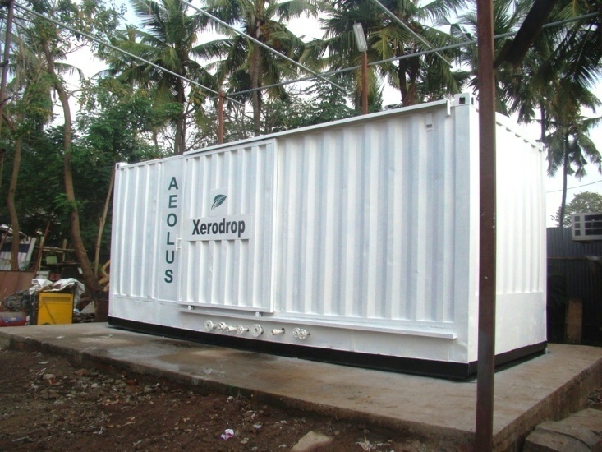
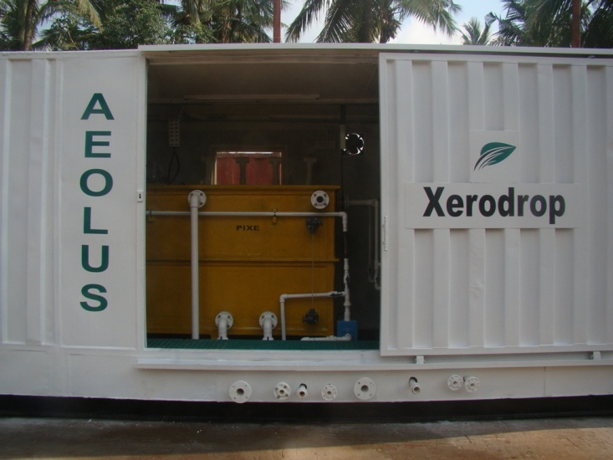
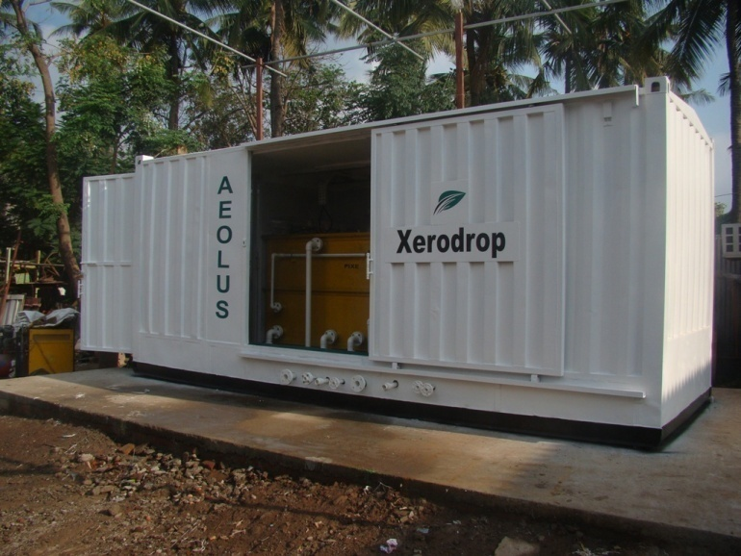
XERODROP – Pilot Plant

Slide 11
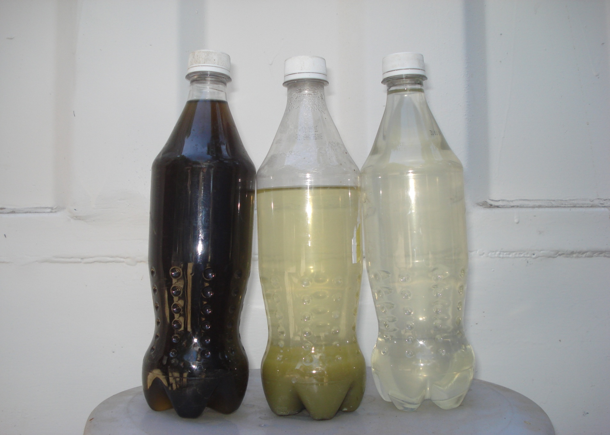
Xerodrop Distillery spent wash results

Slide 12
XERODROP Process Block Diagram
Effluent A
From various collection points
Effluent B
From various collection points
Screening
Equalization tank
XERODROP Reactor -1
Clarifier
Solid Sludge
XERODROP Reactor -2
Settling tank
Pressure sand filter
Activated carbon filter
Treated effluent

Slide 13
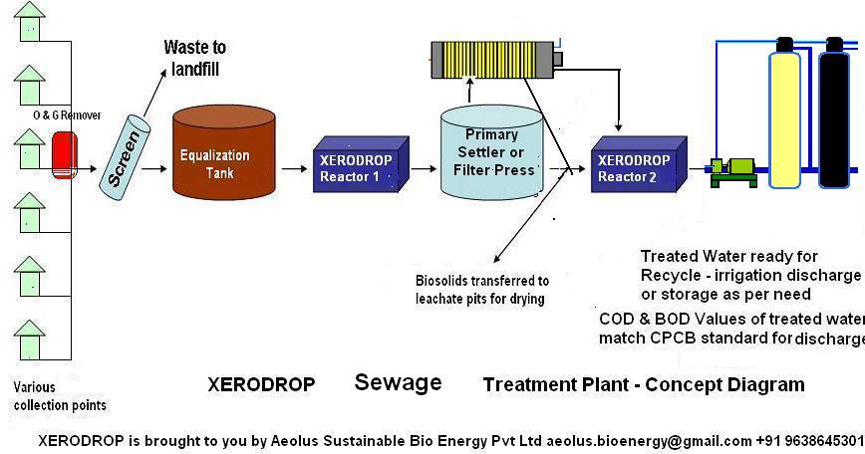
Xerodrop – Concept

Slide 14
XERODROP - PROCESS
Primary Treatment
    Screening
    Collection and Equalization Tank
Secondary Treatment
    Electro-chemical process 3 stages in reactors
    Settling
Tertiary Treatment
    Sand filtration
    Activated Carbon adsorption
    Reverse Osmosis (optional)

Slide 15
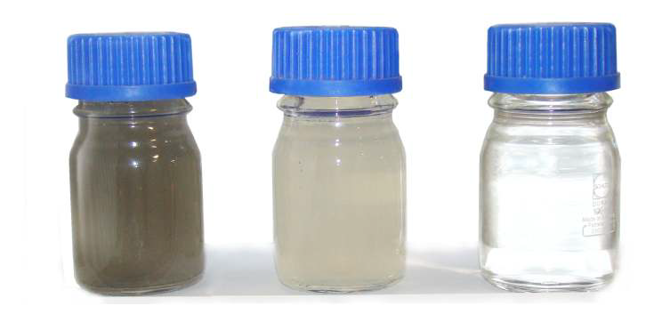
XERODROP Results
Before Treatment
After Stage 1
Treatment
After Final Treatment

Slide 16
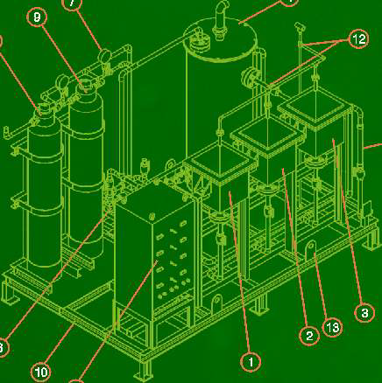
XERODROP Plant Layout

Slide 17
Xerodrop implementation for
Municipal bodies
Xerodrop can be implemented in 2 possible ways
Xerodrop Satellite units for each wards
Xerodrop Centralized units for existing STP

Slide 18
Xerodrop Satellite units for Wards
Water recovery treatment centers
Xerodrop units for each ward benefits by:
  Reduced load on central STP. Up to 95% reduction in wastewater effluent from the development resulting in:
    Saving in wastewater transportation costs
    Elimination of expensive and time consuming expansion projects
  Instant & localized, point of use recycling of treated water
  Small footprint
  Source of emergency potable / non potable / fire fighting water
  Rapid implementation for >95% water recovery
  Industrial / domestic utility reuse of water

Slide 19
Xerodrop Centralized unit for existing
STP
Enhancing capacity utilization of existing infrastructure by more than 500%
Holding time of the primary clarifier reduced to less than 5 hours from 4 days
Stage wise development of the project finally ends up in complete switching over to Xerodrop technology.

Slide 20
Xerodrop Infrastructure for drinking water from sewage
Sewage can be converted to drinking water if appropriate infrastructure is created
Singapore recycles sewage to drinking water
Stringent quality assurance is required

Slide 21
Sewage to drinking water concept
Screening
Equalization
Xerodrop 1
Filtration
Xerodrop 2
Desalination
Ultraviolet
Treatment
Electro-chlorination
Drinking water
Sewage
IS standard
NABL accredited
Quality Control
Laboratory

Slide 22
XERODROP – Way forward
XERODROP Technology is tested on various industrial effluents including power plants, fertilizers, pharmaceuticals, service stations, textile, dairy, Municipal STP, and many more
Controlled treat ability test on a Pilot plant is advisable for all specific industrial effluents.
Pilot plant of Xerodrop is available for technology demonstration at nominal charge.

Slide 23
Thank You!
For more details please contact:
Mr. Niraj Mithani – Director
Aeolus Sustainable Bio-energy Pvt Ltd
LG-15, Dada Bhagwan Complex, Nr. Kamrej Char Rasta,
SURAT. Gujarat. India.
Cell: +91 96386 45301 // 98250 77613
Email: aeolus.bioenergy@gmail.com
info@aeolusbioenergy.com
Web: www.aeolusbioenergy.com

