Slide 1
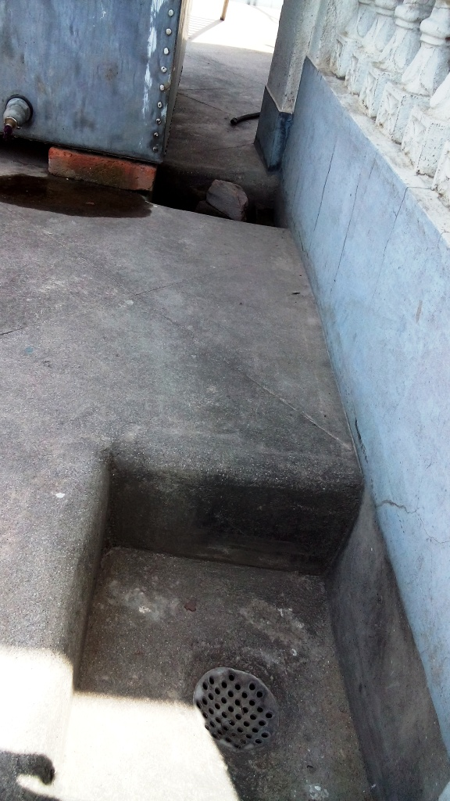
Step 1: Rainwater collected on the terrace and flows through the strain
Strain
Terrace Area: 630 Square feet

Slide 2
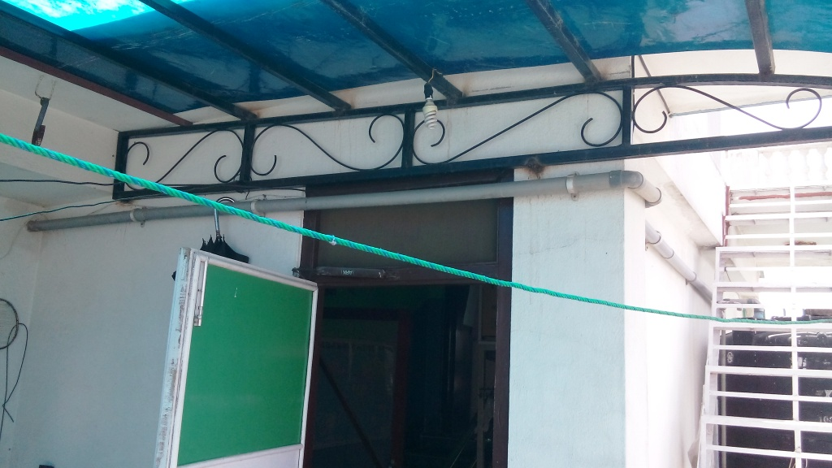
Step 2: Water collected in the tank of 1000 liter capacity.
1000 liter tank

Slide 3
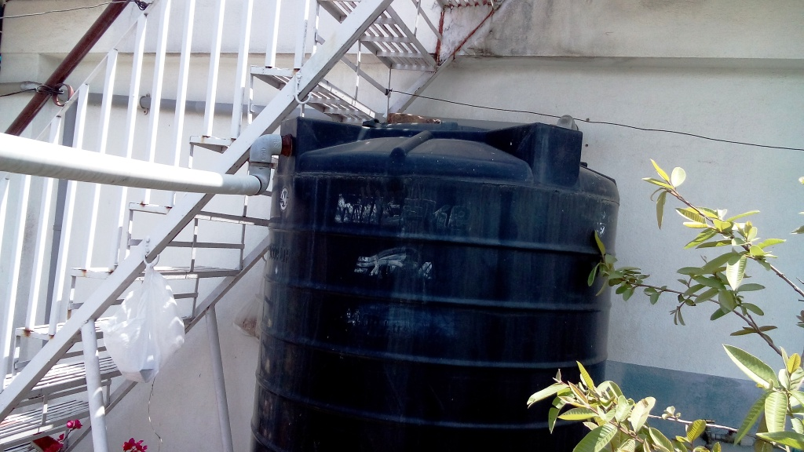
Step 3: Collected water sediments few seconds and overflows in another 500 liter capacity tank.
Overflow water

Slide 4
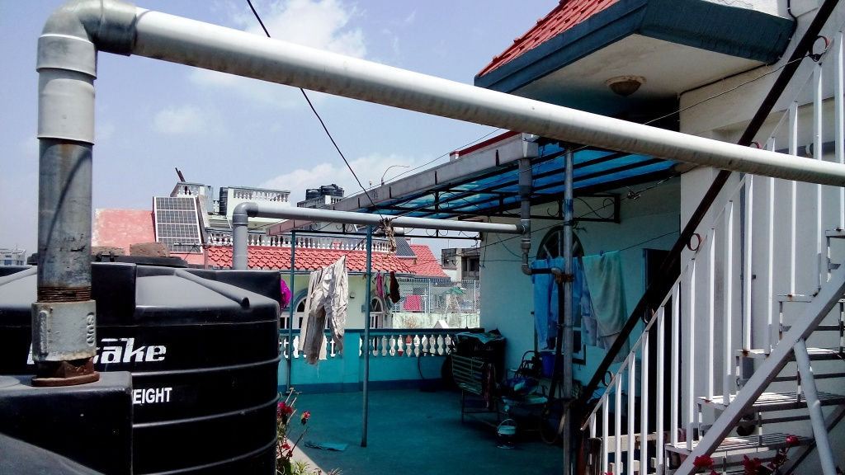
Step 4: Overflowed water from 1000 liter tank collected in 500 liter tank.
1000 liter tank to collect water from separate 150 square feet area blue fiber roof.
500 liter tank

Slide 5
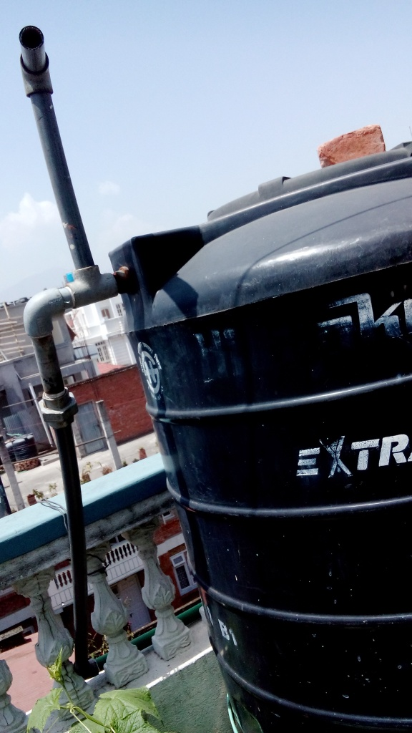
Step 5: Water further sediments in 500 liter tank for few seconds and overflowed through one inch pipe

Slide 6
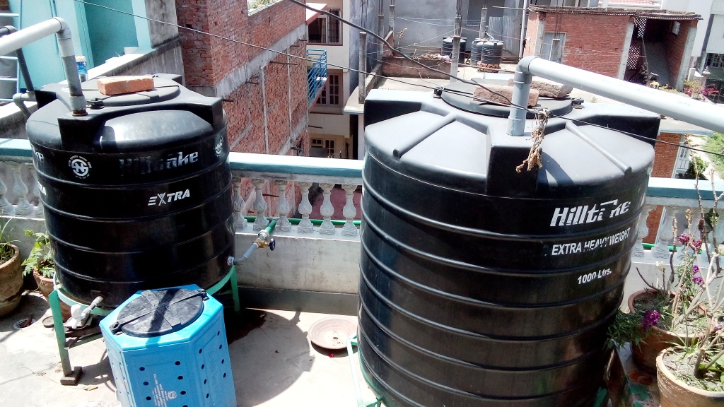
Step 6: If water not sufficient for overflow, the gear valve is used after sufficient sedimentation time.
Gear Valve

Slide 7
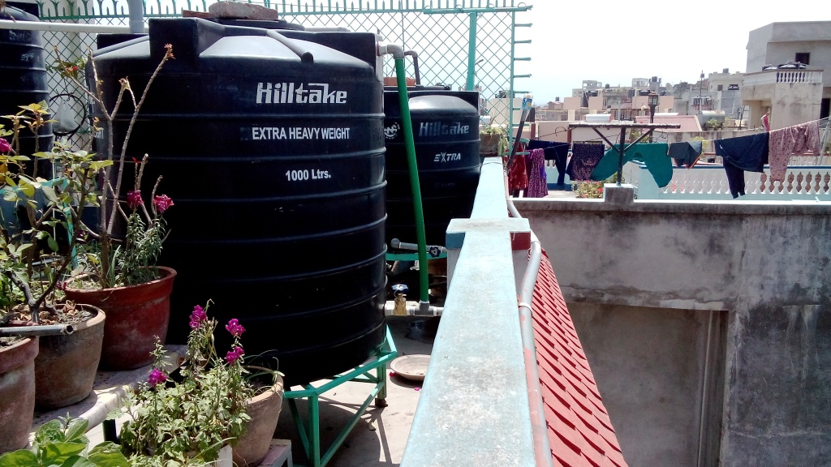
Step 7: Another gear valve used for separate tank of 1000 liter.
Gear valve

Slide 8
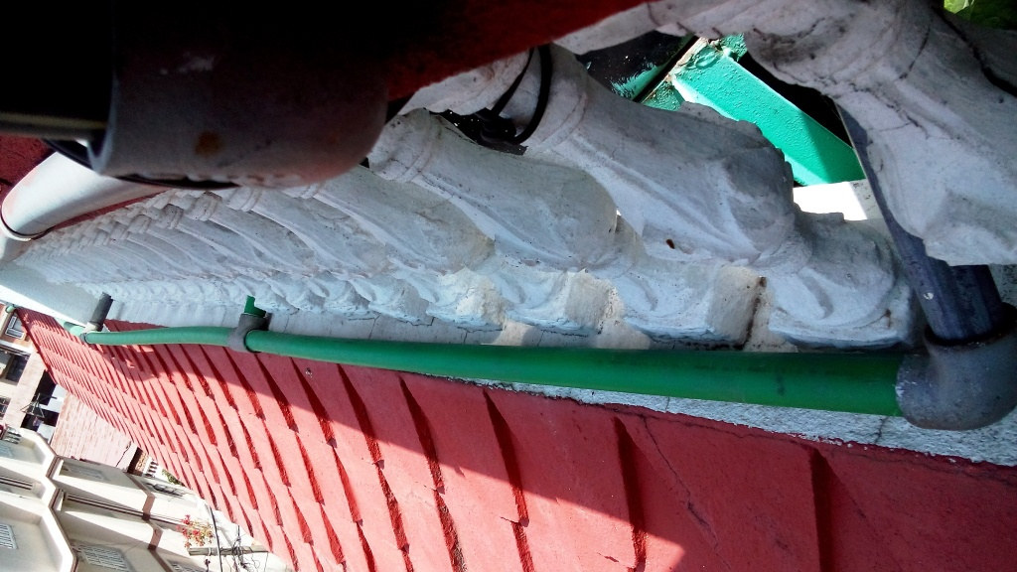
Step 8: Water from both 500 liter and 1000 liter tanks flows down towards ground.
rain water flows towards ground

Slide 9
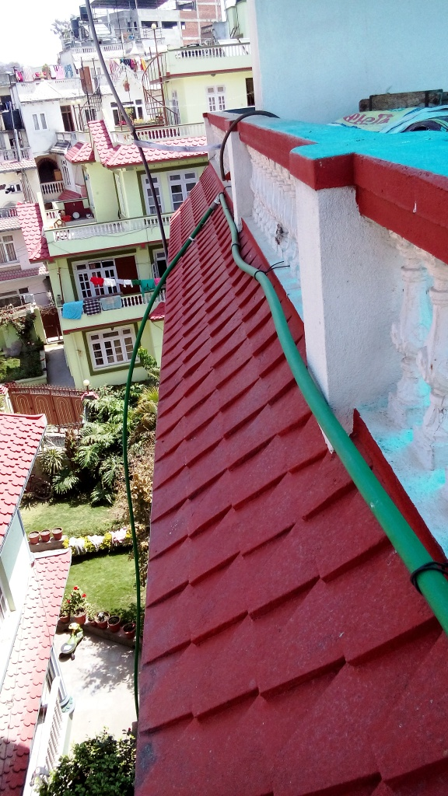
Step 9: Water flowing down continued

Slide 10
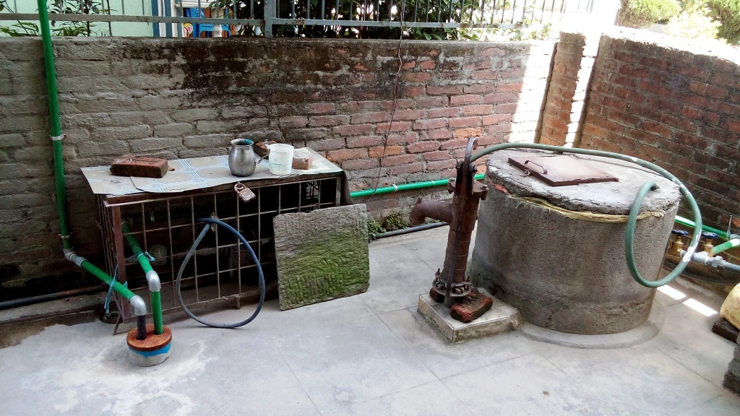
Step 10: Rainwater harvested and recharged in the ground
rain water flowing towards ground
28 feet deep boring with 10 feet filter pipe.

Slide 11
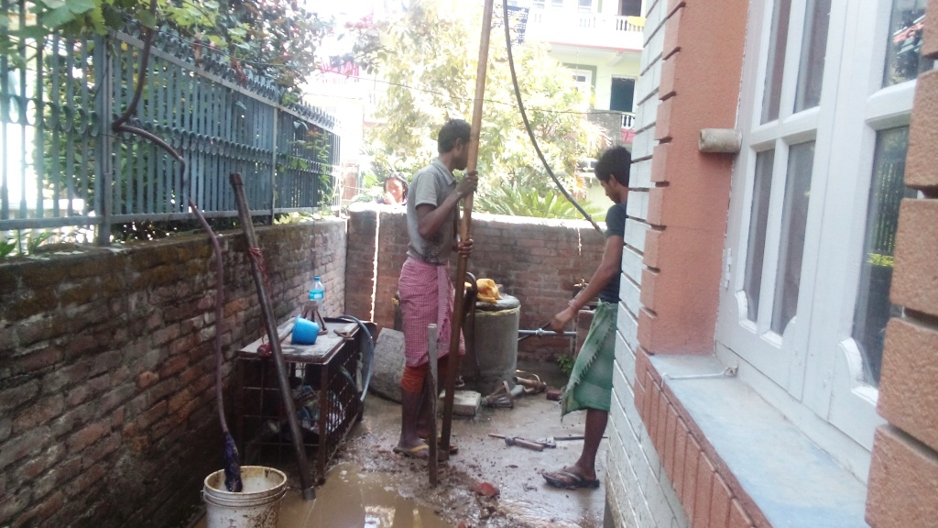
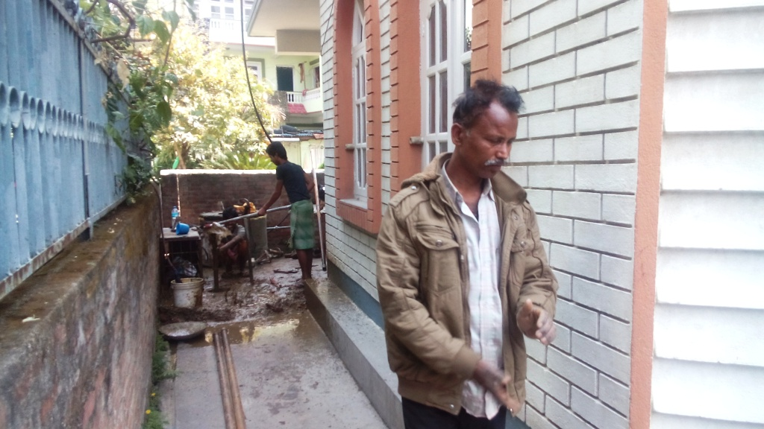
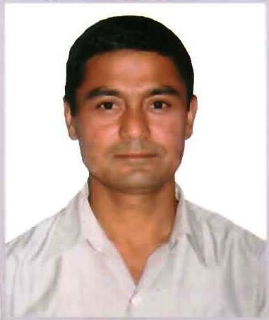
Technicians working for ground water recharge by rain water harvesting
Finally, If you are interested, please try to visit my home at Sankhamul, Kathmandu, ward number 10 and observe the rain water harvesting system.
Thank you very much.
Date: 21st April 2015
Kaji Awaley
kaji.awaley@gmail.com

