Slide 1


Natural Inorganic Cohesive agent

Slide 2
Features
Natural inorganic minerals are used as main material.
Treatment process can be shortened due to fast cohesion reaction speed.
Cohesion of metal ions is excellent.
Cohesion is possible without adjusting pH as a single cohesive agent.
Neutral inorganic cohesive agent.
Eco-friendly cohesive agent with high stability and low burden on the environment.
Effective in removing waste water containing heavy metals.
Dehydration effect is increased due to little viscosity (The amount of generated dehydration cake is reduced by 20 % or more compared to conventional product)
Field of Application
PCB, semiconductor, dying, plating, iron processing, paper production, butchery paint, oil refinery factory, first cohesion processing in waste water processing factory for chemical factory
Sewage and livestock waste, cohesion processing for dehydration of biological sludge
Wastewater/sewage flow T-P processing
Processing plating and glass grinding waste water containing heavy metals (Pb, Cr, Cu, etc.)
When much chemical cohesive agent (ALUM, PAC, POLYMER, etc.) is used
When cohesion and precipitation efficiency are low due to light FLOC
Compositions
Item | Al₂O₃ | SO₃ | K₂O | CaO | SiO₂ | Cl | FeO | Na₂ | MgO | OH
% | 4.7 | 27.7 | 0.1 | 20.1 | 16.8 | 0.2 | 0.5 | 11.0 | 0.3 | 18.5
* pH 7.2 / specific weight 0.84

Slide 3
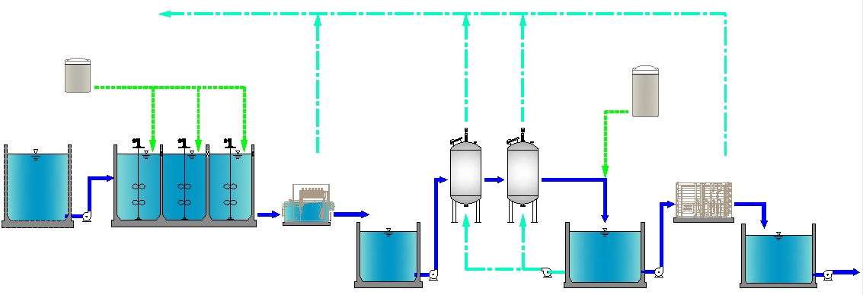
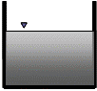
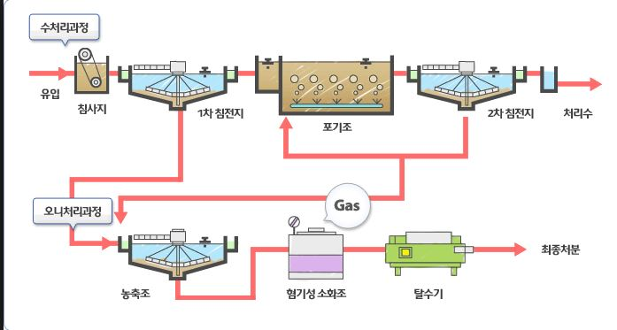
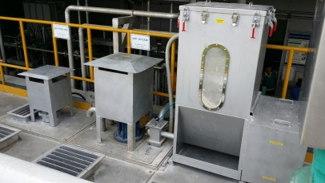
Application to water treatment process
Waste water sewage treatment process
Wastewater/sewage inflow
Chemical treatment process
(cohesion reaction tank)
First precipitation tank
Biological treatment process
Second precipitation tank
Post treatment process
■ Types of cohesive agents and field of application
Item | Field of application
TSC-A | Green algae wastewater, paint wastewater, tunneling wastewater, dredging wastewater, plating wastewater, paper production wastewater, sewage flow, oil wastewater, dying wastewater, painting wastewater
TSC-B | Sewage sludge, and sludge dehydration
TSC-C | Oil wastewater, semiconductor wastewater, PCB wastewater, paint wastewater
TSC-D | Semiconductor, PCB wastewater, grinding wastewater, livestock wastewater, chicken wastewater, plating wastewater, dying wastewater, painting wastewater
TSC-E | Floating, chicken wastewater
TSC-F | Emulsion oil, releaser wastewater
TSC particulate inserter
Fast / slow reaction tank
Processing time is drastically reduced due to fast precipitation sped, minimizing the area of site.
When capacity of existing facility is exceeded and when there is little area for further construction
Control of contaminants that is difficult to form cohesion through general cohesion precipitation
Secure excellent treatment rate through small amount of agents in controlling heavy metals and toxics
From the perspective of economics, the effect if increased biological treatment capacity when installed on the front

Slide 4
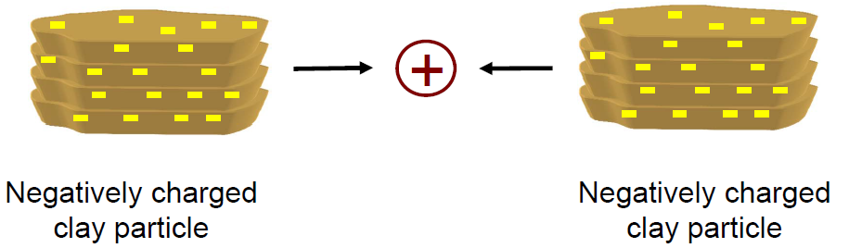
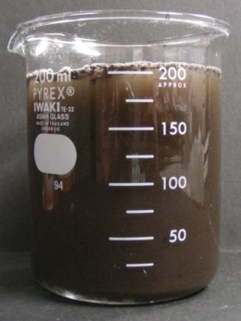
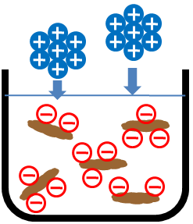
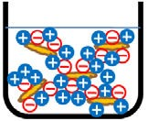
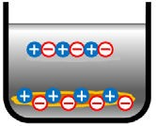
Principles of Cohesion
Surface compositions react with water molecules along with permanent minus charges through “ion exchange function” of natural minerals and charges are generated on the attached surface, absorbing plus and minus material at the same time. Furthermore, since charges are changed by positive features under the condition of pH 7, stronger cohesion effects can be generated when conditions are met.
TSC is produced by special technology using features of natural minerals, and
Since it has much more + charges than general cohesive agents, floc with large
cohesive force is formed through ion bond with multiple – charges in wastewater.
When TSC is inserted into wastewater containing colloid particles, cohesion is
formed through ion bond, and remaining + charges attract – charges on colloid
particles, forming floc through direct bond.
Negatively charged particle
Negatively charged particle
FLOC is formed through adhesion by plus charges
Addition/stirring
Cohesion
Precipitation
Separation
Ion exchange by stirring after adding cohesive agent
Absorption of contaminants by condensation and cohesion
Rapid precipitation while forming flocs
Formation of sludge that does not elute again after separation
＋
－
＋
－
＋
－
＋
－
＋
－
－
－
＋
－
－
＋
－
＋
－
＋
＋
＋
－
＋
＋
－
＋
－
＋
－
＋
－
＋
－
＋
－
＋
－
＋
－
＋
－
－
－
＋
－
＋
＋
＋
－
＋
－
＋
－

Slide 5
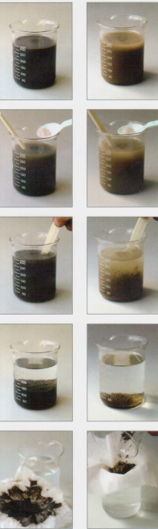





Test Procedure
<Sludge>
<Cement waste water>
1
<Sludge>
< Cement waste water >
4
Preparation for sampling waste water
When concentration is high, dilute with water.
pH of wastewater is basically neutral.
Although cement wastewater can be treated as is, emit by finally neutralizing.
Precipitation
When stopped for about 10 seconds FLOC is precipitated.
When FLOC is small, increase the amount of cohesive agent.
When the agent is excessive, water becomes thick.
2
5
Inserting KA/KC → Stirring
(0.5~1g for 1,000mL of wastewater. 2~3 g for decoloring)
Insert by small amount while stirring since beads can be formed when inserted in one time.
Filtering
Filter by overlapping 2~3 pieces of non-woven fabrics.
Transparent water will flow out when the non-woven fabrics are strongly twisted.
Sludge has little viscosity.
(However, oil portion has viscosity.)
3
Stirring
FLOC is generated by strongly stirring for about 20 seconds and slowly stirring for about 10 seconds.
(In decoloring, the stirring times are twice the above cases respectively.)

Slide 6
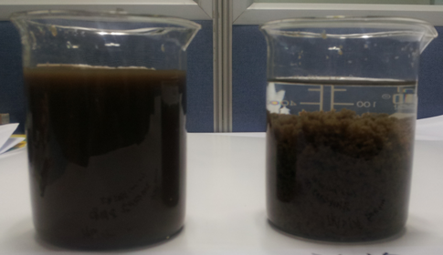
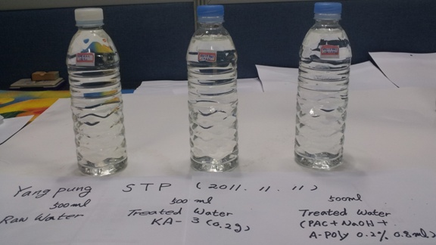
Data of cohesion treatment experiment
Gangseo sewage processing site in Yangpyeong_ sewage sludge cohesion test results
(cohesive agent TSC – B 500mg/L)
Item | Raw water (mg/L) | Treatment water (mg/L) | Removing rate (%)
BOD | 1,550 | 3.0 | 99.8
SS | 6,114 | - | -
T-N | 687 | 5.1 | 99.3
T-P | 136.9 | 0.08 | 99.9
Sewage flow from Gangseo, Yanpyeong _ flow water T-N, T-P sewage cohesion test results
(cohesive agent TSC – A 200mg/L)
Item | Raw water (mg/L) | Treatment water (mg/L) | Removing rate (%)
BOD | 5.4 | 0.4 | 92.6
CODmn | 11.4 | 8.0 | 29.8
T-N | 9.6 | 9.3 | 3.1
T-P | 1.05 | 0.031 | 97.0

Slide 7
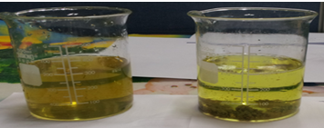
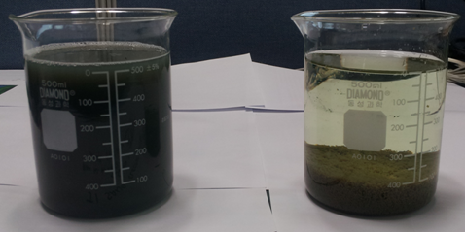
Data of cohesion treatment experiment
Heavy metal waste water
Test results of waste water in cleaning packaging material of Yulchon Chemistry
( cohesive agent TSC-A 300mg/L ) * cohesion additive – PAC used
Item | Raw water (mg/L) | Treatment water (mg/L) | Removing rate (%)
Cr | 101 | 40.06 | 60.4
Cu | 21 | 0.07 | 99.7
Plating waste water
Test results of plating waste water in Banwol plating association in Ansan
(cohesive agent TSC-A 300mg/L) * cohesion additive – not used
Item | Raw water (mg/L) | Treatment water (mg/L) | Removing rate (%)
CODmn | 720 | 204 | 71.7
SS | 1,310 | 18 | 98.6
T-N | 750 | 389 | 48.1
T-P | 108 | 0.4 | 99.6
CN | 154 | 5.2 | 96.6
Cr | 107 | 0.2 | 99.8
Cu | 170 | 23.3 | 86.3

Slide 8
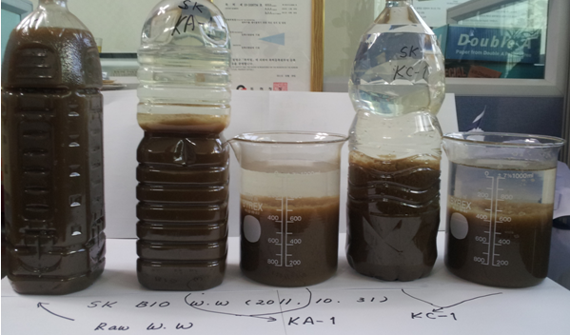
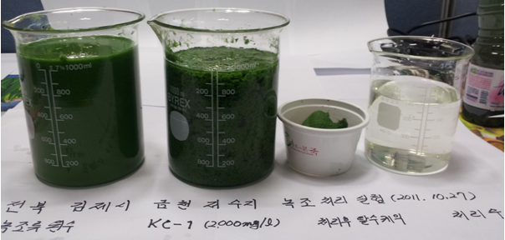
Data of cohesion treatment experiment
Bio sludge from SK Energy Ulsan factory (cohesive agent TSC-A 500mg/L) * cohesion additive - PAC used
Item | Raw water (mg/L) | Treatment water (mg/L) | Removing rate (%)
BOD | 750 | 32.6 | 95.7
CODmn | 1,660 | 30.4 | 98.2
T-N | 869 | 51.5 | 94.1
T-P | 26.07 | 0.09 | 99.7
Green algae in reservoir _ Geumchen reservoir in Gimje, Gyeongbuk
(cohesive agent TSC-B 500mg/L)
Item | Raw water (mg/L) | Treatment water (mg/L) | Removing rate (%)
BOD | 4,228 | 110 | 97.4
T-N | 637 | 9.3 | 98.5
T-P | 90.6 | 0.1 | 99.9
Chlorophyll-a | 85,235 | 12.6(mg/m³) | 99.9

Slide 9
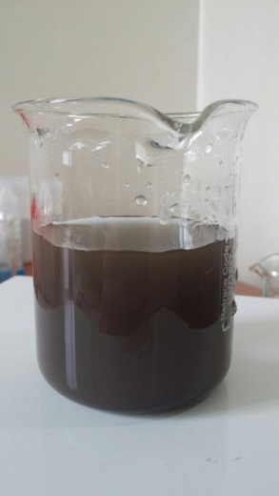
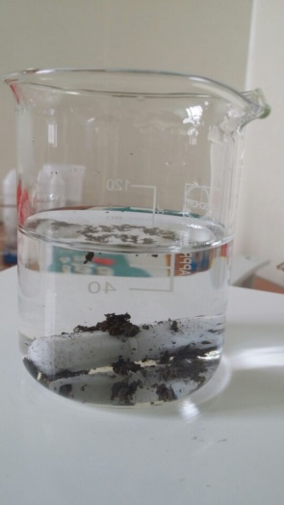
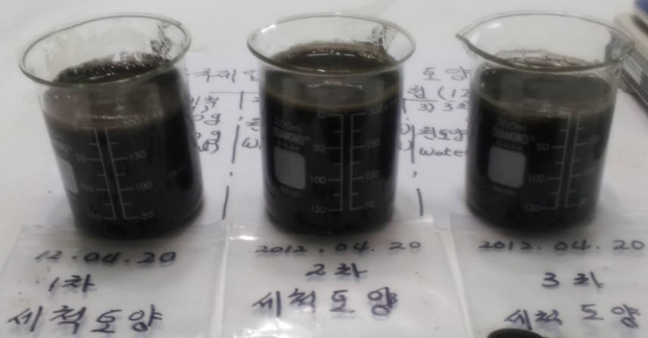
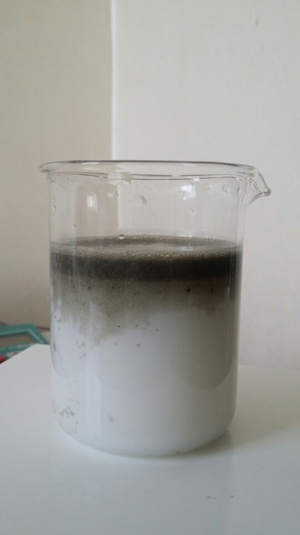
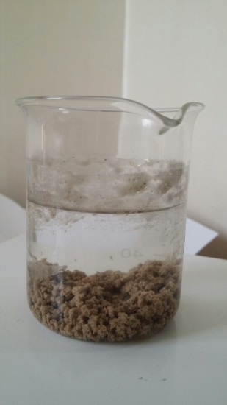
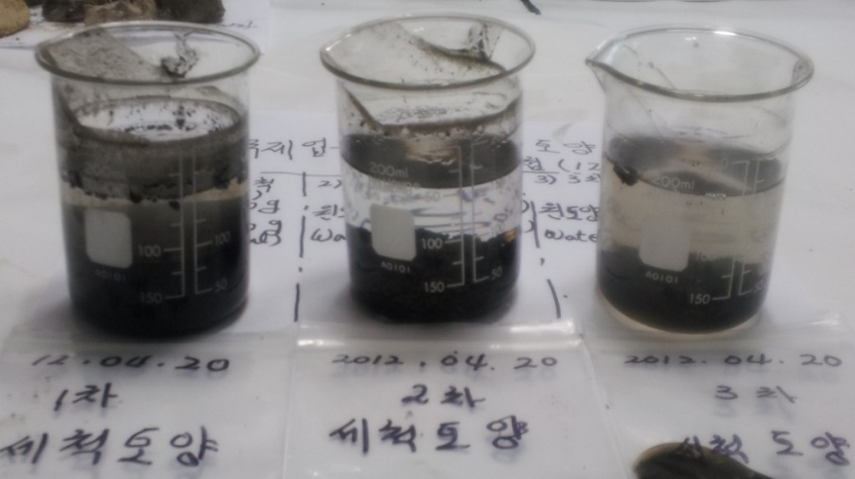
Data of cohesion treatment experiment
Waste water in cleaning contaminated soil
KCC semiconductor waste water cohesion processing
(Cohesive agent TSC-D 150mg/L)
Item | Raw water (mg/L) | Treatment water (mg/L) | Removing rate (%)
CODmn | 8,400 | 8.4 | 99.9
SS | 43,025 | 12.0 | 99.9
n-H (Mineral oils) | 87.7 | 2.1 | 97.6
Zn | 0.179 | 0.031 | 82.7
Cu | 0.029 | 0.009 | 69.0
<Raw water>
<Treatment water>
Cohesion processing of waste water from casting factory
Cohesive agent TSC-D 500mg/L)
<Raw water of cleansing water>
<Treatment water of cleansing water>
<Treatment water>
<Raw water>

Slide 10
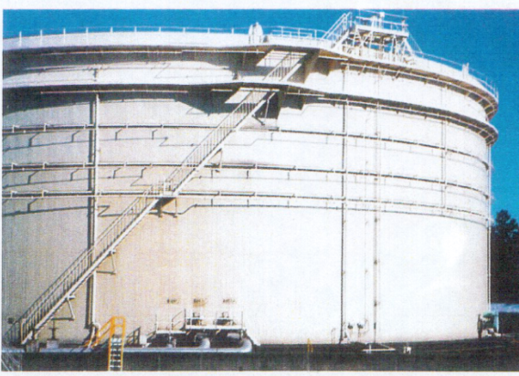

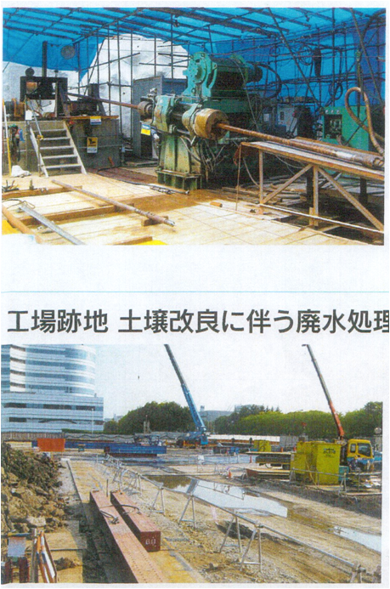

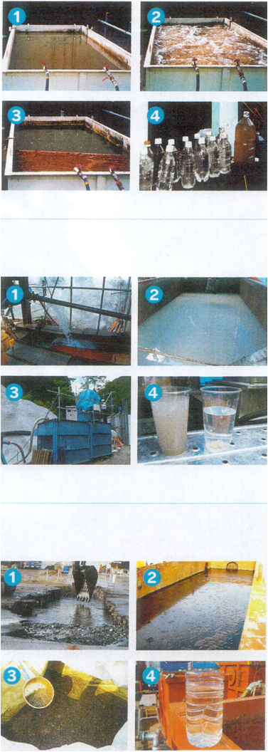
Actual Use Cases
Cleansing waste water processing in petroleum tank
Waste water in tunneling constructions
Waste water processing by soil improvement in factory destruction
For specific oil tanks regulated by Law on Fire, interior cleansing every 5 years is obligatory.
KA is used in cleansing waste water processing in the tanks.
① Cleansing waste water treatment vessel in tank (8㎥)
② Air stirring after adding KA
③ Floc floats – collected through skimmer
④ Treatment water sampling
(Left: Treatment water, right: Raw water)
① Tunneling waste water
② Waste water containing bentonite
③ Waste water processing equipment
④ Treatment water sampling
(Left: Raw water, Right: Treatment water)
① Waste water of asphalt and oils \
② Asphalt cleansing waste water
③ Separated sludge after processing
④ Treatment water sample

Slide 11
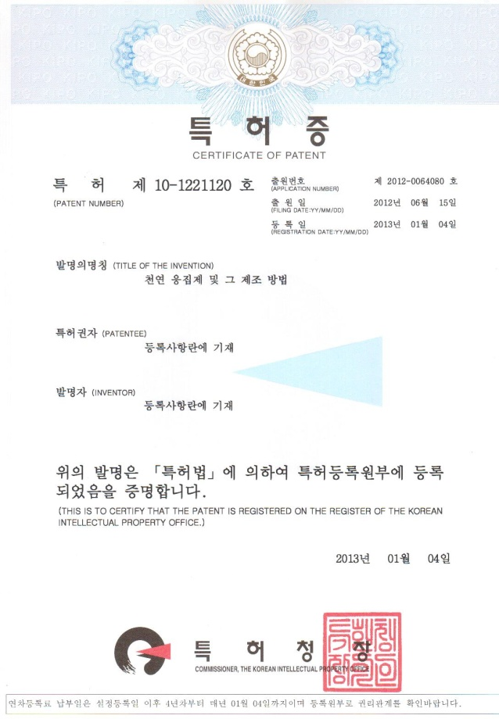
Certificate of Patent

