Slide 1


Water Sustainability
Zero Effluent Discharge for Process plants
Dr. M. P. Sukumaran Nair,
Centre for Green Technology & Management

Slide 2


Water intensity of Manufacturing
Bulk chemical manufacturing ( refining/petrochemical/chlor-alkali /fertilizer etc) is a water intensive industry
Last 20 years average specific consumption of water (m³/MT) for
  Urea reduced by 50% (12 to 6)
  Complex (NP/NPK) reduced by 65% (11.4 to 3.5)
  Caustic soda reduced by 70% (110 to 35)

Slide 3
Average specific water consumption and effluent discharge Phosphate plants

Slide 4
Availability & Quality
Water Availability
  Sources of usable water are limited whereas the demand of water has increased manifolds.
  Resulted in water scarcity of usable water thus putting tremendous strain on both the government and industry to put in efforts to optimize usage of water for industrial applications and make available potable water for the communities.
Water Quality
  Indiscriminate use of water is not only resulting in depletion of fresh water resources but also pollution of surface water and ground water in many areas. Deterioration of water quality is leading to an impact on the entire community.

Slide 5
Water Management
Zero Effluent discharge and Total Water Management are key areas that the industries work on not only to reduce the water footprint, but reuse and recycle of water in the industries substantially adds to the profit margins.
Growing industrialization and ever growing population has resulted in rampant growth of Water treatment industry. But there are few challenges too that the industry is facing in terms of availability and quality of water.

Slide 6
Water conservation to Zero effluent approach
Zero discharge system is meant to treat all the incoming effluent, leave nothing behind.
However, this is not fully achievable as any chemical processing always generate some waste in the treatment process.
Therefore, the main aim is to recover usable materials such as water and other ingredients from the effluent, and; minimize the generation of waste so that it can be safely stored on-site without the need for discharge into the environment.

Slide 7
Practicability?
The Zero Discharge System helps to reduce unfavorable impacts on the environment. Water savings with the consequential reduction of water supply and water discharge can be achieved by this system:
The Zero Discharge system saves more than 90% waste water compared to a conventional cycle.
Beside the environmental aspect the Zero Discharge Concept enhance the project profitability by life cycle cost reduction

Slide 8
Methodology
Reduce
  Process optimization
  New technologies
  Retrofits/revamps
Recycle
  Recyclability study- water balance
  Extent of recycle
  Quality impacts
Reuse
  Potential for reuse in the same plant
  Alternate uses elsewhere

Slide 9
Case Study: Ammonium Phosphate industry
Plants in a Phosphatic Fertilizer Complex
  Sulphuric Acid Plant
  Phosphoric Acid Plant
  DAP, Complex plants
Associated utilities and offsites

Slide 10
Water use in phosphate industry
Reaction medium
Dilution of acids
Slurry transport
Scrubbing of fumes and dust
Gypsum disposal
Washings

Slide 11
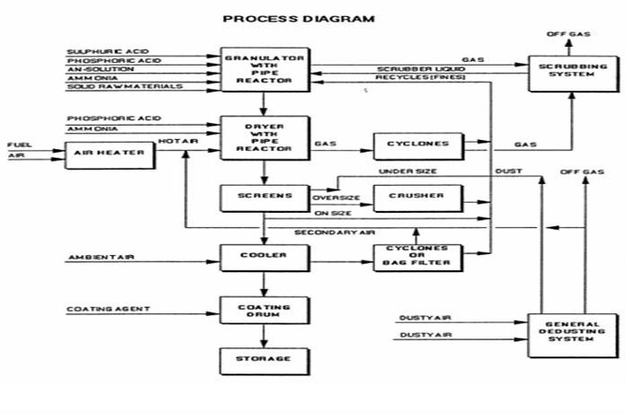
Ammonium Phosphate flow sheet

Slide 12
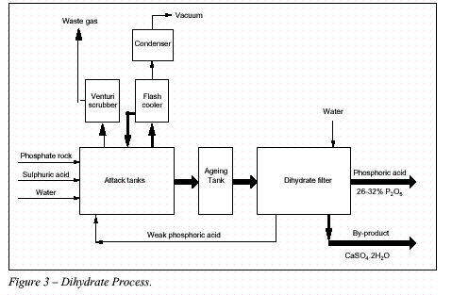
Phosphoric Acid plant

Slide 13
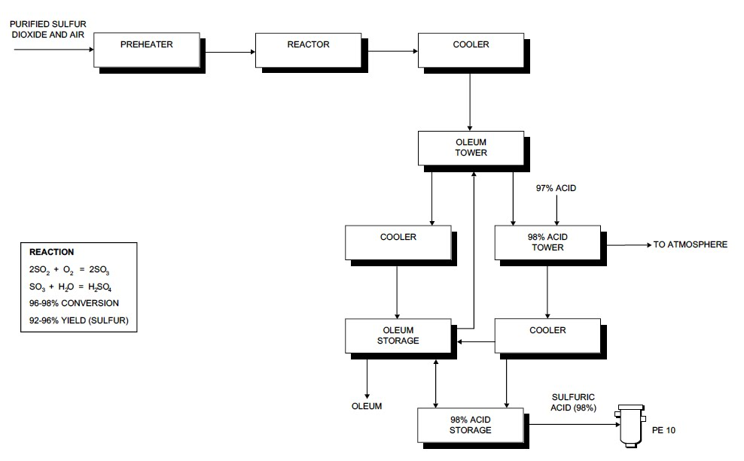
Sulphuric acid plant

Slide 14
Reduction strategies
Develop Water balance
Effluent source reduction
Recycle
Control scrubber water use –CFD
Measurement
Analysis
85% recovery

Slide 15
How CFD helps?
A computational fluid dynamics (CFD) model improved the efficiency of an scrubber by revealing regions of poor gas/liquid contact and identifying a solution to eliminate them. The poor gas/liquid contact inside the scrubber lowered the efficiency of the unit necessitating more water use.

Slide 16
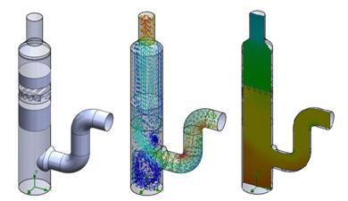
CFD modeling of Ventury Scrubbers

Slide 17
Avenues for effluent reuse
Reuse of oil free effluent from Ammonia/ Urea plants in Phosphate plant.
Reuse of treated effluent from phosphoric acid plant for gypsum disposal to pond , washing of filters, and slurry preparation.
Utilisation of treated effluent for dust scrubbing in the phosphate rock grinding section and Phosphate plants, for fume scrubbers, condensers, flash coolers and other miscellaneous purposes.
Lime neutralisation pit effluent is used in the gypsum slurry tank.
Sulphuric acid plant cooling tower blow-down reused as makeup for hot sump of phosphoric acid plant.

Slide 18
Avenues for effluent reuse
Wastewater from urea plants used in Phosphate plants for various process use
Phosphate plant effluent from washing, leakages etc. are collected and recycled into process.
Reuse of part of final effluent for irrigation. Treated effluent from fertiliser plants still contain small amount of nutrient N and/or P2O5 and thus helps plant growth.

Slide 19
Alternate and unconventional water sources
Use of sea water for cooling instead of fresh water at coastal locations
Use of treated municipal sewage.
Installation of Reverse Osmosis plant: Desalination of sea water/brackish water
Tertiary treatment of secondary treated sewage provided dependable sources of plant water
Economics is favorable- costs only 30-50% of municipal water
Rain water Harvesting

Slide 20
Case Study: Chlor-alkali industry
The Chlor-alkali industry is a sub-segment of basic chemicals industry, accounting for about 74% of the total basic chemicals production in India.
Chlor-alkali industry mainly comprises caustic soda, soda ash, chlorine,hydrogen and hydrochloric acid. Caustic soda and soda ash together account for about 68% the total Chlor-alkali industry.
Both, find application in number of industries such as textiles, paper, PVC, water treatment, alumina, soaps & detergents, glass etc.

Slide 21

Chlor-Alkali manufacturing
Sodium chloride (common salt ) solution (brine) is electrolytically decomposed to elemental chlorine (in the anode) and sodium hydroxide solution and elemental hydrogen (in the cathode )

Slide 22
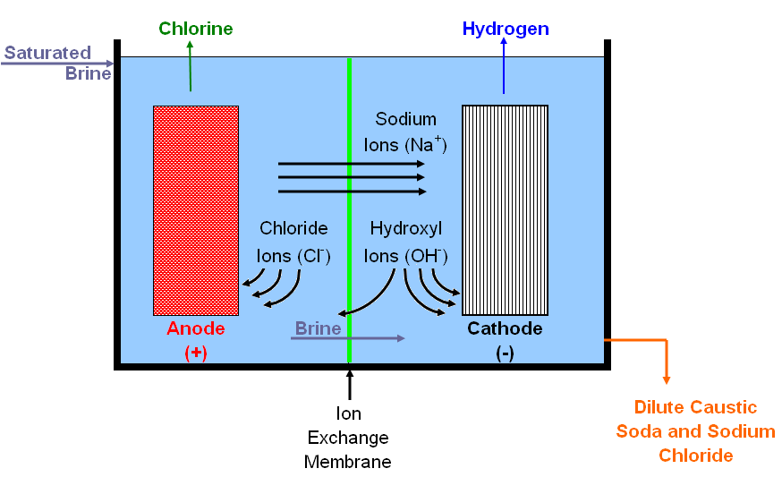
Electrolysis of brine

Slide 23
Source of effluents
Cell house washings, draining
Chlorine seal pot overflow
Rectifier cooling
Caustic Soda Fusion plant
Hypochlorite plant
Brine purification plant

Slide 24
Typical water balance of the Chlor-alkali Plant
TOTAL WATER CONSUMPTION
PROCESS
COOLING
DOMESTIC
TOWNSHIP
PRODUCT
EFFLUENT TREATMENT PLANT
CAPTIVE POWER
COOLING TOWER
DISPOSAL
IRRIGATION/SEWER
REUSE FOR CHEMICAL REPARATION /SANITATION WATER

Slide 25
Avenues for reuse
Brine preparation
HCl burner cooling
Acid dilution
Make up water for seal pots
ETP outlet for Irrigation

Slide 26
Water Pinch
Pinch analysis provides a formalised approach to the rational management of water.
It helps to determine superior reuse strategies featuring improved water utilisation together with improvements in raw material and reagent utilisation.
Fresh water abstraction and effluent generation are reduced, both of which represent economic benefits to the industry concerned in terms of raw water and effluent treatment costs.

Slide 27
Points to ponder
Process use of water is limited by technology/reaction kinetics
Unit operations can be optimized to conserve water
Redesign of water use equipment-CFD
Measure water usage & pressure drop across towers/scrubbers
Accurate level control
Water balance diagram
Recycle by plant trials
Use RO, Filtration, Ion exchange
Water Pinch
Handle storm water/effluents separately
Benchmark with BAT in industry
Encourage industry to use recovered water
CETPs shall strictly control quality to promote reuse.

Slide 28
Thank you
Centre for Green Technology & Management
Cochin, India 682030
Tel + 91 9447154540
www.cgtm.in
www.drmpsukumarannair.com

