Slide 1
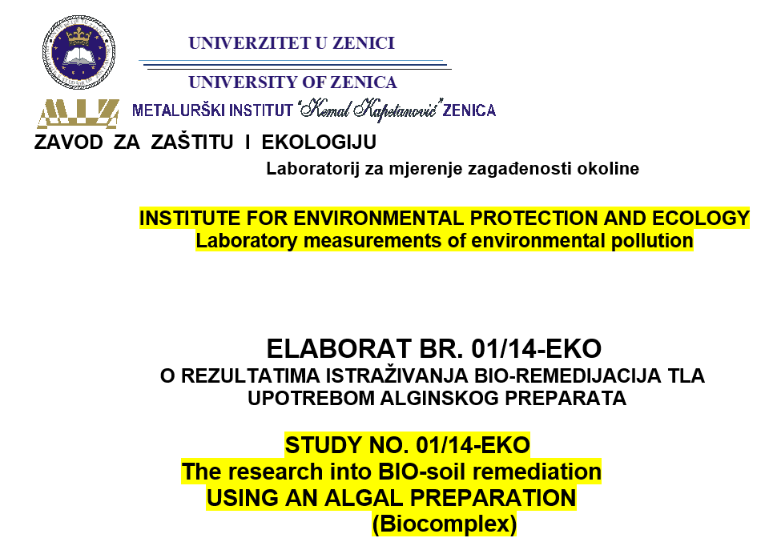
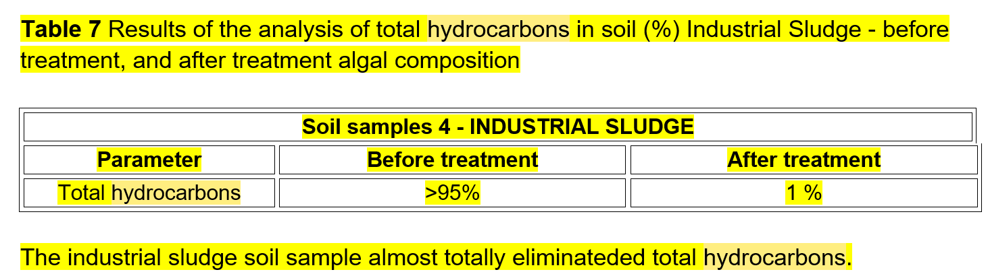

Hydrocarbon reduction in petroleum-contaminated sludge
by the Metallurgy Institute
University of Zenica, Bosnia
Method: Biocomplex prebiotic additive mixed with industrial sludge at a rate of 250 ml/m3.
Full report available upon request.
Ul. M. Grevenbroich 13
3000 Celje SLOVENIA
Tel: +386 64 13 95 30
Email: mkeenan@ekogea.com
Website: www.ekogea.com/en

